Slide 1
UNIT-IV
Python- OOPs concepts
Regular expressions

Slide 2
Topics to be covered:
Python- OOPs concept:
Class and object,
Attributes,
Inheritance,
Overloading Overriding,
Data hiding.
Regular expressions:
Match function,
Search function,
Matching VS Searching,
Modifiers Patterns.

Slide 3
Python OOPs Concepts
Like other general purpose languages, python is also an object-oriented language since its beginning. Python is an object-oriented programming language. It allows us to develop applications using an Object Oriented approach. In Python, we can easily create and use classes and objects.
Major principles of object-oriented programming system are given below.
Object
Class
Method
Inheritance
Polymorphism
Data Abstraction
Encapsulation

Slide 4
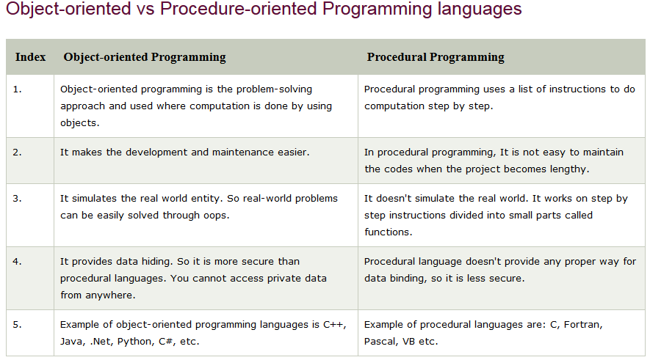

Slide 5
Class:
In python every thing is an object.
To create objects we required some Model or Plan or Blue print, which is nothing but class.
We can write a class to represent properties (attributes) and actions (behaviour) of object.
Properties can be represented by variables
Actions can be represented by Methods.
Hence class contains both variables and methods.
How to Define a class?
We can define a class by using class keyword.
Syntax:
class className:
''' documentation string '''
variables: instance variables, static and local variables
methods: instance methods, static methods, class methods

Slide 6
Documentation string represents description of the class. Within the class doc string is always optional.
We can get doc string by using the following 2 ways.
1. print(classname.__doc__)
2. help(classname)
Within the Python class we can represent data by using variables.
There are 3 types of variables are allowed.
1. Instance Variables (Object Level Variables)
2. Static Variables (Class Level Variables)
3. Local variables (Method Level Variables)
Within the Python class, we can represent operations by using methods. The following are various types of allowed methods
1.Instance Methods
2. Class Methods
3. Static Method

Slide 7
What is Object:
Physical existence of a class is nothing but object.
We can create any number of objects for a class.
Syntax :
reference variable=class name()
Example: s = Student()
What is Reference Variable:
The variable which can be used to refer object is called reference variable.
By using reference variable, we can access properties and methods of object.

Slide 8
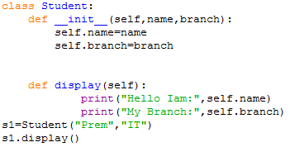


Slide 9
Self variable:
self is the default variable which is always pointing to current object(like this keyword in Java)
By using self we can access instance variables and instance methods of object.
Note:1. self should be first parameter inside constructor
def __init__(self):
2. self should be first parameter inside instance methods
def display(self):

Slide 10
Constructor:
Constructor is a special method in python.
The name of the constructor should be __init__(self)
Constructor will be executed automatically at the time of object creation.
The main purpose of constructor is to declare and initialize instance variables.
Per object constructor will be executed only once.
Constructor can take at least one argument(atleast self)
Constructor is optional and if we are not providing any constructor then python will provide default constructor.
Example:
def__init__(self,name,rollno,marks):
self.name=name
self.rollno=rollno
self.marks=marks

Slide 11
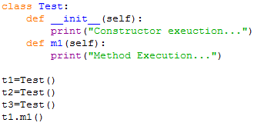

program to demonstrate constructor will execute only once per object:

Slide 12
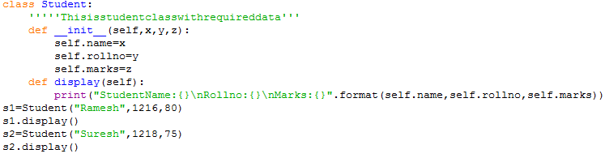
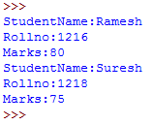

Slide 13
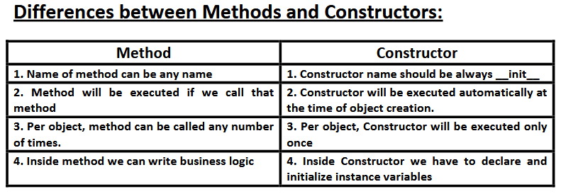

Slide 14
Types of Variables:
Inside Python class 3 types of variables are allowed.
1. Instance Variables(Object Level Variables)
2.Static Variables(Class Level Variables)
3. Local variables (Method Level Variables)
Instance Variables(Object Level Variables):
If the value of a variable is varied from object to object, then such type of variables are called instance variables.
For every object a separate copy of instance variables will be created.
Where we can declare Instance variables:
1. Inside Constructor by using self variable
2. Inside Instance Method by using self variable
3. Outside of the class by using object reference variable

Slide 15
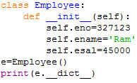

1. Inside Constructor by using self variable:
We can declare instance variables inside a constructor by using self keyword.
Once we creates object, automatically these variables will be added to the object.
__dict__ : Dictionary containing the class's namespace.

Slide 16
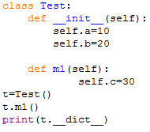

2. Inside Instance Method by using self variable:
We can also declare instance variables inside instance method by using self variable.
If any instance variable declared inside instance method, that instance variable will be added once we call that method.

Slide 17
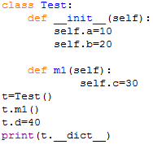
3. Outside of the class by using object reference variable:
We can also add instance variables outside of a class to a particular object.

Slide 18
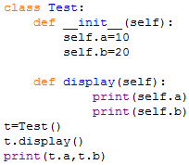

How to access Instance variables:
We can access instance variables with in the class by using self variable and outside of the class by using object reference.

Slide 19
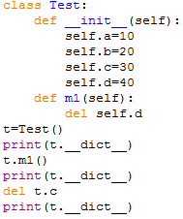

How to delete instance variable from the object:
1. Within a class we can delete instance variable as follows
del self.variableName
2. From outside of class we can delete instance variables as follows
del objectreference.variableName

Slide 20
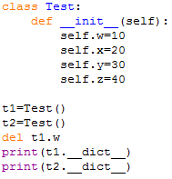

Note: The instance variables which are deleted from one object,will not be deleted from other objects.

Slide 21
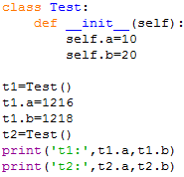

If we change the values of instance variables of one object then those changes won't be reflected to the remaining objects, because for every object we are separate copy of instance variables are available.

Slide 22
2.Static Variables(Class Level Variables):
If the value of a variable is not varied from object to object, such type of variables we have to declare with in the class directly but outside of methods. Such type of variables are called Static variables.
For total class only one copy of static variable will be created and shared by all objects of that class.
We can access static variables either by class name or by object reference. But recommended to use class name.
Instance Variable vs Static Variable:
Note: In the case of instance variables for every object a separate copy will be created, but in the case of static variables for total class only one copy will be created and shared by every object of that class.

Slide 23
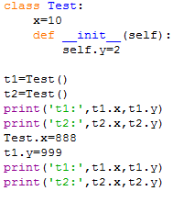


Slide 24
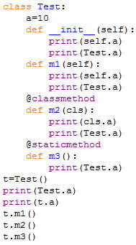
Various places to declare static variables:
1. In general we can declare within the class directly but from out side of any method
2. Inside constructor by using class name
3. Inside instance method by using class name
4. Inside class method by using either class name or cls variable
5. Inside static method by using class name

Slide 25
classmethod() is considered un-Pythonic so in newer Python versions, you can use the @classmethod decorator for classmethod definition.
syntax is:
@classmethod def func(cls, args...)
The difference between a static method and a class method is:
Static method knows nothing about the class and just deals with the parameters
Class method works with the class since its parameter is always the class itself.
the class method is always attached to a class with first argument as the class itself cls.
def classmethod(cls, args...)

Slide 26
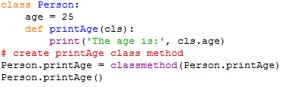

cls accepts the class Person as a parameter rather than Person's object/instance.

Slide 27
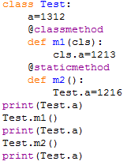

Where we can modify the value of static variable:
Anywhere either with in the class or outside of class we can modify by using classname.But inside class method, by using cls variable.

Slide 28
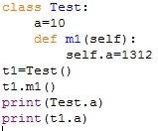

If we change the value of static variable by using either self or object reference variable:
If we change the value of static variable by using either self or object reference variable, then the value of static variable won't be changed, just a new instance variable with that name will be added to that particular object.

Slide 29
How to delete static variables of a class:
We can delete static variables from anywhere by using the following syntax
del classname.variablename
But inside class method we can also use cls variable
del cls.variablename
Note: By using object reference variable/self we can read static variables, but we cannot modify or delete.
If we are trying to modify, then a new instance variable will be added to that particular object.t1.a=16
If we are trying to delete then we will get error.
We can modify or delete static variables only by using classname or cls variable.

Slide 30
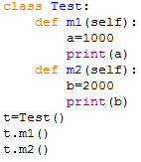

Local variables:
Sometimes to meet temporary requirements of programmer, we can declare variables inside a method directly,
such type of variables are called local variable or temporary variables.
Local variables will be created at the time of method execution and destroyed once method completes.
Local variables of a method cannot be accessed from outside of method.

Slide 31
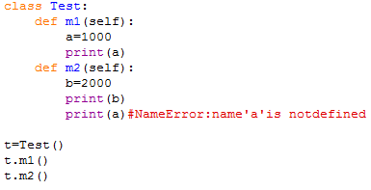
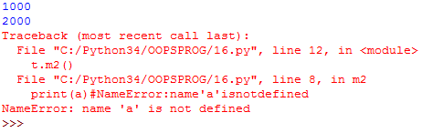

Slide 32
Types of Methods:
Inside Python class 3 types of methods are allowed
1. Instance Methods
2. Class Methods
3. Static Methods
1. Instance Methods:
Inside method implementation if we are using instance variables then such type of methods are called instance methods.
Inside instance method declaration, we have to pass self variable.
def m1(self)
By using self variable inside method we can able to access instance variables.
Within the class we can call instance method by using self variable and from outside of the class we can call by using object reference.

Slide 33
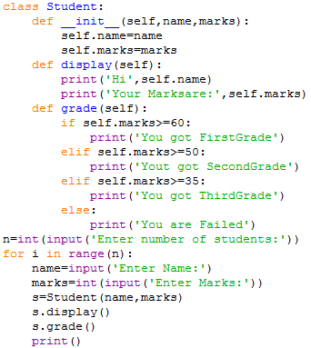
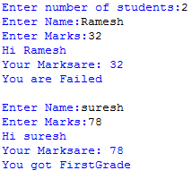

Slide 34
Setter and Getter Methods:
We can set and get the values of instance variables by using getter and setter methods.
Setter Method:
setter methods can be used to set values to the instance variables. setter methods also known as mutator methods.
syntax:
def setVariable(self,variable):
self.variable=variable
Example:
def setName(self,name):
self.name=name

Slide 35
Getter Method:
Getter methods can be used to getvalues of the instance variables.
Getter methods also known as accessor methods.
syntax:
def getVariable(self):
return self.variable
Example:
def getName(self):
return self.name

Slide 36
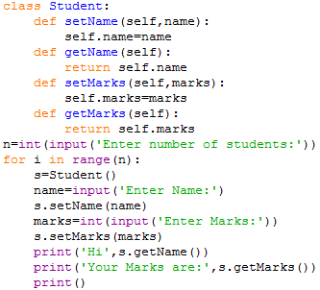
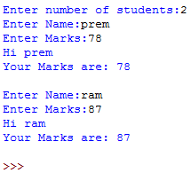
Example on setter and getter methods:

Slide 37
2. Class Methods:
Inside method implementation if we are using only class variables(static variables),then such type of methods we should declare as class method.
We can declare class method explicitly by using @classmethod decorator.
For class method we should provide cls variable at the time of declaration
We can call classmethod by using classname or object reference variable.

Slide 38
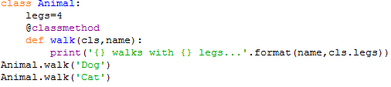


Slide 39
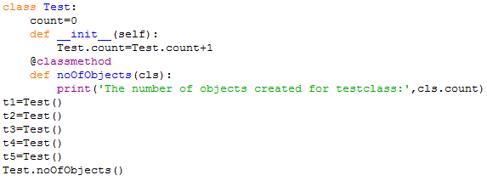

Program to track the number of objects created for a class:

Slide 40
3. Static Methods:
In general these methods are general utility methods.
Inside these methods we won't use any instance or class variables.
Here we won't provide self or cls arguments at the time of declaration.
We can declare static method explicitly by using @staticmethod decorator
We can access static methods by using classname or object reference
Note: In general we can use only instance and static methods.
Inside static method we can access class level variables by using class name.
class methods are most rarely used methods in python.

Slide 41
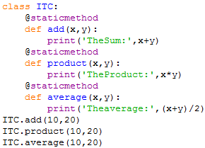


Slide 42
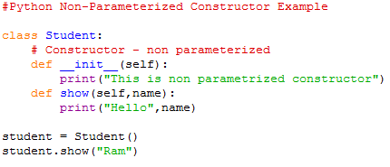

Python Constructor
A constructor is a special type of method (function) which is used to initialize the instance members of the class.
Constructors can be of two types.
Parameterized Constructor
Non-parameterized Constructor

Slide 43
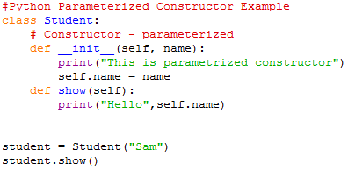


Slide 44
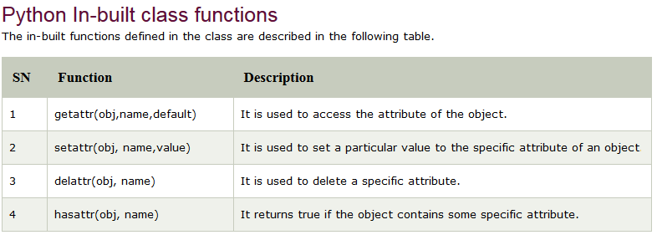

Slide 45
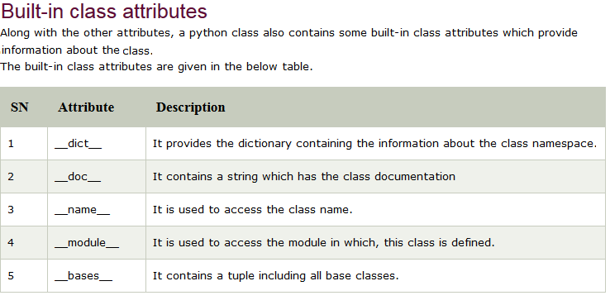

Slide 46
Python Inheritance:
Inheritance is an important aspect of the object-oriented paradigm.
Inheritance provides code reusability to the program because we can use an existing class to create a new class instead of creating it from scratch.
In inheritance, the child class acquires the properties and can access all the data members and functions defined in the parent class.
A child class can also provide its specific implementation to the functions of the parent class.
In python, a derived class can inherit base class by just mentioning the base in the bracket after the derived class name.
Consider the following syntax to inherit a base class into the derived class.

Slide 47
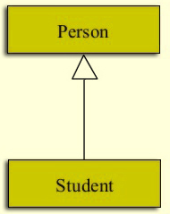
The relationship from person to a student is termed ‘Specialization’. Conversely, every student is a person, this is called Generalization.
In this representation, we use an arrow towards the base class as a UML (Unified Modeling Language) convention.
Here,
Person can be called any of the following:
Super Class
Parent Class
Base Class
Likewise, Student here is:
Sub Class
Child Class
Derived Class

Slide 48
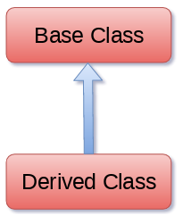

Example:
class A:
# variable of class A
# functions of class A
class B(A):
# variable of class A
# functions of class A
# add more properties to class B

Slide 49
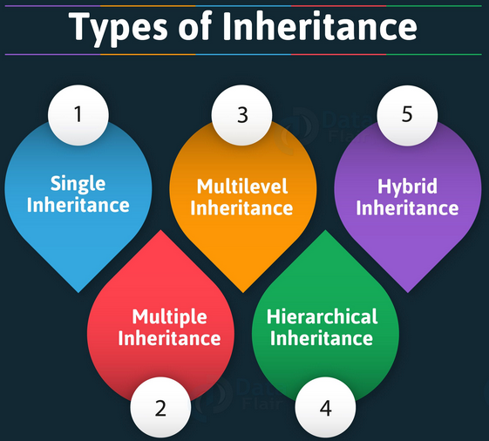

Slide 50
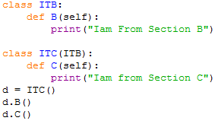

1. Single inheritance: When a child class inherits from only one parent class, it is called as single inheritance.

Slide 51
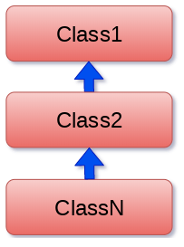
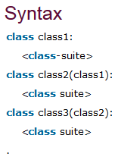
2. Multi-Level inheritance:
Multi-Level inheritance is possible in python like other object-oriented languages.
Multi-level inheritance is archived when a derived class inherits another derived class.
There is no limit on the number of levels up to which, the multi-level inheritance is archived in python.

Slide 52
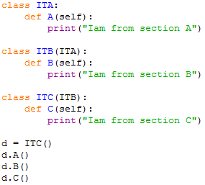


Slide 53
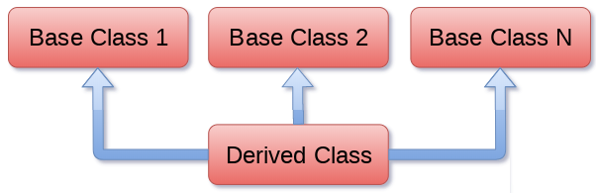
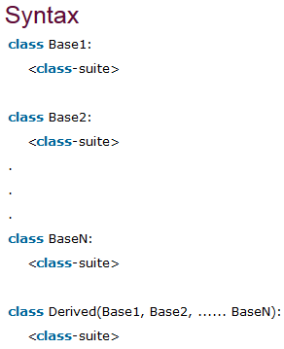
3.Multiple inheritance:
Python provides us the flexibility to inherit multiple base classes in the child class.

Slide 54
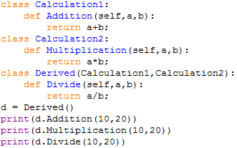


Slide 55
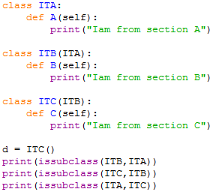

Using issubclass() method
In python, there is a function which helps us to verify whether a particular class is a sub class of another class, that built-in function is issubclass(paramOne, paramTwo), where paramOne and paramTwo can be either class names or class's object name.
The issubclass(sub, sup) method is used to check the relationships between the specified classes.
It returns true if the first class is the subclass of the second class, and false otherwise.

Slide 56
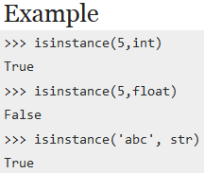
isinstance (obj, class) method
The isinstance() method is used to check the relationship between the objects and classes. It returns true if the first parameter, i.e., obj is the instance of the second parameter, i.e., class.
Syntax
isinstance(object, classinfo)
Python isinstance() takes two parameters as the argument.
object (required) – an object to be checked
classinfo (required) – A class, type or a tuple of classes, types or other tuples
Example:
x = isinstance("Hello", (str, float, int, str, list, dict, tuple))
print(x)

Slide 57
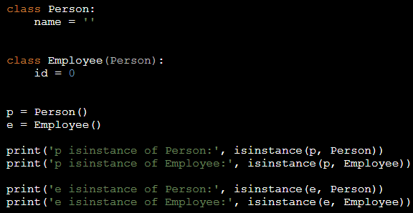


Slide 58
Polymorphism:
Poly means many.
Morphs means forms.
Polymorphism means 'Many Forms'.
Eg1:Yourself is best example of polymorphism. In front of Your parents You will have one type of behavior and with friends another type of behaviour.Same person but different behaviors at different places, which is nothing but polymorphism.
Eg2:+ operator acts as concatenation and arithmetic addition
Eg3:* operator acts as multiplication and repetition operator
Eg4:The Same method with different implementations in Parent class and child classes.(overriding)

Slide 59
Overloading:
We can use same operator or methods for different purposes.
Eg1:+ operator can be used for Arithmetic addition and String concatenation
print(10+20)#30
print(‘Sree'+‘nidhi')#Sreenidhi
Eg2:* operator can be used for multiplication and string repetition purposes.
print(10*20)#200
print(‘snist'*3)#snistsnistsnist
Eg3:We can use deposit() method to deposit cash or cheque or dd
deposit(cash)
deposit(cheque)
deposit(dd)

Slide 60
There are 3 types of overloading
1. Operator Overloading
2. Method Overloading
3. Constructor Overloading
1. Operator Overloading:
We can use the same operator for multiple purposes,which is nothing but operator overloading.
Python supports operator overloading.
Eg1:+ operator can be used for Arithmetic addition and String concatenation
print(10+20)#30
print(‘Sree'+‘nidhi')#sreenidhi
Eg2:* operator can be used for multiplication and string repetition purposes.
print(10*20)#200
print(‘snist'*3)#snistsnistsnist

Slide 61
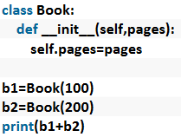
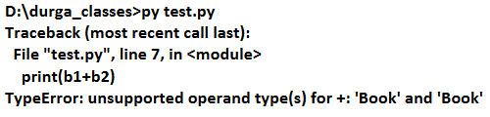

Slide 62
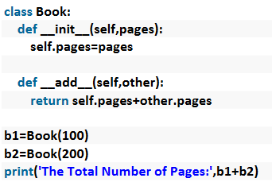
We can overload + operator to work with Book objects also. i.e
Python supports Operator Overloading.
For every operator Magic Methods are available.
To overload any operator we have to override that Method in our class.
Internally + operator is implemented by using __add__() method.
This method is called magic method for + operator.
We have to override this method in our class.

Slide 63
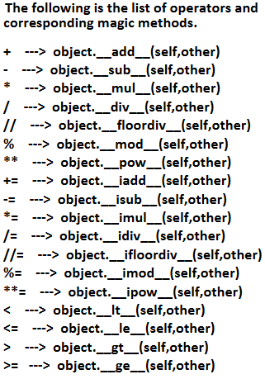


Slide 64
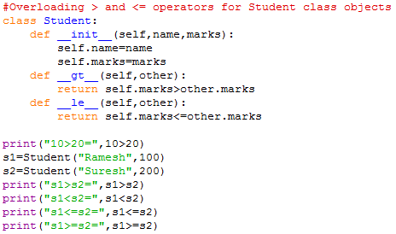


Slide 65



Slide 66
2. Method Overloading:
If 2 methods having same name but different type of arguments then those methods are said to be overloaded methods.
Eg:
m1(int a)
m1(double d)
But in Python Method overloading is not possible.
If we are trying to declare multiple methods with same name and different number of arguments then Python will always consider only last method.

Slide 67



Slide 68



How we can handle overloaded method requirements in Python:
Most of the times, if method with variable number of arguments required then we can handle with default arguments or with variable number of argument methods.

Slide 69



Slide 70

3. Constructor Overloading:
Constructor overloading is not possible in Python.
If we define multiple constructors then the last constructor will be considered.
In the above program only Two-Arg Constructor is available.
But based on our requirement we can declare constructor with default arguments and variable number of arguments.

Slide 71



Slide 72



Slide 73


Method overriding:
What ever members available in the parent class are by default available to the child class through inheritance.
If the child class not satisfied with parent class implementation then child class is allowed to redefine that method in the child class based on its requirement. This concept is called overriding.
Overriding concept applicable for both methods and constructors.

Slide 74


From Overriding method of child class, we can call parent class method also by using super() method.

Slide 75

In the above example, if child class does not contain constructor then parent class constructor will be executed From child class constructor we can call parent class constructor by using super() method.

Slide 76



Slide 77
Data hiding
Definition
Data hiding is the process of restricting access to the internal data of a class to protect it from unauthorized access or modification.
Purpose
Protect sensitive data
Improve security
Prevent accidental changes
Support encapsulation

Slide 78
Access Specifiers in Python
Python uses naming conventions instead of strict access control:
1. Public Members
Accessible everywhere
No underscore used
Ex:
class Demo:
def __init__(self):
self.name = "Nalini“
2. Protected Members(_)
Indicated using single underscore _
Should not be accessed outside class
EX:
class Demo:
def __init__(self):
self._age = 20

Slide 79
3. Private Members(__)
Indicated using double underscore__
Cannot be accessed directly outside the class
Ex:
class Demo:
def __init__(self):
self.__salary = 50000

Slide 80
Data Hiding Using Methods
Getter and Setter Methods
Ex:
class Employee:
def __init__(self):
self.__salary = 50000
def get_salary(self):
return self.__salary
def set_salary(self, value):
if value > 0:
self.__salary = value

Slide 81
Advantages
Data security
Controlled access
Better code organization
Easy maintenance
Disadvantages
Not strictly enforced in Python
Can still access private data (name mangling)

Slide 82
Regular Expressions:
If we want to represent a group of Strings according to a particular format/pattern then we should go for Regular Expressions.
i.e. Regular Expressions is a declarative mechanism to represent a group of Strings according to particular format/pattern.
Eg 1:We can write a regular expression to represent all mobile numbers
Eg 2:We can write a regular expression to represent all mail ids.
The main important application areas of Regular Expressions are
1. To develop validation frameworks/validation logic
2. To develop Pattern matching applications(ctrl-f in windows, grep in UNIX etc)
3. To develop Translators like compilers, interpreters etc
4. To develop digital circuits5. To develop communication protocols like TCP/IP,UDP etc.

Slide 83

We can develop Regular Expression Based applications by using python module: re
This module contains several inbuilt functions to use Regular Expressions very easily in our applications.
1. compile()
re module contains compile() function to compile a pattern into RegexObject.(Python Object)
pattern = re.compile("ab")

Slide 84
2. finditer():
Returns an Iterator object which yields Match object for every Match.
We can check how many matches are available.
matcher = pattern.finditer(“Python is very is easy")
On Match object we can call the following methods.
1. start()→Returns start index of the match
2. end() →Returns end+1 index of the match
3. group() →Returns the matched string

Slide 85



Slide 86



Slide 87


Slide 88





Slide 89


Slide 90






Slide 91
Quantifiers:
We can use quantifiers to specify the number of occurrences to match.
a→ Exactly one 'a‘
a→ Atleast one 'a‘
a*→Any number of a's including zero number
a?→Atmost one 'a' i.e. either zero number or one number
a{m}→Exactly m number of a's
a{m,n}→Minimum m number of a's and Maximum n number of a's

Slide 92






Slide 93






Slide 94
Important functions of re module:
1. match()
2. fullmatch()
3. search()
4.findall()
5.finditer()
6. sub()
7.subn()
8. split()
9. compile()

Slide 95



1. match():
We can use match function to check the given pattern at beginning of target string.
If the match is available then we will get Match object, otherwise we will get None.

Slide 96



Slide 97


2. fullmatch():
We can use fullmatch() function to match a pattern to all of target string. i.e. complete string should be matched according to given pattern.
If complete string matched then this function returns Match object otherwise it returns None.

Slide 98
3. search():
We can use search() function to search the given pattern in the target string.
If the match is available then it returns the Match object which represents first occurrence of the match.
If the match is not available then it returns None

Slide 99



Slide 100


4. findall():
To find all occurrences of the match.
This function returns a list object which contains all occurrences.

Slide 101


5. finditer():
Returns the Iterator yielding a match object for each match.
On each match object we can call start(),end() and group() functions.

Slide 102

6. sub():
sub means substitution or replacement
re.sub(regex,replacement,target string)
In the target string every matched pattern will be replaced with provided replacement.

Slide 103


7. subn():
It is exactly same as sub except it can also returns the number of replacements.
This function returns a tuple where first element is result string and second element is number of replacements.
(resultstring, number of replacements)

Slide 104




8.split():
If we want to split the given target string according to a particular pattern then we should go for split() function.
This function returns list of all tokens.

Slide 105


^ symbol:
We can use ^ symbol to check whether the given target string starts with our provided pattern or not.

Slide 106

$ symbol:
We can use $ symbol to check whether the given target string ends with our provided pattern or not

Slide 107



Slide 108
Matching Versus Searching
Python offers two different primitive operations based on regular expressions: match checks for a match only at the beginning of the string, while search checks for a match anywhere in the string

