Slide 1
Data Representations
Unit-1

Slide 2
Data Representaions
Data Representations are two types
1. Fixed Point Representation
2. Floating Point Representation

Slide 3
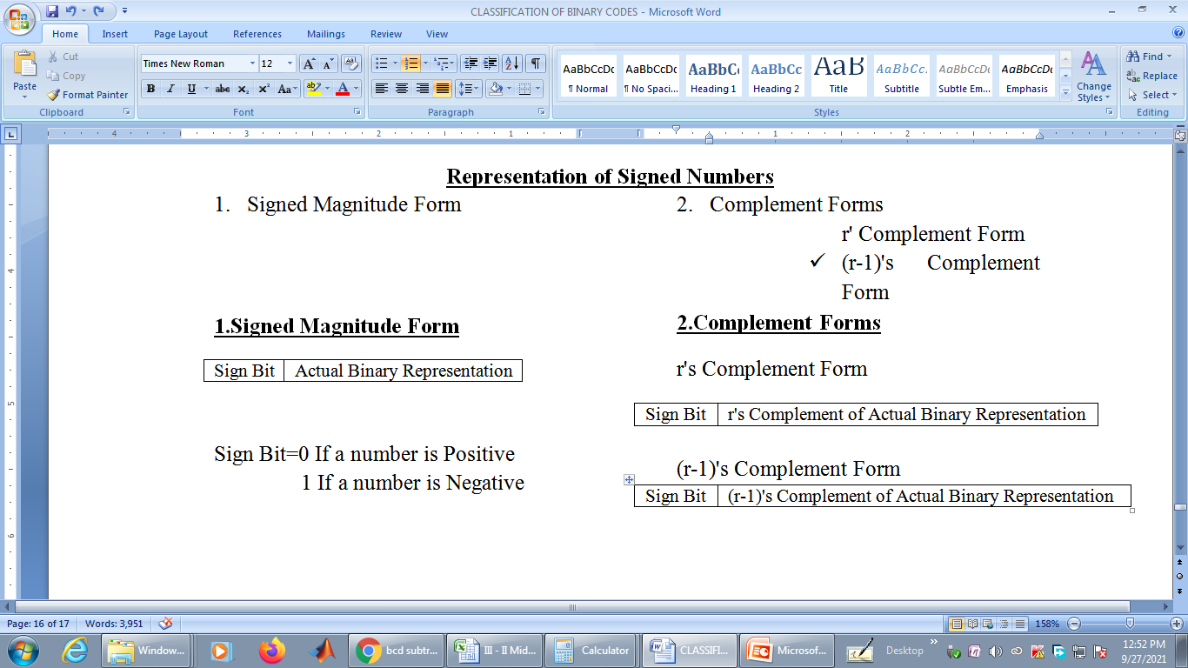
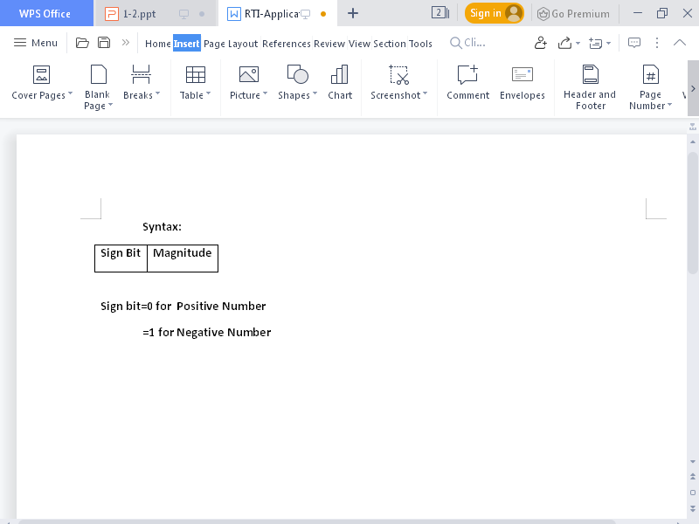
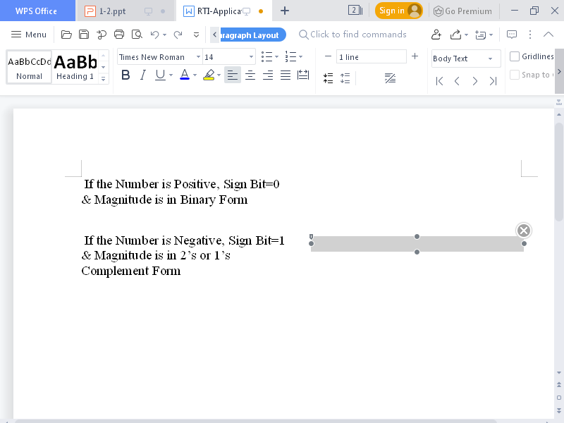
1.Fixed Point Representation

Slide 4
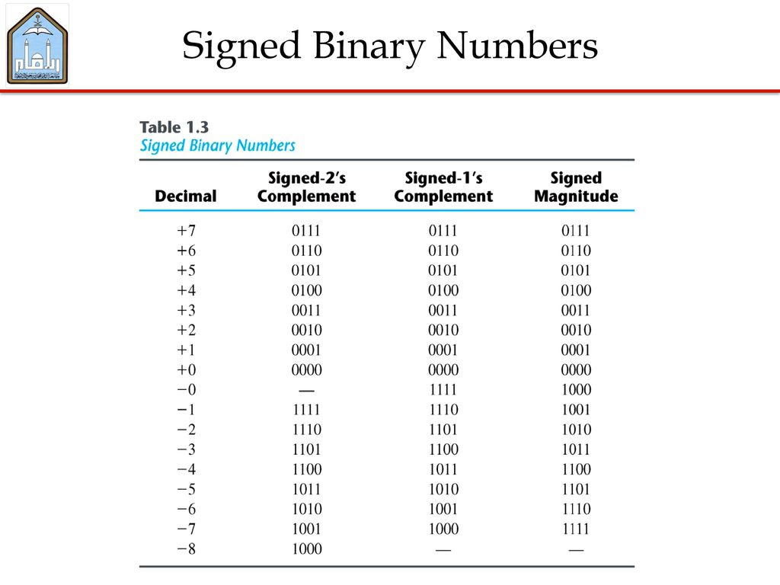

Slide 5
* Decimal + 6132.789
Fraction Exponent
+0.6132789 +4
2. Floating-Point Representation
  The floating-point representation of a number has two parts
    1) Mantissa : signed, fixed-point number
    2) Exponent : position of binary(decimal) point
  Scientific notation : m x r^{e} (+0.6132789 x 10⁺⁴)
    m : mantissa, r : radix, e : exponent
  Example : m x 2e = +(.1001110)₂ x 2⁺⁴
  Normalization
    Most significant digit of mantissa is nonzero
Fraction Exponent
01001110 000100

Slide 6
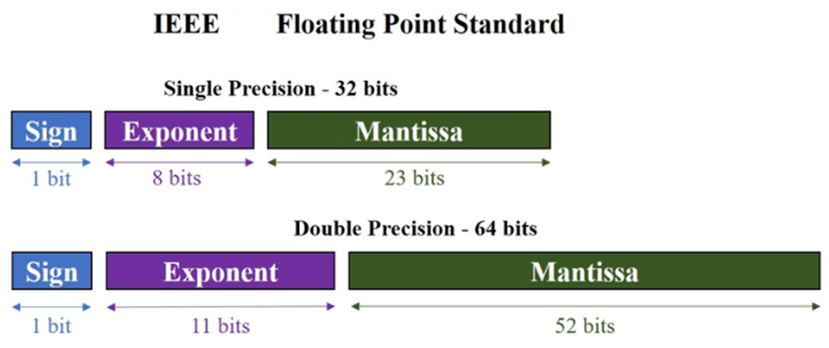

Slide 7
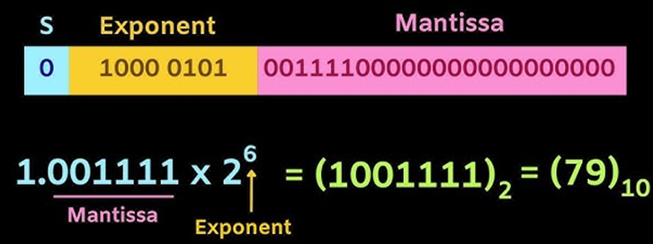
Single Precision Floating Point Representation

Slide 8
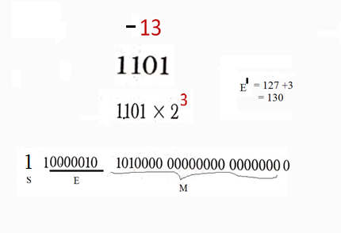

Slide 9
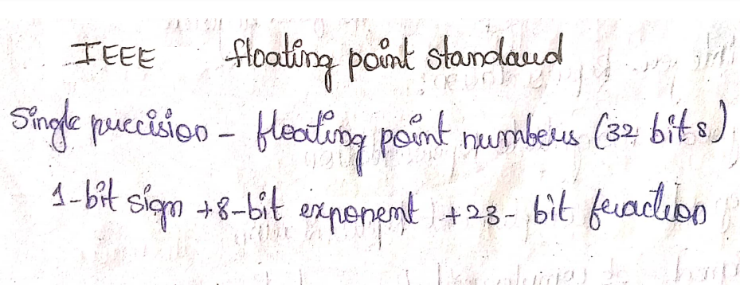
Example : (1259.125)10

Slide 10
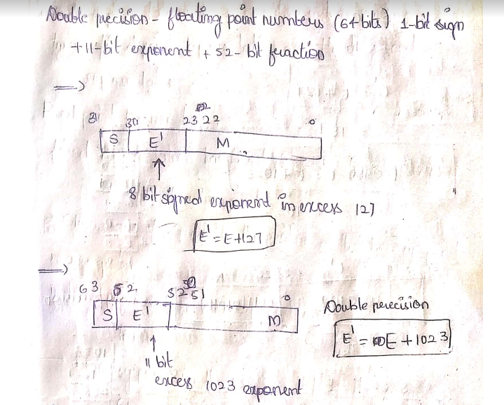

Slide 11
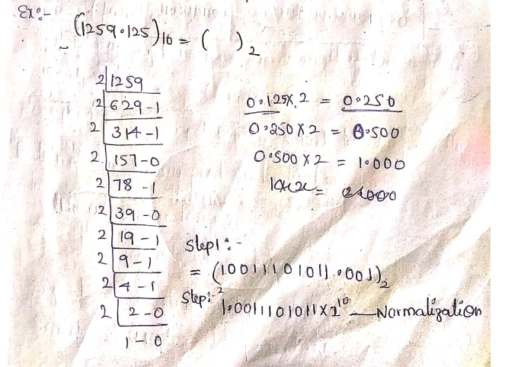

Slide 12
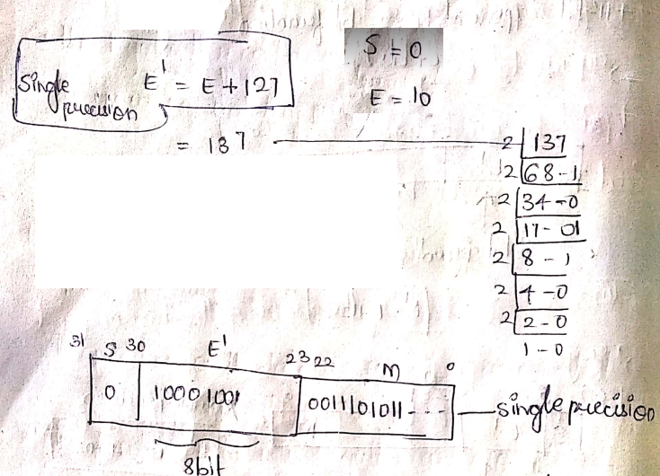

Slide 13
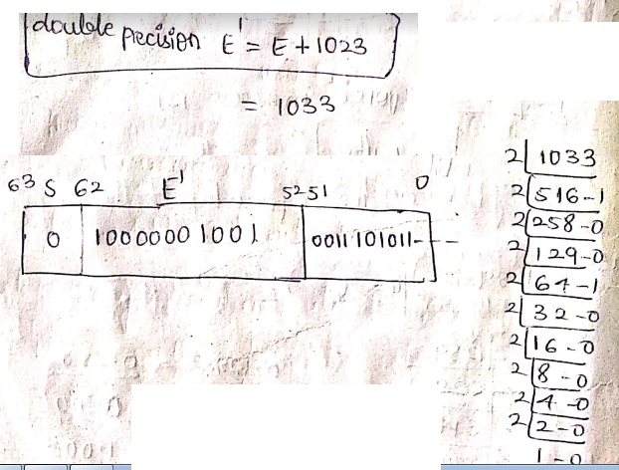

Slide 14
End of Unit-1

