Slide 1
B.Tech II Year
BUSINESS ECONOMICS AND FINANCIAL ANALYSIS
Code: 9ZC01
(COMMON TO ALL BRANCHES)

Slide 2
UNIT I
INTRODUCTION TO BUSINESS ECONOMICS

Slide 3
UNIT 1 - TOPICS
Definition of Business Economics
Nature and Scope of Business Economics
Demand Analysis: Demand Determinants
Law of Demand and its exceptions
Elasticity of Demand
Types of Elasticity of Demand
Demand Forecasting – Statistical and Non-Statistical techniques.

Slide 4
WHY BUSINESS ECONOMICS?
Managers in their day to day activities, are always confronted with the several issues such as:
How much quantity is to be produced
At what price
Make or buy decision
What will be the likely demand…etc
Business Economics provides basic insight into seeking solutions for managerial problems. Business Economics is also referred as Managerial Economics

Slide 5
WHAT IS ECONOMICS?
Economics is the social science that analyzes the production, distribution and consumption of goods and services.
Economics is study of human activity both at individual and national level.
Adam Smith, the father of Economics defined Economics as “The study of the nature & uses of national wealth”.

Slide 6
BRANCHES OF ECONOMICS:
There are two branches in Economics
Micro Economics
Macro Economics
The study of individual firm is Micro Economics and is also called theory of firm.
The study of total level of economic activity in a country is called Macro Economics.

Slide 7
MICRO ECONOMICS
Microeconomics is the branch of economics that considers the behaviour of decision takers within the economy, such as individuals, households and firms.
Microeconomics contrasts with the study of macroeconomics, which considers the economy as a whole.

Slide 8
MACRO ECONOMICS
Macroeconomics is a branch of economics that studies how an overall economy—the market or other systems that operate on a large scale—behaves.
Macroeconomics studies economy-wide phenomena such as inflation, price levels, rate of economic growth, national income, gross domestic product (GDP), and changes in unemployment.

Slide 9
DEFINITION OF MANAGERIAL ECONOMICS
“The integration of economic theory with the business practice for the purpose of facilitating decision making & forward planning by management”.
Spencer & Siegel man
Managerial economics refers to application of principles of Economics to solve the managerial problems such as Minimizing the cost or Maximizing profit.

Slide 10
MANAGERIAL ECONOMICS
Managerial economics directs the utilization of scarce resources in a goal oriented manner.
Seeks to understand & analyze the problems of business decision making.
Facilitates foreword planning.
Examines how an organization can achieve its objectives in most effectively.
Focuses on Minimizing the cost & Maximizing the profit.

Slide 11
NATURE OF MANAGERIAL ECONOMICS
Micro-economic in character.
Operates against the backdrop of Macro Economics.
It is pragmatic.
Prescriptive Actions.
Applied in nature.
Offers scope to evaluate each alternative.
Interdisciplinary (Economics, OR, Mathematics, Statistics, Accountancy, Psychology, OB etc.)

Slide 12
SCOPE OF MANAGERIAL ECONOMICS
The scope of managerial economics refers to its area of study. Subject matter of Managerial Economics consists of applying economic principles & concepts towards adjusting various uncertainties faced by the business firms, such as
Demand uncertainty
Cost uncertainty
Price uncertainty
profit uncertainty
Production uncertainty

Slide 13
SCOPE OF MANAGERIAL ECONOMICS
Managerial Decision Areas:
Production
Cost Control
Price Determination
Make or buy decisions
Inventory Decisions
Capital Investment Decisions
Profit planning and Management
Concepts and Techniques of ME
Optimal Solutions

Slide 14
SCOPE OF MANAGERIAL ECONOMICS
CONSUMPTION
PRODUCTION
SCOPE
DISTRIBUTION
EXCHANGE

Slide 15
What is Demand?
Demand for a commodity refers to the quantity of the commodity which an individual consumer or a household is willing to purchase per unit of time at a particular price.
It implies:
  Desire to buy
  Willingness to buy
  Purchasing power

Slide 16
DEMAND DETERMINANTS
ADDITIONAL FACTORS RELATED TO LUXURY GOODS AND DURABLES
ADDITIONAL FACTORS RELATED TO MARKET DEMAND
GENERAL FACTORS
Price of the product
Expectations of future prices
Income of the consumer
Population
Tastes and Preferences
Social, Economic, Demographic distribution of consumers
Expectations of future income
Price of related goods
Advertisements
Others

Slide 17
DEMAND FUNCTION
A mathematical expression of the relationship between quantity demanded of the commodity and its determinants is known as Demand Function.
Qd = f (P, I, T, PR, EP, EI, P, DC, A, O)

Slide 18
DEMAND SCHEDULE
Price of Apple (In. Rs.) | Quantity Demanded
10 | 1
8 | 2
6 | 3
4 | 4
1 | 5
It shows functional relationship between the quantity demanded of a product & its price.
Demand schedule shows different quantities of a commodity demanded at various prices at a given time.

Slide 19
LAW OF DEMAND
Law of demand shows the relation between price and quantity demanded of a commodity in the market.
In the words of Marshall, “the amount of demand increases with a fall in price and diminishes with a rise in price”.

Slide 20
The law of demand may be explained with the help of the following demand schedule.
Demand Schedule:
Price of Apple (In. Rs.) | Quantity Demanded
10 | 1
8 | 2
6 | 3
4 | 4
2 | 5

Slide 21
When the price falls from Rs. 10 to 8 quantity demand increases from 1 to 2. In the same way as price falls, quantity demand increases on the basis of the demand schedule we can draw the demand curve.
The demand curve DD shows the inverse relation between price and quantity demand of apple. It is downward sloping.

Slide 22
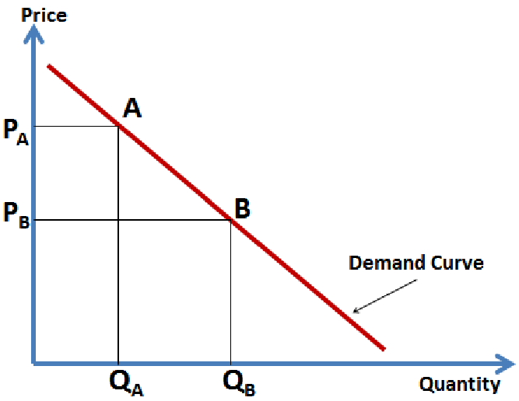
DEMAND CURVE

Slide 23
ASSUMPTIONS UNDERLYING LAW OF DEMAND
Law of demand is based on certain assumptions:
There is no change in consumers taste and preferences.
Income should remain constant.
Price of other goods should not change.
There should be no substitute for the commodity.
The commodity should not confer at any distinction.
The demand for the commodity should be continuous.
People should not expect any change in the price of the commodity.

Slide 24
EXCEPTIONS TO LAW OF DEMAND
1. Veblen Goods or Luxury Goods
Ignorance
Speculative Effect
Fear of Shortage
Necessaries
Giffen Paradox

Slide 25
VEBLEN GOODS OR LUXURY GOODS
‘Veblan’ has explained the exceptional demand curve through his doctrine of conspicuous consumption. Rich people buy certain good because it gives social distinction or prestige for example diamonds are bought by the richer class for the prestige it possess.
It the price of diamonds falls poor also will buy is hence they will not give prestige. Therefore, rich people may stop buying this commodity.

Slide 26
IGNORANCE
Sometimes, the quality of the commodity is Judge by its price. Consumers think that the product is superior if the price is high. As such they buy more at a higher price.

Slide 27
SPECULATIVE EFFECT
If the price of the commodity is increasing the consumers will buy more of it because of the fear that it increase still further, Thus, an increase in price may not be accomplished by a decrease in demand.

Slide 28
FEAR OF SHORTAGE
During the times of emergency of war People may expect shortage of a commodity. At that time, they may buy more at a higher price to keep stocks for the future.

Slide 29
NECESSARIES
In the case of necessaries like rice, vegetables etc. people buy more even at a higher price.

Slide 30
GIFFEN PARADOX
The Giffen good or inferior good is an exception to the law of demand. When the price of an inferior good falls, the poor will buy less and vice versa. For example, when the price of maize falls, the poor are willing to spend more on superior goods than on maize if the price of maize increases, he has to increase the quantity of money spent on it.
Otherwise he will have to face starvation. Thus a fall in price is followed by reduction in quantity demanded and vice versa. “Giffen” first explained this and therefore it is called as Giffen’s paradox.

Slide 31
ELASTICITY OF DEMAND
The law of demand explains the direction of change in the quantity demanded, due to the changes in the price in case of normal goods.
Law of demand explains only the direction but not magnitude of change i.e., Law of demand does not explain how much quantity demanded will change, in response to change in the price, the concept of ELASTICITY OF DEMAND explains this.

Slide 32
The concept of Elasticity of Demand is very important to the Economic theory as it explains the extent to which the demand changes when the price changes.
Elasticity of Demand in general it refers to Price Elasticity of Demand.
Elasticity of Demand is always negative (-) for normal goods. This is due to inverse relationship between price & demand.

Slide 33
PRICE ELASTICITY OF DEMAND – Definition:
Degree to which quantity demanded responds to a change in price is known as Price Elasticity of Demand.
In other words, the price elasticity of demand is the ratio of percentage change in quantity demanded, to percentage change in price.

Slide 34
Mathematically it can be expressed as follows:
Price Elasticity of Demand (Ep) =
Percentage change in quantity demanded /Percentage change in price.
OR
(Ep) = Proportionate change in quantity demanded / Proportionate change in price.
Proportionate change in quantity demanded =change in demand / initial demand
Proportionate change in price = change in price / initial price

Slide 35
TYPES OF ELASTICITY OF DEAMAND
The following are various types of elasticity of demand
Price Elasticity of Demand
Income Elasticity of Demand
Cross Elasticity of Demand
Advertisement Elasticity of Demand

Slide 36
Price Elasticity of Demand: It refers to the responsiveness of quantity demanded to changes in prices.
Measurement -Price Elasticity of Demand (Ep):
(Ep) = Proportionate change in quantity demanded /
Proportionate change in price.

Slide 37
Income Elasticity of Demand: It refers to the responsiveness of quantity demanded to changes in the incomes of the consumers.
Measurement - Income Elasticity of Demand (Ei):
(Ei) = Proportionate change in quantity demanded /
Proportionate change in income

Slide 38
Cross Elasticity of Demand: It refers to the responsiveness of quantity demanded to changes in the prices of the related goods, say which may be substitute goods.
Measurement - Cross Elasticity Of Demand (Ec):
(Ec) = Proportionate change in quantity demanded /
Proportionate change in prices of related goods.

Slide 39
Advertisement Elasticity of Demand: It refers to the responsiveness of quantity demanded to changes in the advertisement efforts & expenditure.
Measurement -Advertisement Elasticity of Demand (Ea):
(Ea) = Proportionate change in quantity demanded /
Proportionate change in advertisement efforts
or cost.

Slide 40
TYPES OF PRICE ELASTICITY OF DEMAND

Slide 41
Based on numerical values price elasticity of demand can be of five (5) types.
Perfectly elastic demand (Ep = ∞)
Perfectly inelastic demand (Ep = 0)
Unit elastic demand (Ep = 1)
Relatively elastic (Ep = > 1)
Relatively inelastic (Ep = < 1)

Slide 42
PERFECTLY ELASTIC DEMAND
Perfectly elastic demand is also called as infinitely elastic demand.
It means small change in price leads to an infinite expansion in demand.
Even if the price remain same the quantity demanded increases.
Perfectly elastic demand curve is horizontal straight line to X axis

Slide 43
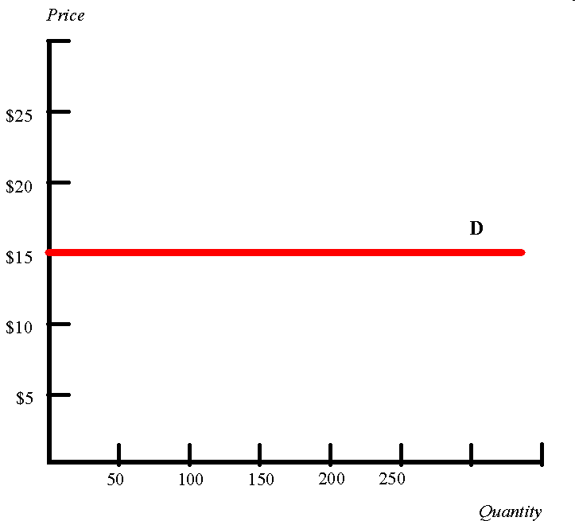
Perfectly elastic demand curve is horizontal straight line to X axis.
Even if the price remain same the quantity demanded increases.

Slide 44
PERFECTLY INELASTIC DEMAND
In perfectly inelastic demand even with a great fall or rise in the price the quantity demanded of the product does not change.
perfectly inelastic demand curve is vertical straight line parallel to Y axis

Slide 45
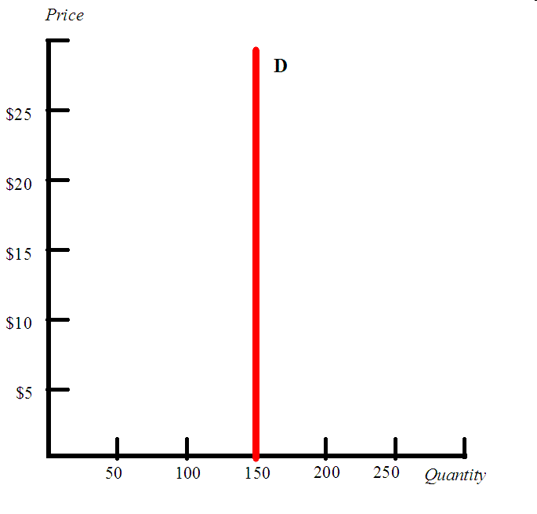
perfectly inelastic demand curve is vertical straight line parallel to Y axis
What ever may be the change in the price high or low the quantity demanded is the same.

Slide 46
UNIT ELASTIC DEMAND
Proportionate change in price leads to a proportionate change in quantity demand is called unit elastic demand.
If demand increases by 1% for a 1% fall in the price, the elasticity of demand is equal to 1.
When the change in demand is equal to change in price is called unit elasticity demand.

Slide 47
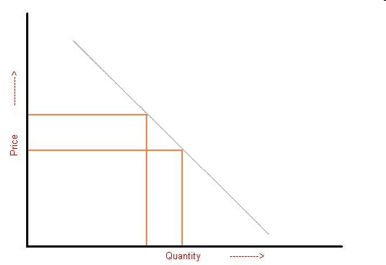
UNIT ELASTICITY

Slide 48
RELATIVELY ELASTIC
It means Proportionate change in price leads to more than proportionate change in quantity demanded is called Relative elastic demand.
If demand increases by more than 1% for a 1% fall in the price, the elasticity of demand is said to be Relative elastic demand.

Slide 49
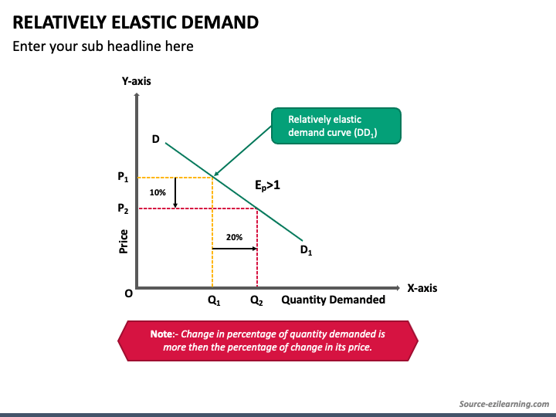

Slide 50
RELATIVELY INELASTIC
It means Proportionate change in price leads to less than proportionate change in quantity demanded is called Relative inelastic demand.
If demand increases by less than 1% for a 1% fall in the price, the elasticity of demand is said to be Relative inelastic demand.

Slide 51
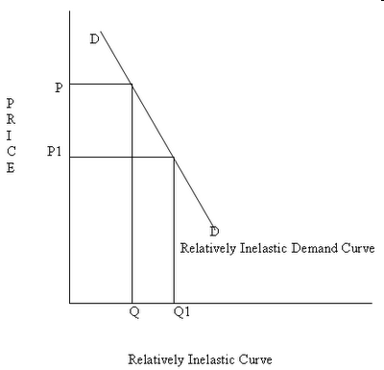

Slide 52
IMPORTANCE OF ELASTICITY OF DEMAND
The concept of elasticity of demand is very useful to the Producers and the Policy makers.
It is used to fix prices of goods.
To fix prices (rewards) of Factors of production.
To forecast demand. (income elasticity man be used to forecast demand for the product)
To plan the level of output & price.

Slide 53
DEMAND FORECASTING METHODS

Slide 54
WHY TO FORECAST DEMAND?
To assess the likely demand.
To plan the production accordingly.
To plan the inputs (factors of productions) Manpower (labour), Raw material, and Capital.

Slide 55
DEMAND FORECASTING
NON – STATISTICAL METHODS
STATISTICAL METHODS
Complete Enumeration Survey
Sample Method
Survey Techniques
Sales force Opinion Method
Expert Opinion Method Delphi Technique / GD
Test Marketing
Controlled Experiments
Judgemental Approach

Slide 56
Survey of buyer intentions: in this method information is drawn from the buyer to estimate demand.
In this method each potential buyer is asked how much does he plan to buy, of the given product at a given point of time under particular condition.
This is the most effective method because the buyer is the ultimate decision maker, & we are collecting the information from the potential buyer.

Slide 57
Survey can be conducted by considering either whole population or by selecting a small group of potential buyers.
If survey is conducted by considering the whole population it is called Census method. census method is also called as Total Enumeration method.
If survey is conducted by considering the small group of potential buyers who can represent the whole population, it is called Sample method.

Slide 58
Sales force opinion method: Sales people are in constant touch with the large number of buyers of a particular market.
Sales force constitute valid source of information about the likely sales of a product.
Sales force is capable of assessing the likely reaction of the customers of their territories quickly, given the companies marketing strategy.

Slide 59
Expert opinion method: An expert is good at forecasting and analyzing the future trends for a given product or service at a given level of technology.
Apart from salesmen, consumers & distributors, outside experts may also used for forecasting. In the United States of America, the automobile companies get sales estimates directly from their dealers. Firms in advanced countries make use of outside experts for estimating future demand.

Slide 60
Delphi Method: A variant of the survey method is Delphi method. It is a sophisticated method to arrive at a consensus. Under this method, a panel is selected to give suggestions to solve the problems in hand. Both internal and external experts can be the members of the panel. Panel members one kept apart from each other and express their views in an anonymous manner.
There is also a coordinator who acts as an intermediary among the panelists. He prepares the questionnaire and sends it to the panelist. At the end of each round, he prepares a summary report. On the basis of the summary report the panel members have to give suggestions.

Slide 61
Test marketing: In test marketing the entire product and marketing program is carried for the first time in a small number of well chosen and authentic sales environment.
The primary objective of test marketing is to know whether the customer will accept the product in the present form or not

Slide 62
Controlled experiments: Major determinants of demand are manipulated to suit to the customers with different tastes and preferences
In this method the product is introduced with different packages, different prices, in different markets to assess which combination appeals to the customer most

Slide 63
Judgmental Approach: When none of statistical and other methods are directly related to the given product/service the management has no alternative other than using its own judgment in forecasting the demand.

Slide 64
DEMAND FORECASTING
NON – STATISTICAL METHODS
STATISTICAL METHODS
Mechanical Extrapolation / Trend Projection Methods
Barometric Techniques
Correlation and Regression Methods

Slide 65
Trend projection methods:
A well-established firm will have accumulated data. These data is analyzed to determine the nature of existing trend. Then, this trend is projected in to the future and the results are used as the basis for forecast.

Slide 66
Mechanical Extrapolation / Trend Projection Methods
Fitting Trend Line by Observation
Time Series Analysis using Least Squares Method
Moving Average Method

Slide 67
Time Series Analysis using Least Squares Method
Sales = a + b (year number)
i.e., S = a + b . T
Where, a and b are constants determined using
ΣS = Na + b Σt
Σ St = a Σ t + b Σ t^2
Where, N = No. of years for which data is available

Slide 68
MOVING AVERAGE METHOD
This method considers that the average of past events determine the future events. The average keeps on moving depending up on the number of years selected.

Slide 69
EXPONENTIAL SMOOTHING
This method determines values by computing exponentially weighted system. The weights assigned to each value reflect the degree of importance of that value.
Smoothened Value = w (current observed value) +
(1-w) (previous smoothened value)

Slide 70
BAROMETRIC TECHNIQUES
It is based on the presumption that relationship can exist among various economic time series. Under this technique one set of data is used to predict another set.
In other words to forecast demand for a product , some other relevant indicator, which is known as BAROMETER is used to forecast the future demand.
E.g. To forecast demand for cement the relevant indicator number of new construction projects, are taken into consideration for forecasting demand.
There are three kinds of relationships.
Leading series
Coincident series
Lagging series

Slide 71
CORRELATION
Correlation describes the degree of association between two variables such as sales and advertisement expenditure.
When two variables tend to change together then they are said to be correlated.
The extent to which they are correlated is measured by correlation coefficient.
For example if sales have gone up as a result of increase in advertisement expenditure we can say that sales and advertisement are positively correlated.

Slide 72
REGRESSION
A statistical measure that attempts to determine the strength of the relationship between one dependent variable (usually denoted by Y) and a series of other changing variables (known as independent variables).
The two basic types of regression are linear regression and multiple regression. Linear regression uses one independent variable to explain and/or predict the outcome of Y, while multiple regression uses two or more independent variables to predict the outcome.

Slide 73
END

