Slide 1
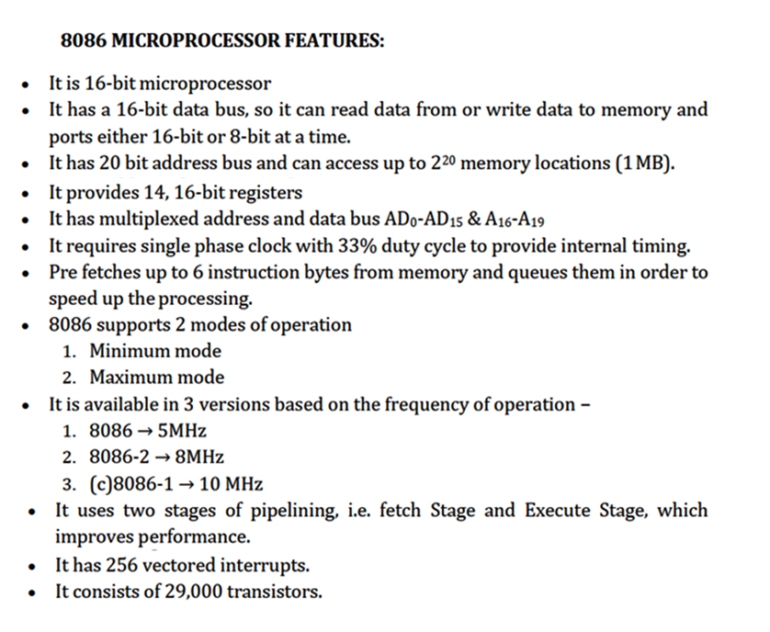

Slide 2
Memory Segmentation

Slide 3
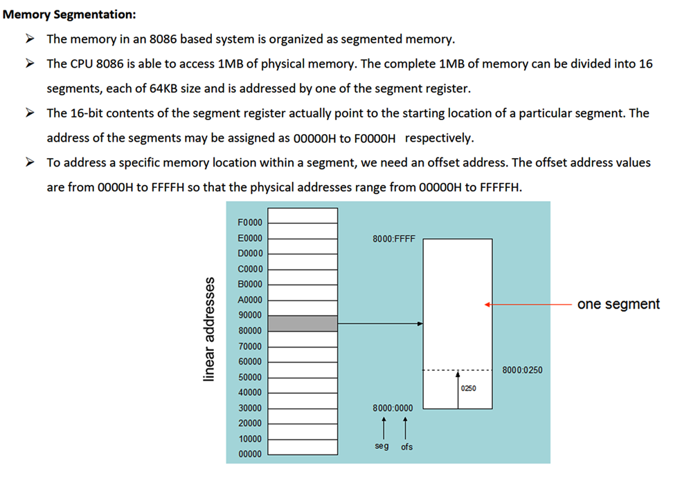
2 Logical Addresses for each Segment
Logical Address – 16 bits
  Base Address (16 bits)
  Offset Address (16 bits)

Slide 4
Physical Address Calculation

Slide 5
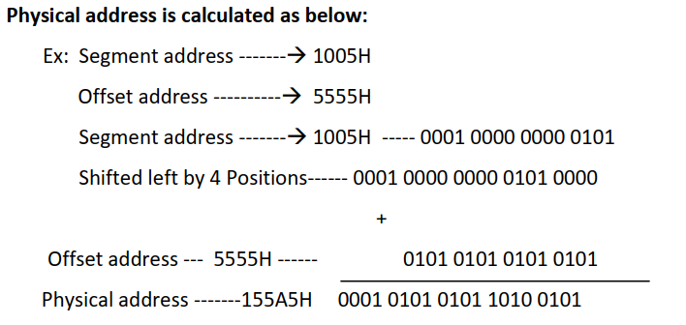
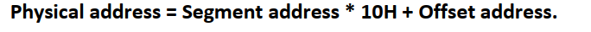
Memory Address Generation
The BIU has a dedicated adder for determining physical memory addresses.
Offset Value (16 bits)
Segment Register (16 bits)
0 0 0 0
Adder
Physical Address (20 Bits)

Slide 6
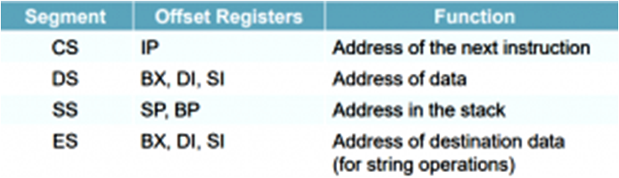
Memory Address Generation
Logical Address is specified as Segment Address : offset Address
Physical address is obtained by shifting the segment address 4 bits to the left and adding the offset address.
Thus the physical address of the logical address A4FB:4872 is:
A4FB0
+ 4872
A9822

Slide 7
Advantages:
It allows the programmer to access 1MB memory using only 16-bit address.
It allows placing of code, data and stack portions of the same program in different segments, for data and code protection.
It is possible to enhance the memory size of code, data or stack segments beyond 64KB by allotting more than one segment for each area.
It allows to share the data easily.
Disadvantages:
Although the total memory is 16*64KB, at a time only 4*64KB memory can be accessed.

Slide 8
Architecture of 8086

Slide 9
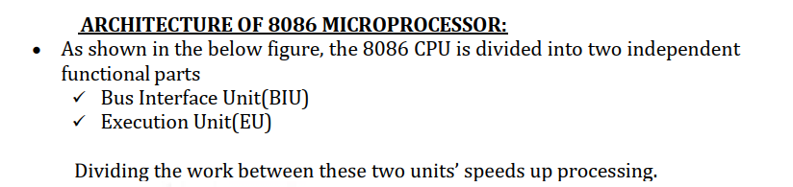
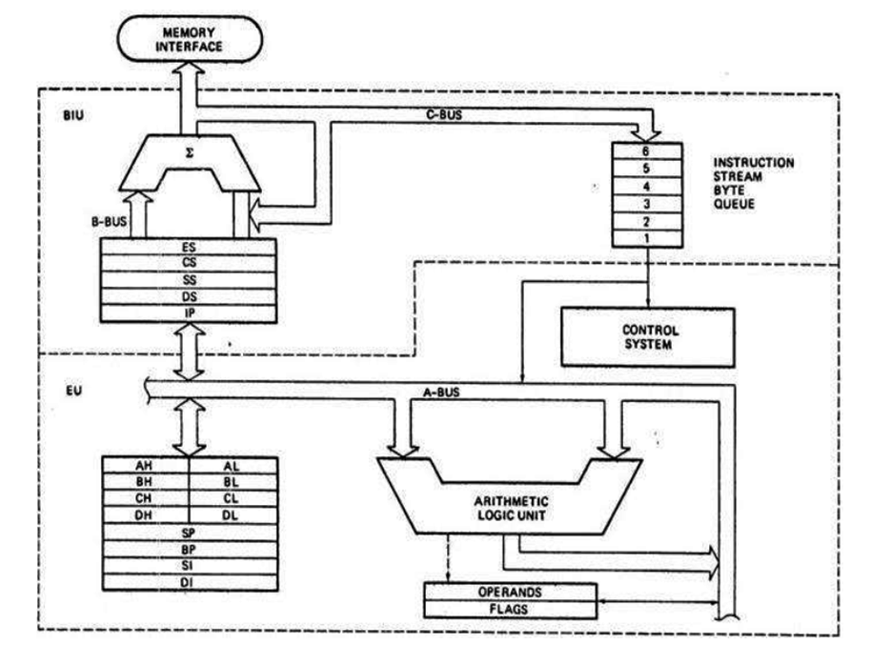
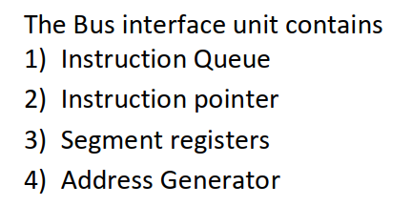
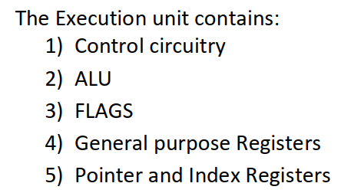

Slide 10
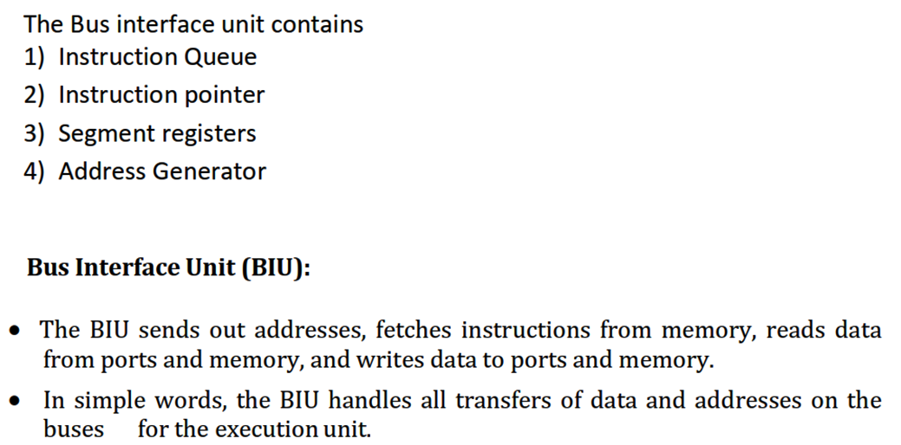

Slide 11
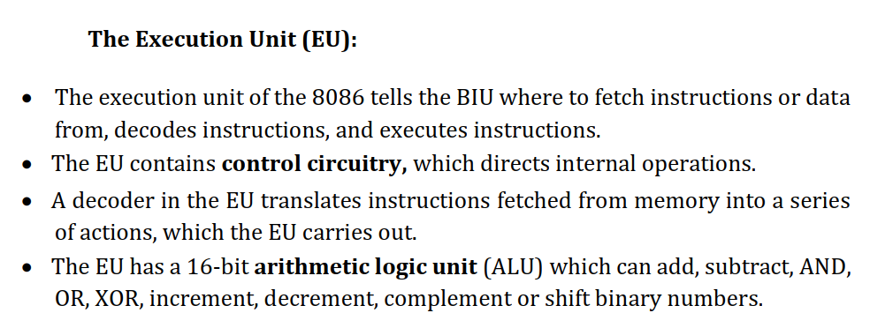

Slide 12
Pipelining

Slide 13
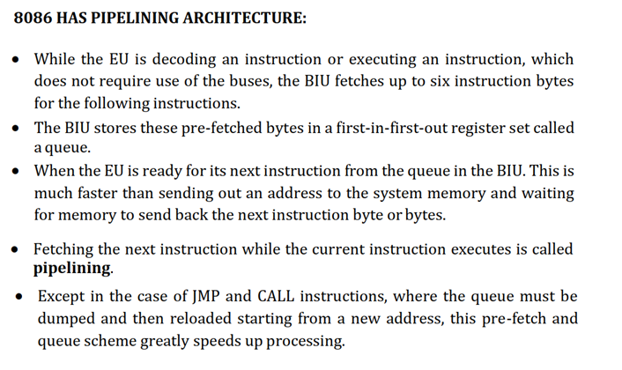

Slide 14
Register Organization

Slide 15
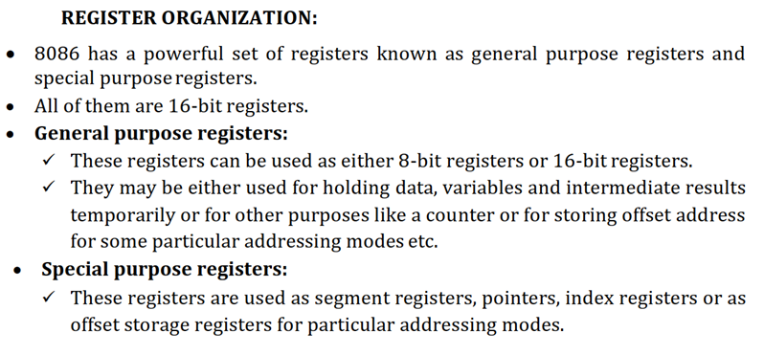

Slide 16
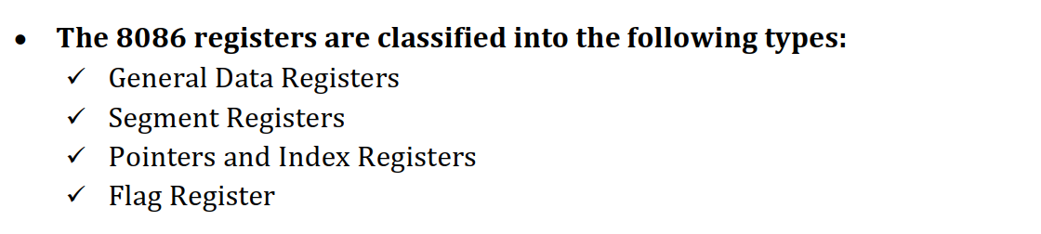
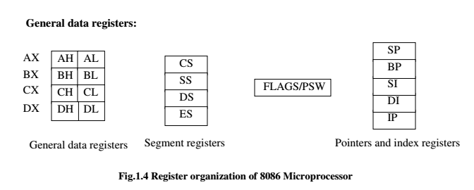

Slide 17
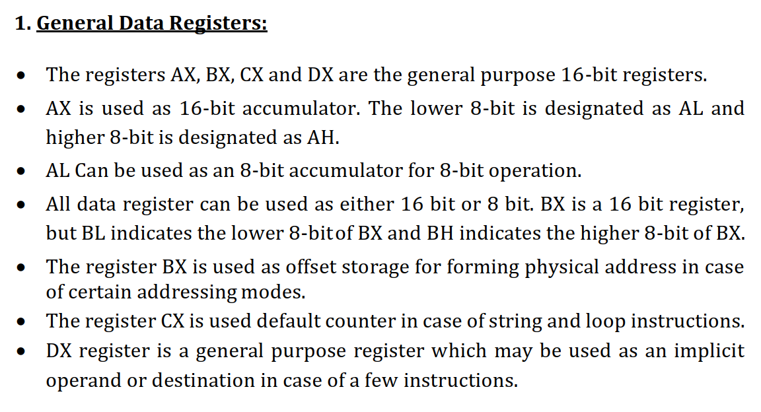

Slide 18
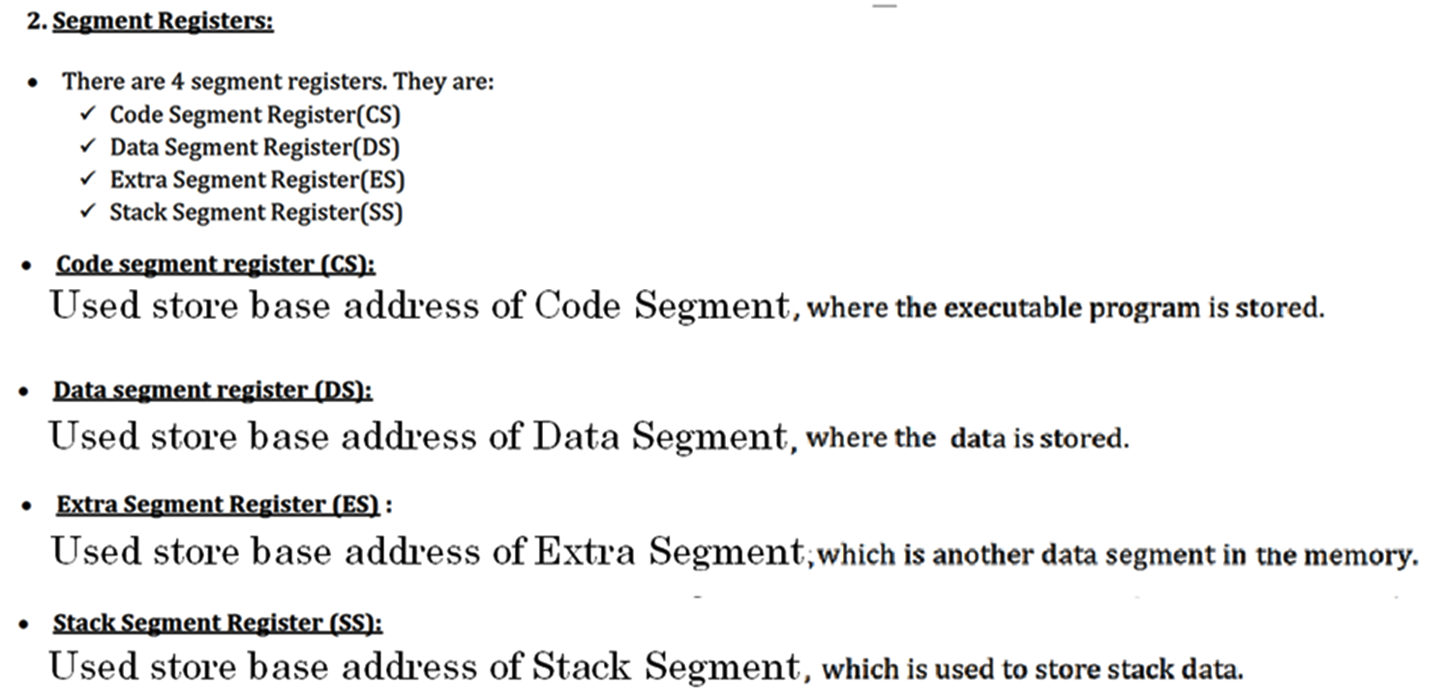

Slide 19
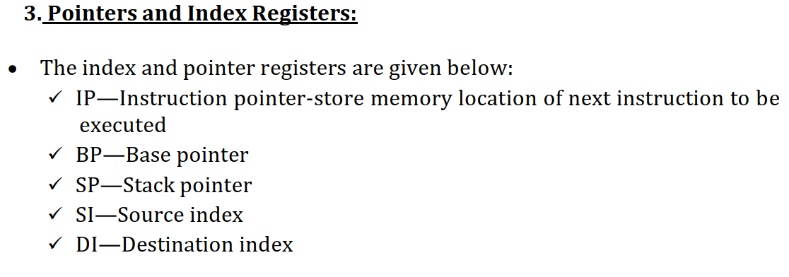
IP → Offset within the Code segment.
BP → Offset within the Data segment.
SP → Offset within the Stack segment.
SI → Offset within the Data segment.
DI → Offset within the Extra segment.
4.Queue register: Used to store pre-fetched instructions and inputs it to EU.

Slide 20
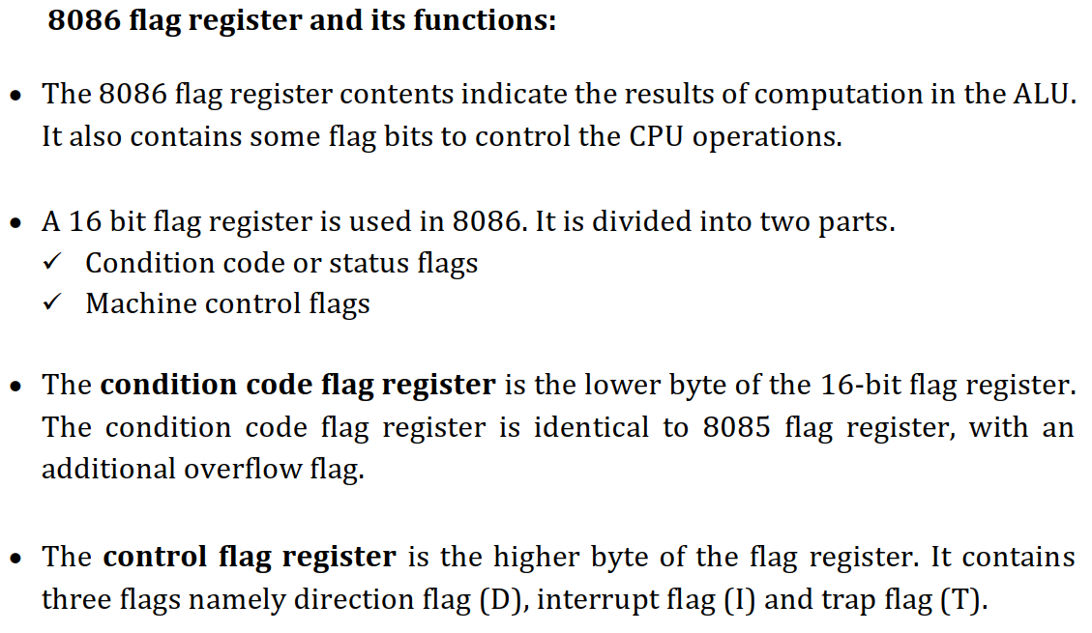

Slide 21
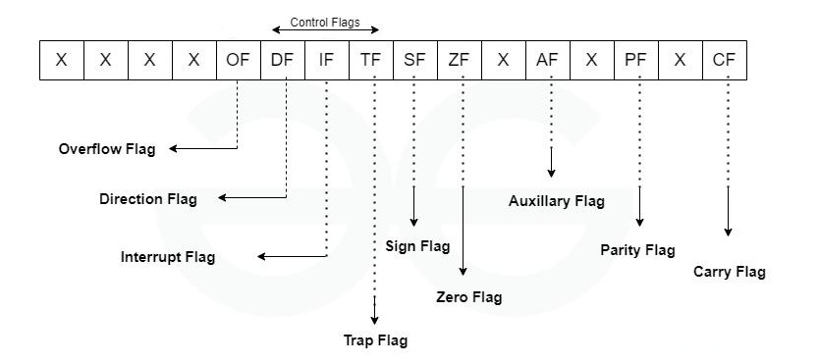

Slide 22
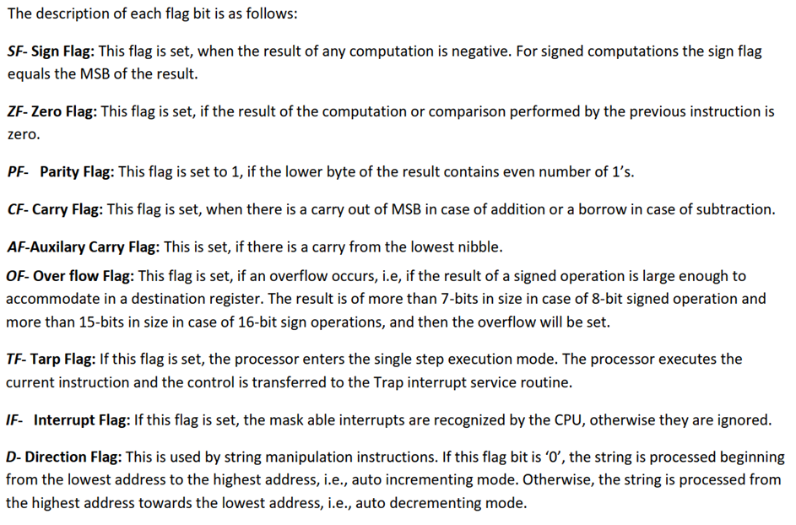

Slide 23
Addressing Modes

Slide 24
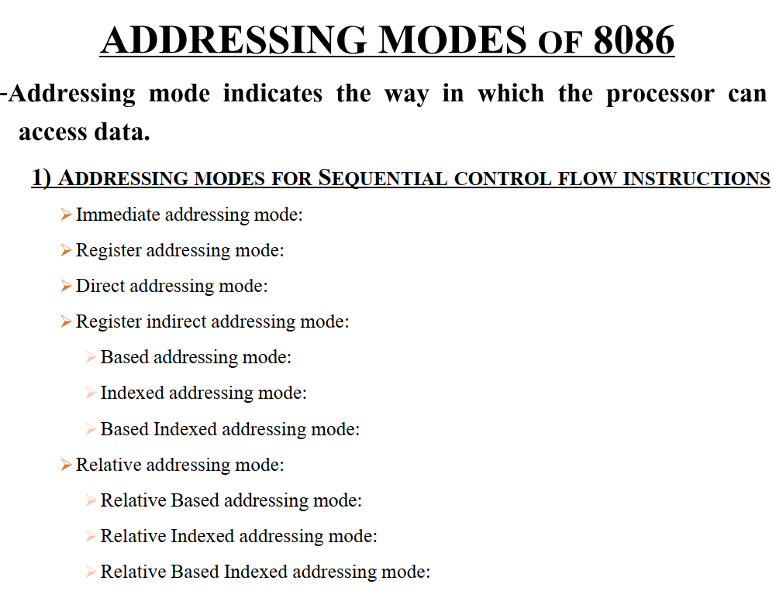

Slide 25
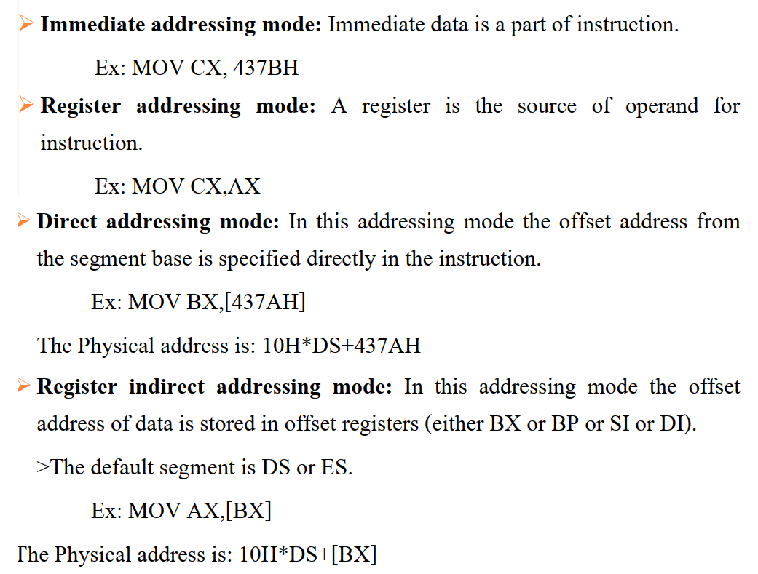

Slide 26
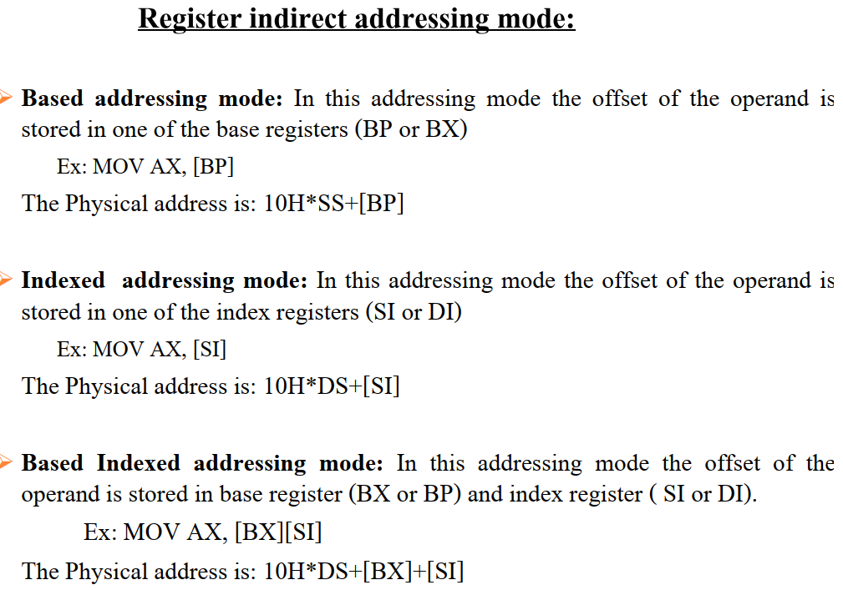

Slide 27
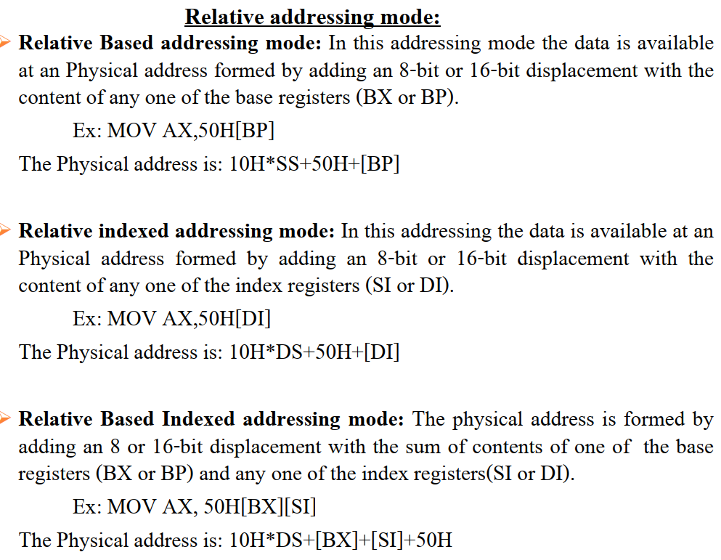

Slide 28
Instruction Set

Slide 29
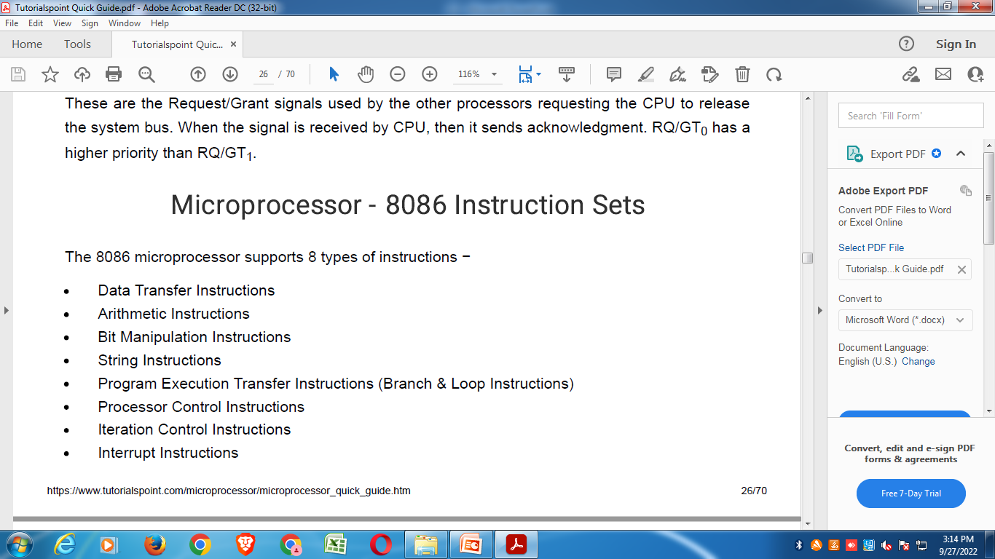

Slide 30
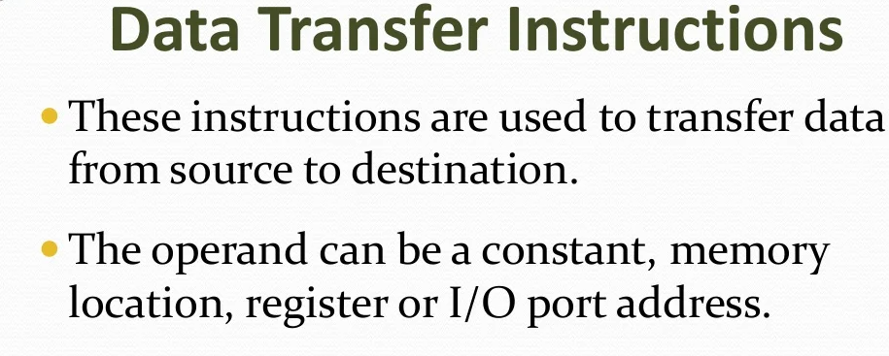

Slide 31
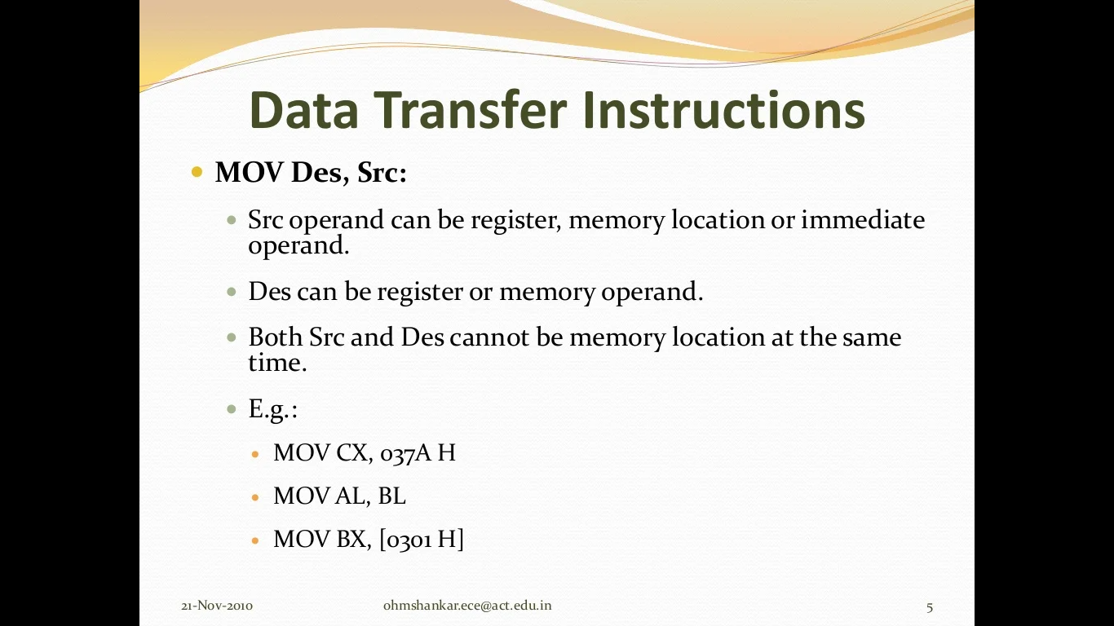
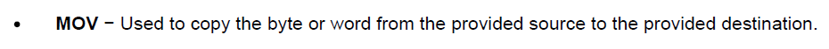

Slide 32
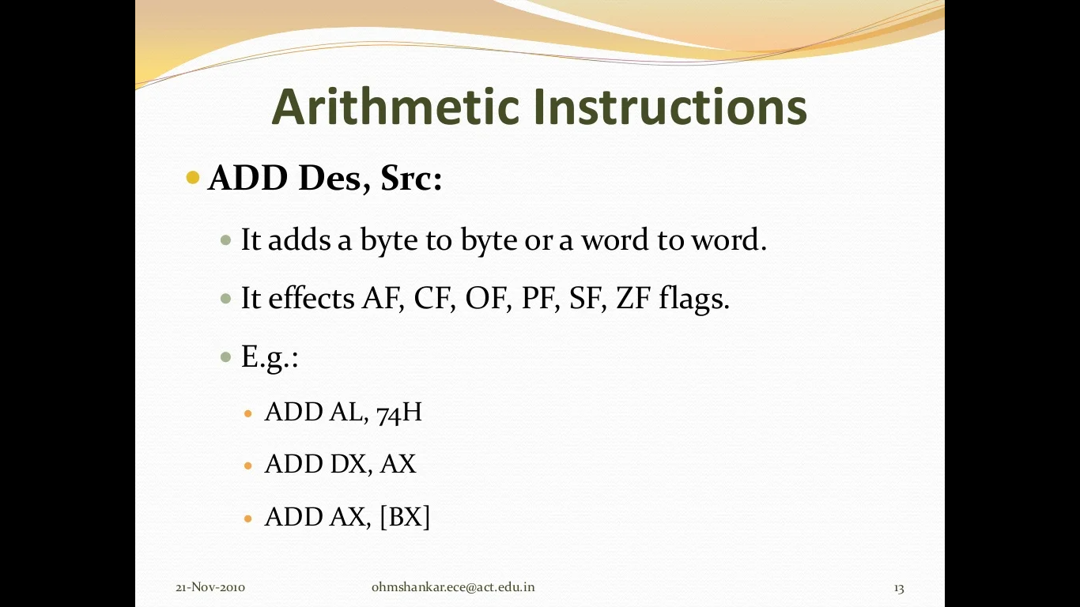

Slide 33
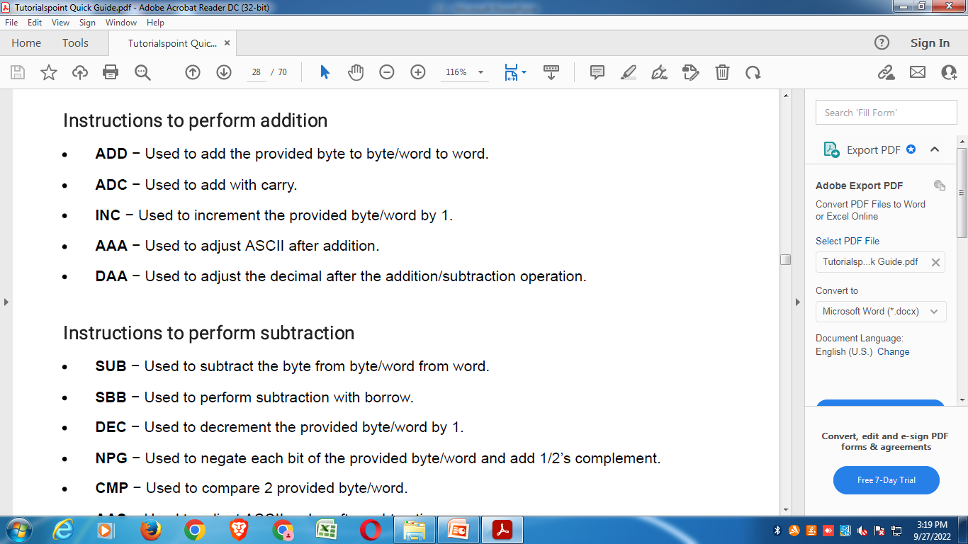

Slide 34
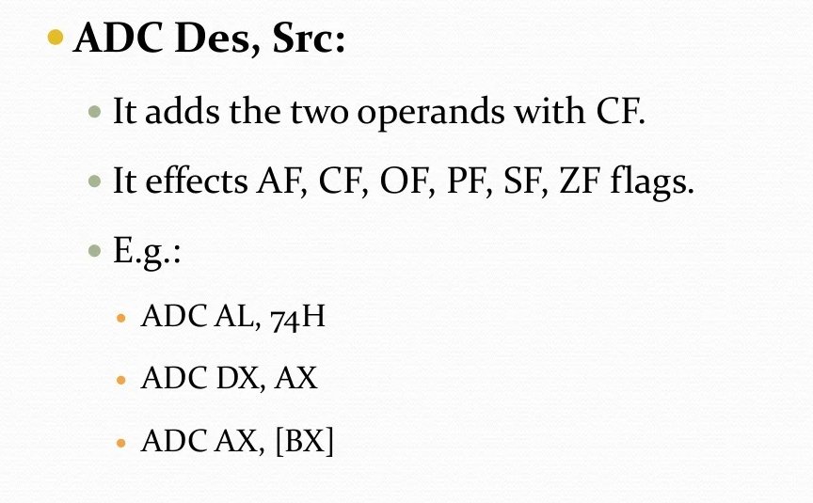

Slide 35
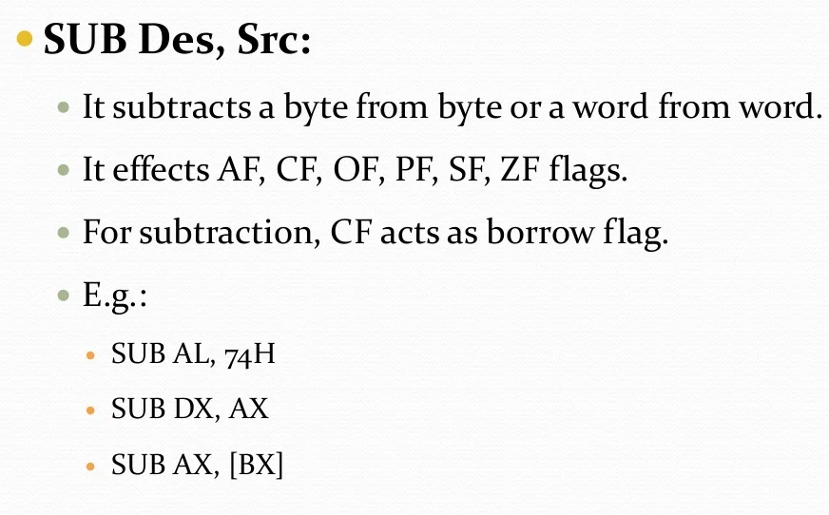

Slide 36
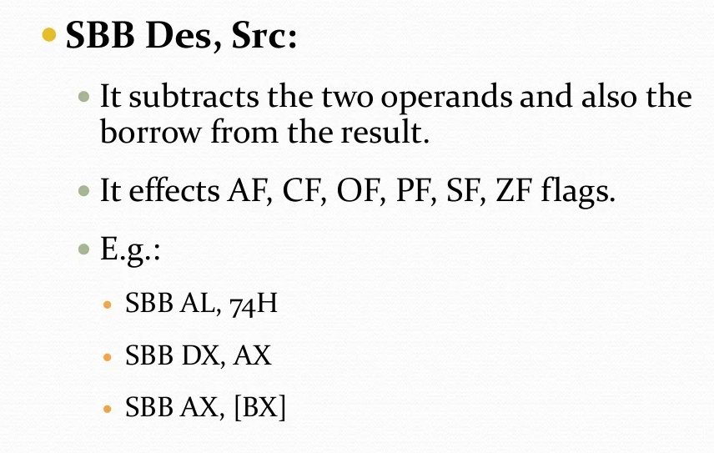

Slide 37
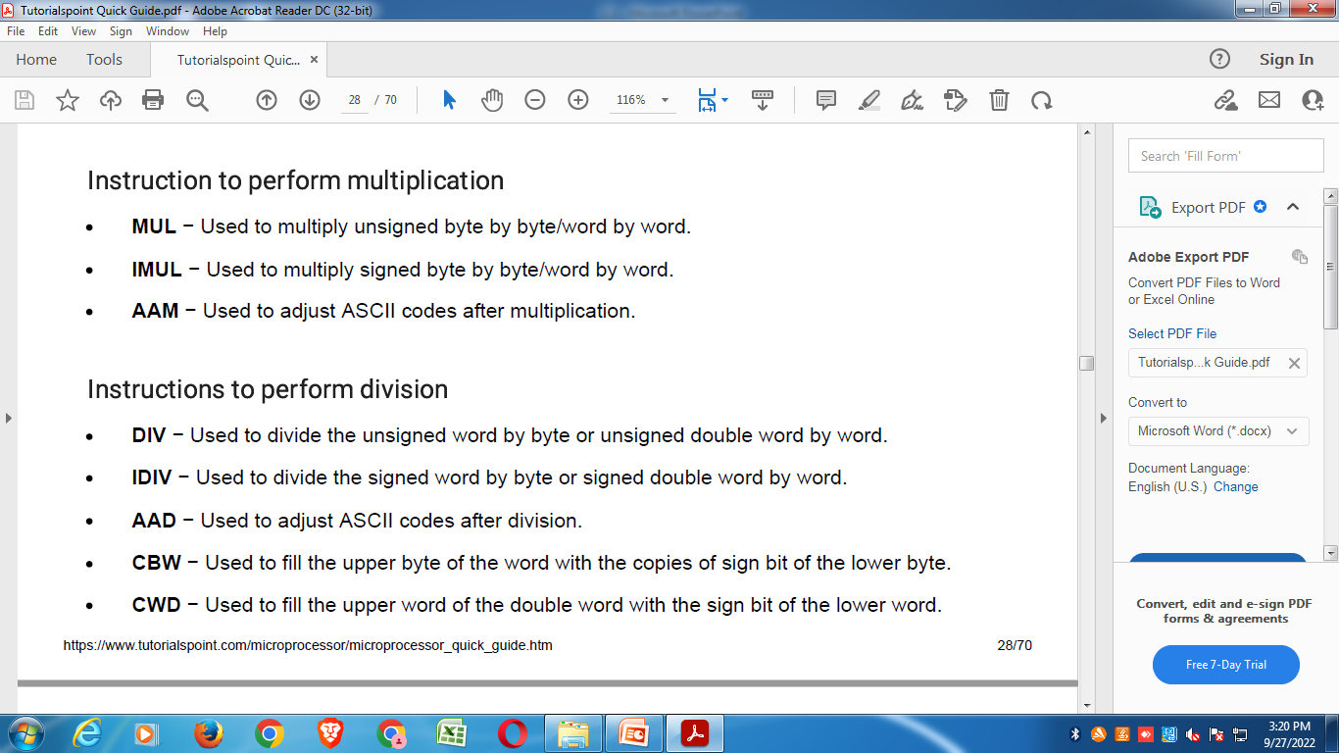
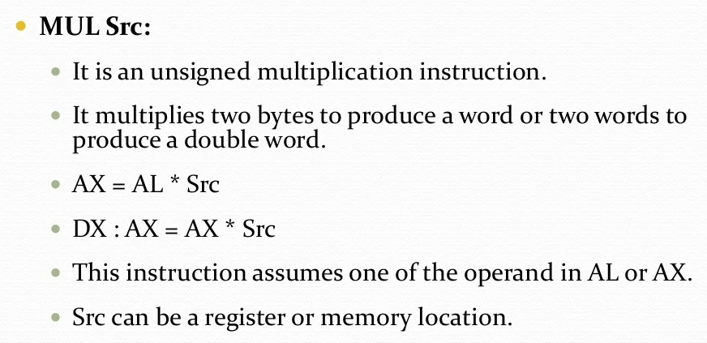

Slide 38


