Slide 1
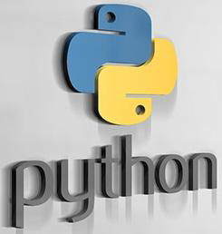
Prepared By
K Nalini
Assistant Professor
Dept., of. IT

Slide 2
UNIT-II

Slide 3
Topics to be covered:
Functions:
Defining a function, calling a function, Types of functions, Function Arguments, Anonymous functions, Global and local variables
String Manipulation:
Accessing Strings, Basic Operations, String slices, Function and Methods
Lists:
Accessing list, Operations, Working with lists Function and Methods
Tuple:
Accessing tuples, Operations, Working.
Dictionaries:
Accessing values in dictionaries, working with dictionaries, Properties Functions and Methods.

Slide 4
Functions:
In Python, function is a group of related statements that perform a specific task.
Functions help break our program into smaller and modular chunks.
As our program grows larger and larger, functions make it more organized and manageable.
If a group of statements is repeatedly required then it is not recommended to write these statements every time separately.
We have to define these statements as a single unit and we can call that unit any number of times based on our requirement without re writing.
This unit is nothing but function.
The main of advantage of functions is code is Reusability.
Note: In other languages functions are also known as methods,procedures,subroutine etc.

Slide 5
Advantage of functions in python
There are the following advantages of C functions.
By using functions, we can avoid rewriting same logic/code again and again in a program.
We can call python functions any number of times in a program and from any place in a program.
We can track a large python program easily when it is divided into multiple functions.
Reusability is the main achievement of python functions.

Slide 6
Python supports 2 types of functions
1.Built in Functions
2.User Defined Functions
Anonymous functions
1.Built in Functions:
Functions that are built into Python.
The function which are coming along with python software automatically, are called built-in functions or pre defined functions.
Example:id(),type(),input(),eval() etc…

Slide 7
2.User Defined Functions:
The functions which are developed by programmer explicitly according o business requirements, are called User defined functions.
Defining a Function
Here are simple rules to define a function in Python.
Function blocks begin with the keyword def followed by the function name and parentheses ( ( ) ).
Any input parameters or arguments should be placed within these parentheses. You can also define parameters inside these parentheses.
The first statement of a function can be an optional statement - the documentation string of the function or docstring.
The code block within every function starts with a colon (:) and is indented.
The statement return [expression] exits a function, optionally passing back an expression to the caller. A return statement with no arguments is the same as return None.

Slide 8
Syntax of Function:
def function_name(parameters):
"""docstring""“
statement(s)
Keyword def marks the start of function header.
A function name to uniquely identify it. Function naming follows the same rules of writing identifiers in Python.
Parameters (arguments) through which we pass values to a function. They are optional.
A colon (:) to mark the end of function header.
Optional documentation string (docstring) to describe what the function does.
One or more valid python statements that make up the function body. Statements must have same indentation level (usually 4 spaces).
An optional return statement to return a value from the function.

Slide 9


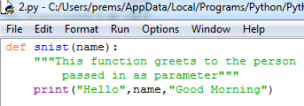

Slide 10




Parameters:
Parameters are inputs to the functions.
If a function contains parameters, then at the time of calling , compulsory we should provide values otherwise we will get error.

Slide 11
Return Statement:
The return statement is used to exit a function and go back to the place from where it was called.
Function can take input values as parameters and executes business logic, and returns output to the caller with return statement.
Syntax of return:
return [expression_list]
This statement can contain expression which gets evaluated and the value is returned.
If there is no expression in the statement or the return statement itself is not present inside a function, then the function will return the None object.

Slide 12
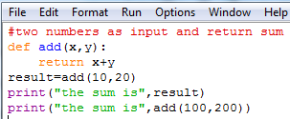




Slide 13
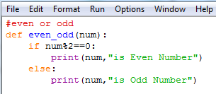
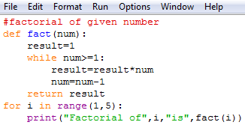



Slide 14
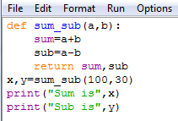
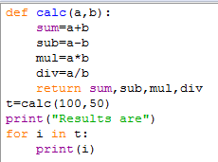

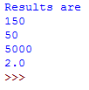
Returning multiple values from a function:
In other languages like C,C++ and java, function can return atmost one value.
But in python, a function can return any number of values.

Slide 15
Function Arguments:
There are 4 types of Actual arguments are followed in python.
1.positional arguments
2.keyword arguments
3.default arguments
4.variable length arguments.
1.positional arguments:
These are arguments passed to function in correct positional order.
def sub(a,b):
print(a-b)
sub(100,200)
sub(200,100)
The number of arguments and position of arguments must be matched.
If we change the order then the result may be changed.
If we change the number of arguments then we will get error

Slide 16
2.keyword arguments:
We can pass argument values by keyword i.e by parameter name.
Here the order of arguments is not important but number of arguments must be matched.
Python allows us to call the function with the keyword arguments. This kind of function call will enable us to pass the arguments in the random order.
The name of the arguments is treated as the keywords and matched in the function calling and definition.
If the same match is found, the values of the arguments are copied in the function definition.
Note:
We can use positional and keyword arguments simultaneously.
But first we have to take positional arguments and then keyword arguments, otherwise we will get syntax error.

Slide 17


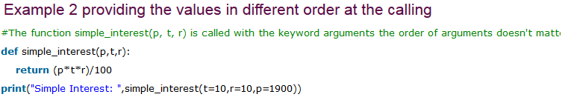
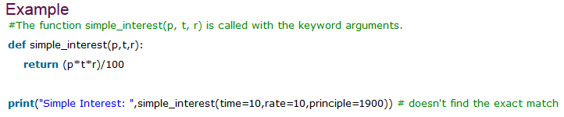

Slide 18



Default argument:
If we are not providing values then automatically it takes default arguments.
Some times we can provide default values for positional argumnets.

Slide 19



Declaring a variable with value then we can say “default argument”
If we are not passing any name then default value will be considered.

Slide 20




Note: After default arguments we should not take non default arguments.

Slide 21
Variable Length Arguments or Arbitrary Arguments:
Some times we can pass variable number of arguments to our function, such type of arguments are called Variable length arguments.
Ex:
def sum(a,b):
print(a+b)
def sum(a,b,c):
print(a+b+c)
By using above method code is increasing.
No overloading in python.
We have to use different name as methods.
To overcome this problem we have variable length arguments.
‘*’ asterisk is used to declare variable length arguments.
For two and three arguments every time special function we have to define

Slide 22


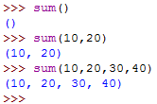

We can declare a variable length argument with * symbol as follows
Syntax:
def f1(*n):
We can call this function by passing any number of arguments including Zero number.
Internally all these values are represented in the form of tuple.

Slide 23

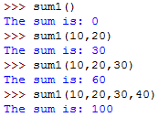


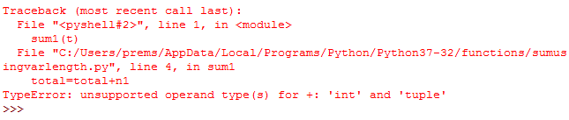
Note: We can mix variable length arguments with positional arguments.

Slide 24
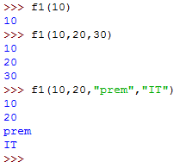



Note: After variable length argument, if we are taking any other arguments then we should provide values as keyword arguments.

Slide 25


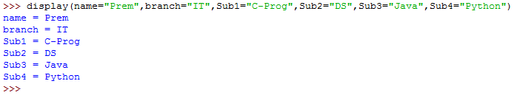
Note: we can declare key word variable length argument also.
For this we have to use **.
Syntax:
def f1(**n): any number of key value pairs we can pass

Slide 26
1.After keyword arguments we should not take positional arguments.
2.After default arguments we should not take non-default arguments.
3.After variable length arguments if we are taking normal arguments, compulsory we should provide value by keywords.

Slide 27
Anonymous Functions:
Some times we can declare the functions without any name, such type of nameless functions are called anonymous functions or lambda functions.
Instant use(one time usgae)
Normal function declaration:
def squareit(n):
return n*n
In anonymous function we can define by using lambda keyword.
Syntax:
Lambda input argument: expression
By using Lambda functions we can write very concise code so that readability of the program will be improved.

Slide 28





Slide 29
Note:
Lambda functions internally returns expression value and we are not required to write return statement explicitly.
Some times we can pass function as argument to another function.
In such case lambda functions are best choice.
We can use lambda functions very commonly with filter(),map() and reduce() functions because these functions expect function as arguments.

Slide 30


Module: Group of functions
Package: Group of Modules
Library: Group of Packages
Recursive Function:
In Python function, recursion is when a function calls itself.
Advantages:
Reduce length of the code
Improve readability
We can solve complex problems.
Factorail(3)=3*Fact(2)
=3*2*Fact(1)
Facr(n)=n*Fact(n-1)

Slide 31
We can use Lambda functions very commonly with filter(), map() and reduce() functions because these functions are expect function as argument.
filter() function:
We can use filter function to filter values from the given sequence based on some condition.
Syntax:
filter(function, sequence)
Where function argument is responsible to perform conditional check sequence can be list or tuple or string.

Slide 32
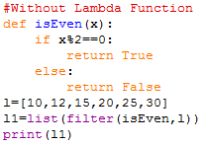
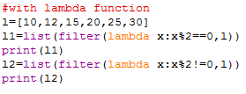



Slide 33
map() function:
For every element present in the given sequence, apply some functionality and generate new element with the required modification.
For this requirement we should go for map() function.
Syntax:
map(function , sequence)
The function can be applied on each element of sequence and generates new sequence.

Slide 34





Slide 35


reduce() function:
Reduce function reduces sequence of elements into a single element by applying the specified function.
Syntax:
reduce(function ,sequence )
reduce() function present in functools module and hence we should write import statement.

Slide 36
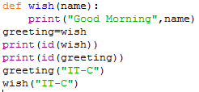
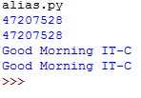
Function Aliasing:
For the existing function we can give anther name, which is nothing but function aliasing.
If we delete one name still we can access that function by using alias name.

Slide 37
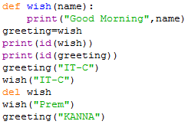
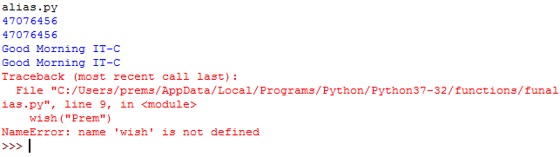
In the above example only one function is available but we can call that function by using either wish name or greeting name.
If we delete one name still we can access that function by using alias name.

Slide 38
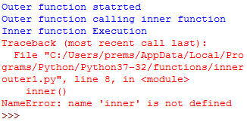
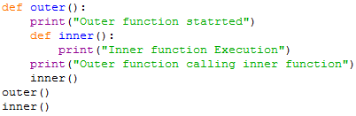
Nested Functions:
A function which is defined inside another function is known as nested function.
Nested functions are able to access variables of the enclosing scope.
In Python, these non-local variables can be accessed only within their scope and not outside their scope.

Slide 39
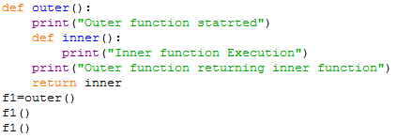

In the above example inner(0 function is local to outer() function and hence it is not possible to call directly from outside of outer() function.
A function can return another function.

Slide 40
Function Decorators:
Decorator is a function which can take a function as argument and extend its functionality and return modified function with extended functionality.
The main objective of decorator functions s we can extend the functionality of existing functions without modifies that function.
This is also called metaprogramming as a part of the program tries to modify another part of the program at compile time.
Decorator
New(add some functionality)
Input function
Inner()
Decorator Function
Output Function with
Extended functionality
Input function

Slide 41


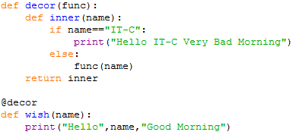



The above function prints always same output for any name.
But if we want to modify this function to provide different message if name for example “IT-C”.
We can do this without touching function by suing decorator.

Slide 42
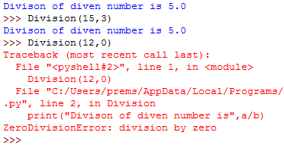

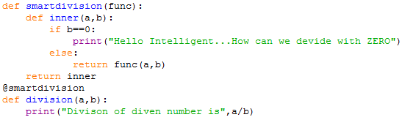


In above program whenever we call function automatically décor function will be executed.

Slide 43
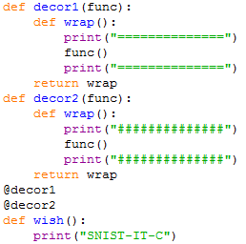

Decorator chaining:
We can define multiple decorators for the same function and all these decorators will from Decorator Chaining.
Ex:

Slide 44
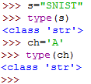
String Manipulation:
String data type :
The most commonly used object in any project and in any programming language is Sting.
What is String?
Any sequence of characters within either single or double quotes is considered as a String.
Syntax: S=‘SNIST’ or s=“SNIST”
In most of other languages like C,C++,java a single character with in single quote is treated as char data type value.
But in python we are not having char data type.
Hence it is treated as String only.

Slide 45
String Formatting Operator:
Python uses C-style string formatting to create new, formatted strings.
# This prints out "Hello, SNIST!"
name = “SNIST"
print("Hello, %s!" % name)
print "My name is %s and weight is %d kg!" % (‘Ram', 21)
When the above code is executed, it produces the following result −
My name is Ram and weight is 21 kg!

Slide 46
How to define multi-line Sting literals:
We can define multi-line String literals by using triple single or double quotes.
Ex:’’’SNIST
IT Dept’’’
We can also use triple quotes to use single quotes or double quotes as symbol inside String literal.
How to access characters of String:
We can access characters of string by using the following ways:
1.By using index
2.By using slice operator.

Slide 47
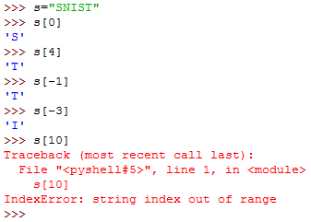
1.By using index:
Python supports both +ve and –ve index.
+ve index means left to right(Forward Direction)
-ve index means right to left(Backward Direction)
If we trying to access characters of string with out of range index then will get error saying:IndexError

Slide 48
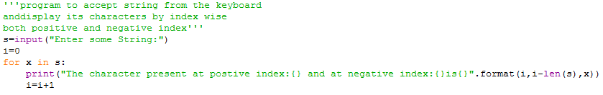


Slide 49
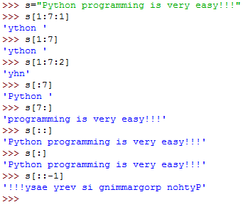

Slide 50
2.By using slice operator.
Syntax:s[begin index: end index:step]
Begin index:from where we have to consier slice(substring)
Endindex:we have to terminate the slice(substring) at endindex-1
Step:incremented value
Note: If we are not specifying begin index then it will consider from beginning of the string
If we are not specifying end index then it will consider up to end of the string.
The default value for step is 1.

Slide 51
Behaviour of slice operator:
S[begin :end :step]
Step value can be either +ve or –ve
If +ve it should be forward direction(left to right) and we have to consider begin to end-1
If -ve it should be backward direction(right to left) and we have to consider begin to end+1
Note:
In the backward direction if end value is -1 then result is always empty.
In the forward direction if end value is 0 then result is always empty.
In forward direction:
Default value for begin:0
Default value for end: length of string
Default value for step:1
In backward direction:
Default value for begin:-1
Default value for end: -(length of string+1)

Slide 52
Mathematical Operators for String:
We can apply the following mathematical operators for string.
1.+ operator for concatenation
2.* operator for repetition
Note:
To use + operator for strings, compulsory both arguments should be str type.
To use * operator for Strings, compulsory one argument should be str and other argument should be int.
Ex:
print(“SREE”+”NIDHI”)→SREENIDHI
print(“SNIST”*2)→SNISTSNIST

Slide 53

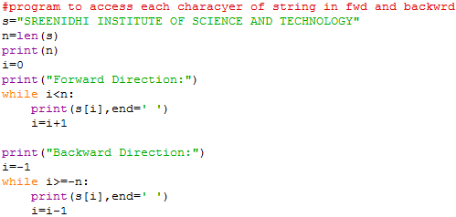

len() in-built function:
We can use len() function to find the number of character present in the string.
Ex:
Task:Print in fwd and bwd using slice operator

Slide 54
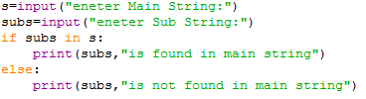
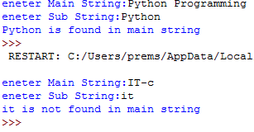
Checking membership:
We can check whether the character or string is the member of another string or not by using in and not in operators.

Slide 55
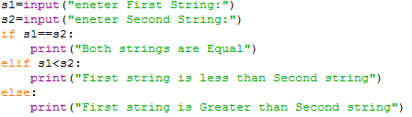
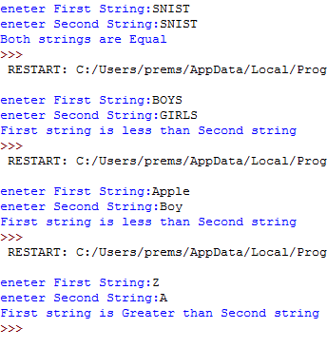
Comparison of Strings:
We can use comparison operators (<,<=,>,>=) and equality operators(==,!=) for strings.
Comparison well be performed based on alphabetical order.

Slide 56
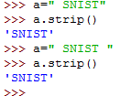
Removing Spaces From the String:
This method removes whitespaces from the beginning and end of the string.
We can use following 3 methods:
1.rstrip()→to remove spaces at right hand side
2.lstrip()→to remove spaces at left hand side
3.strip()→to remove spaces both sides

Slide 57
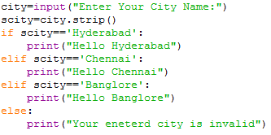
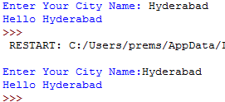
Removing spaces example using strip():

Slide 58
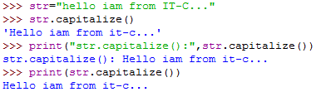
str.capitalize():
It returns a copy of the string with only its first character capitalized.
Syntax:str.capitalize()
str = "this is string example...!!!";
print ("str.capitalize() : ", str.capitalize())
Result:
str.capitalize() : This is string example....!!

Slide 59


Python String count():
In simple words, count() method searches the substring in the given string and returns how many times the substring is present in it.

Slide 60
Python String isalnum()
The isalnum() method returns True if all characters in the string are alphanumeric (either alphabets or numbers). If not, it returns False.
Return Value from isalnum()
The isalnum() returns:
True if all characters in the string are alphanumeric
False if at least one character is not alphanumeric

Slide 61
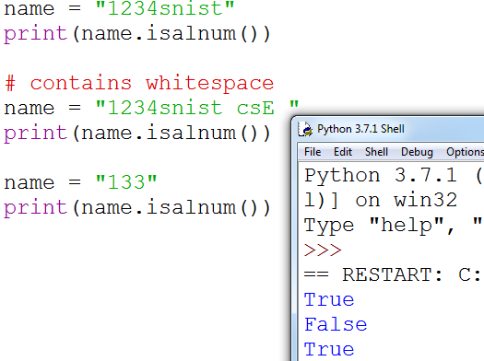

Slide 62
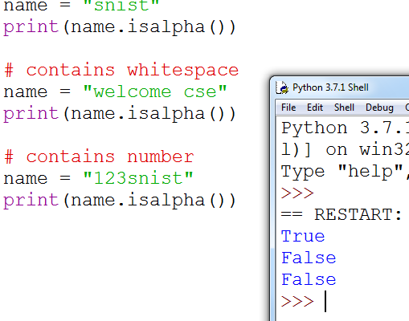
Python String isalpha():
The isalpha() method returns True if all characters in the string are alphabets.
If not, it returns False.

Slide 63
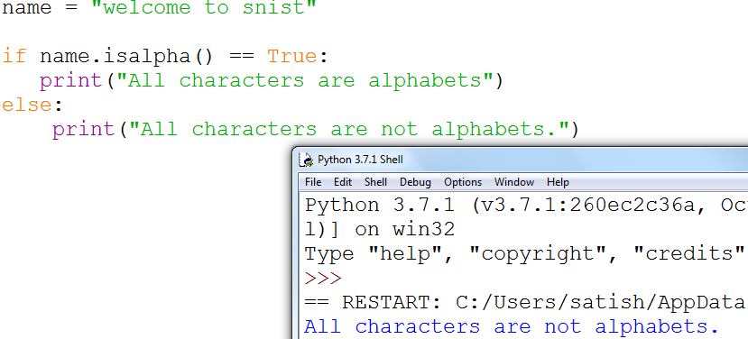

Slide 64
Python String isdigit()
The isdigit() method returns True if all characters in a string are digits. If not, it returns False.
Return Value from isdigit()
The isdigit() returns:
True if all characters in the string are digits.
False if at least one character is not a digit.

Slide 65
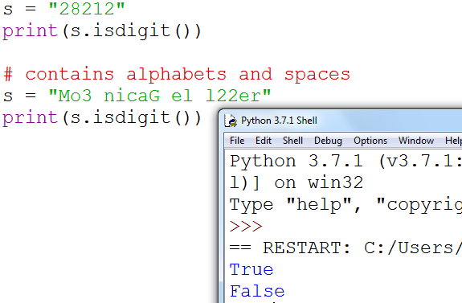

Slide 66
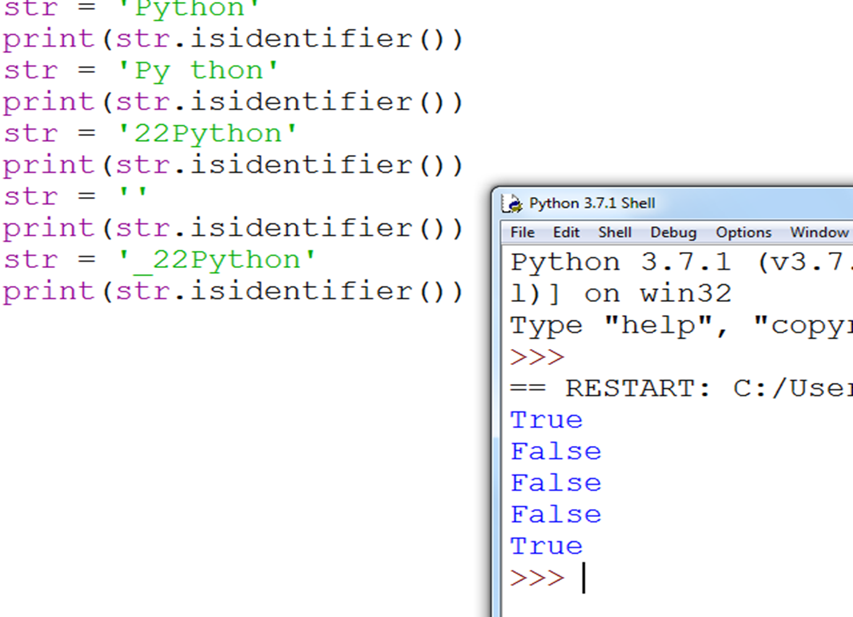
Python String isidentifier():
The isidentifier() method returns True if the string is a valid identifier in Python. If not, it returns False.

Slide 67




Replace a string with another string:
s.replace(oldstring,newstring)
Inside s, every occurrence of oldstring will be replaced with newstring.

Slide 68


String objects are immutable then how we can change the content by using replace() method:
Once we create string object, we cannot change the content.
This non changeable behavior is nothing but immutability.
If we are trying to change the content by using any methods, then with those changes a new object will be changed and changes won’t be happened in existing object.
Hence with replace() method also a new object got created but existing object won’t be changed.

Slide 69




Splitting of Strings:
We can split the given string according to specified seperator by using split() method.
Syntax:split(seperator)
The default seperator is space. The return type of split() method is List.

Slide 70



Joining of String:
We can join a group of strings(list or tuple) with the given seperator.
Syntax:s=seperator.join(group of strings)

Slide 71
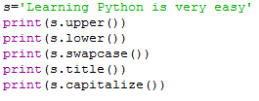

Changing case of a String:
1.upper()➔To convert all character to upper case
2.lower()➔To convert all characters to lower case
3.swapcase➔converts all lowercase characters to upper case and all upper case characters to lower case
4.title()➔To convert all characters to title case.i.e first character in every word should be upper case and all remaining characters should be in lower case.
4.capitalize➔Only first character will be converted to upper case and remaining characters can be converted to lower case

Slide 72
To check type of character present in a string:
Python contains the following methods:
1.isalnum():Returns True if all characters are alphanumeric(a to z,A to Z,0 to 9)
2.isalpha():Returns True if all characters are only alphabet symbols(a to z, A to Z)
3.isdigit():Returns True if all characters are digit only(0 to 9)
4.islower():Returns True if all characters are lower case alphabets symbols.
5.isupper():Returns True if all characters are upper case alphabets symbols.
6.istitle():Returns True if string is in title case
7.isspace():Returns True if string contains only spaces

Slide 73
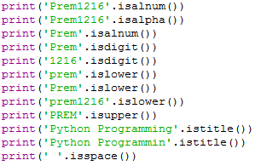


Slide 74
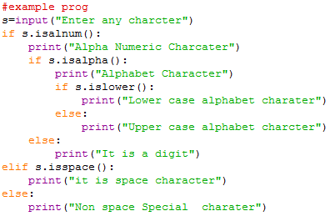
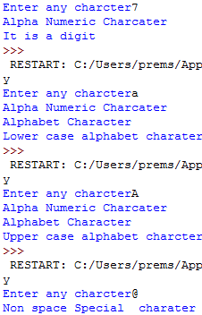

Slide 75


Formatting the Strings:
We can format the strings with the variable values by using replacement operator{} and format() method.

Slide 76
Python Method:
Method is called by its name, but it is associated to an object (dependent).
A method is implicitly passed the object on which it is invoked.
It may or may not return any data.
A method can operate on the data (instance variables) that is contained by the corresponding class
Functions:
Function is block of code that is also called by its name. (independent)
The function can have different parameters or may not have any at all. If any data (parameters) are passed, they are passed explicitly.
It may or may not return any data.
Function does not deal with Class and its instance concept.

Slide 77
Lists:
If we want to represent a group of individual objects as a single entity where insertion order preserved and duplicates are allowed, then we should go for list.
Insertion order preserved
Duplicate objects are allowed
Heterogeneous objects are allowed.
List is dynamic because based on requirement we can increase the size and decreases the size.
In list the elements will be places within square”[ ]” bracket and with comma operator.
We can differentiate duplicate elements by using index and we can preserve insertion order by using index.
Python supports both positive and negative indexes.
+ve➔left to right
-ve➔right to left
List objects are mutable .i.e, we can change the content.

Slide 78





Creation of List Objects:
1.we can create empty list objects as follows…
2.if we know elements already then we can create list as follows
3.with dynamic input

Slide 79






4.With list() function:
5.with split() function:

Slide 80

Accessing Elements of List:
We can access elements of the list ether by using index or by using slice operator(: )
1.By using index:
List follows zero based index. i.e. index of first element is zero.
List supports both +ve and –ve indexes.

Slide 81


2.By using slice operator:
Syntax:list1=list2[start:stop:step]
start➔it indicates the index where slice has to start, default value is 0
stop➔it indicates the index where slice has to end, default value is max allowed index of list i.e. length of the list
step➔increment value, default value is 1

Slide 82


List vs. mutability:
Once we create a list object, we can modify its content.
Hence List objects are mutable.

Slide 83



Traversing the elements of List:
The sequential access of each element in the list is called traversal.
1.By using while loop:

Slide 84


Functions of List:
len():
Returns the number of elements present in the list
max():
It returns the item from the list with the highest value.

Slide 85


min():
The method min() returns the elements from the list with minimum value.
Syntax:min(list)

Slide 86

sum():
It returns the sum of all the elements in the list.

Slide 87

count():
It returns the number of occurrences of specified item in the list

Slide 88


index():
Returns the index of first occurrence of the specified item.
If the specified element not present in the list then we will get ValuError.
Hence before index() method we have to check whether item present in the list or not by using in operator.
>>>print(10 in n)

Slide 89



Manipulating elements in List:
append():
We can use append() function to add item at the end of the list.

Slide 90




insert() function:
To insert item at specified index position.
If the specified index is greater than max index then element will be inserted at last position.
If the specified index is smaller than min index then element will be inserted at first position.

Slide 91

Difference between append() and insert()
extend() function:
To add items of one list to another list
Syntax:l1.extend(l2)
All items present in l2 will be added to l1
append() | insert()
In List when we add any element it will come in last i.e., it will be last element. | In List we can insert any element in specified index position.

Slide 92



remove() function:
We can use this function to remove specified item from the list.
If the item present multiple times then only first occurrence will be removed.
If the specified item is not present in the list then we will get ValueError.
Hence before using remove() method first we have to check specified element present in the list or not by using in operator.

Slide 93


pop() function():
It removes and returns the last element of the list.
This is only function which manipulates list and returns some element.
If the list is empty then pop() function raises IndexError
pop() is the only function which manipulates the list and returns some value.
In general we can use append() and pop() functions to implement stack data structure by using list, which follows LIFO.

Slide 94
In general we can use pop() function to remove last element of the list.But we can use to remove elements based on index.
n.pop(index)➔To remove and return element present at specified index.
n.pop()➔To remove and return last element of the list.
Difference between remove() and pop()
List objects are dynamic. i.e. based on requirement we can increase and decrease the size.
append(),insert(),extend()➔increasing size/growable nature
remove(),pop()➔decreasing size/shrinking nature
remove() | pop()
1.We can use to remove specified element from the List. | 1.We can use to remove last element from the List.
2.It can’t return any value | 2.It returned removed element.
3.If specified element not available then we will get VALUE EROR. | If list is empty then we will get Error.

Slide 95


reverse():
We can reverse() order of elements of list.

Slide 96


sort() function:
In list by default order is preserved.
If we want to sort the elements of list according to default natural sorting order then we should go for sort() method.
For numbers ➔default natural sorting order is Ascending order
For strings ➔default natural sorting order is Alphabetical order
To use sort() function, compulsory list should contain only homogeneous elements, otherwise we will get TypeError

Slide 97




In python 2 if List contains both numbers and Strings then sort() function first sort numbers followed by srtings.
But in python 3 it is invalid.
We can sort according to reverse of default natural sorting order by using reverse=True argument.

Slide 98




Aliasing and Cloning of List objects:
The process of giving another reference varaible to the exisiting list is called aliasing.
The problem in this approach is by using one reference variable if we are changing content, then those changes will be reflected to other reference variable.
To overcome this problem we should go for cloning.
x,y
[40,30,10,60]
x,y
[40,30,10,60]
666

Slide 99




The process of creating exactly duplicate independent object is called cloning.
We can implement cloning by using slice operator or by using copy() function
1.By using slice operator:
2.By using copy() function:
=operator meant for aliasing
copy() function meant for cloning

Slide 100



We can use * and + operators for List Objects.
1.Concatenation operator(+):
We can + to concatenate 2 lists into a single list.
To use + operator compulsory both arguments should be list objects, otherwise we will get TypeError.
Ex:c=a+40➔Type Error:can only concatenate list (not “int”) to list
C=a+[40]➔valid
2.Repetition operator(*):
We can use repetition operator * to repeat elements of list specified number of times.

Slide 101


Comparing List Objects:
We can use comparison operators for List Objects.
Whenever we are using comparison operators(==,!=) foe List objects then the following should be considered.
1.The number of elements
The order of elements
The content of elements(Case sensitive)

Slide 102




When ever we are using relational operators (<,>,<=,>=) between list objects, only first element comparison will be performed.

Slide 103




clear() function:
We can use clear() function to remove all elements of list.
Nested Lists:
Some times we can take one list inside another list.
Such type of Lists are called nested Lists.
We can access nested list elements by using index just like accessing multi dimensional array elements

Slide 104


Nested List as Matrix:
In python we can represent matrix by using nested lists.

Slide 105
Tuple:
Tuple is exactly same as List except that is immutable. i.e. once we creates Tuple object, we cannot perform any changes in that object.
Hence Tuple is Read Only Version of List.
If our data is fixed and never changes then we should go for Tuple.
Insertion order is preserved.
Duplicates are allowed
Heterogeneous objects are allowed.
We can preserve insertion order and we can differentiate duplicate objects by using index.
Hence index will play important role in Tuple.
Tuple supports both +ve and –ve index.
We can represent Tuple elements within parenthesis “()” and with comma separator.
Parenthesis are optional but recommended to use.

Slide 106





Example:
When tuple contains single value then compulsory value should end with comma, otherwise it is not treated as tuple.

Slide 107




Tuple Creation:
1.t=()
Creation of empty tuple.
2.t=(16,) or t=16,
Creation of single valued tuple, parenthesis are optional, should ends with comma.
3.t=10,20,30 or t=(10,20,30)
Creation of multi values tuples & parenthesis are optional
4.By suing tuple() function:

Slide 108




Accessing elements of Tuple :
We can access either by index or slice operator.
1.By using index:
2.By using slice operator:

Slide 109

Tuple vs. immutability:
Once we creates tuple, we cannot change its content.
Hence tuple object are immutable.
We can apply + and * operators for tuple.

Slide 110


Functions of Tuple:
len():
To return number of elements present in tuple.
count():
To return number of occurrences of given elements in the tuple.
index():
Return index of first occurrence of the given element.
If the specified element is not available then ValueError.
sorted():
To sort elements based on default natural sorting order.

Slide 111
min() and max() functions:
These functions return min and max values according o default natural sorting order.
cmp():
It compares the elements of both tuples.
If both tuples are equal then returns 0
If the first tuple is less than second tuple then it returns -1
If the first tuple is greater than second tuple then it returns +1
Note:cmp() function is available only in python 2 but not in Python 3

Slide 112






Tuple Packing and Unpacking:
We can create a tuple by packing a group of variables.
Here a,b,c are packed into tuple this is known as Tuple Packing.
Tuple unpacking is the reverse process of tuple packing.
We can unpack a tuple and assign its value to different variables.
At the time of tuple unpacking the number of variables and number of values should be same. Otherwise we will get ValueError.

Slide 113

Difference between List and Tuple:

Slide 114
Dictionaries: Accessing values in dictionaries, working with dictionaries, Properties Functions and Methods.
Dictionaries:
We can use List, Tuple and Set to represent a group of individual objects as a single entity.
If we want to represent a group of objects as key-value pairs then we should go for dictionary.
Ex:rollno---name
Phone number---address
Ipaddress---domain name
Duplicate keys are not allowed but values can be duplicated.
Heterogeneous objects are allowed for both key and values.
Insert order is not preserved
Dictionaries are mutable.
Dictionaries are dynamic
Indexing and slicing concepts are not applicable.

Slide 115

Note: In C++ and java Dictionaries are known as “Map” where as in Perl and Ruby it is known as “Hash”.
Creating the dictionary :
The dictionary can be created by using multiple key-value pairs enclosed with the small brackets () and separated by the colon (:).
The collections of the key-value pairs are enclosed within the curly braces {}.
Syntax:
d={} or d=dict()
d={key:value,key:value}

Slide 116



Slide 117


Accessing values in dictionaries:
The values can be accessed in the dictionary by using the keys as keys are unique in the dictionary.
If the specified key is not available then we will get KeyError.
We can prevent this by checking whether key is already available or not by using has_key() function or by using in operator.
If key value is available it returns 1 otherwise 0
But has_key() function is available only in Python 2 but not in Python 3.
Hence compulsory we have to use in operator.

Slide 118


Task: write a program to enter name and percentage marks in a dictionary and display information on the screen.

Slide 119


How o update dictionaries?
d[key]=value
If the key is not available then a new entry will be added to the dictionary with the specified key-value pair.
If the key is already available then old value will be replaced with new value.

Slide 120


How to delete elements from dictionary?
del d[Key]
It deletes entry associated with the specified key.
If the key is not available then we will get KeyError.

Slide 121




d.clear():
To remove all entries from the dictionary
del d:
To delete total dictionary. Now we cannot access d

Slide 122
Functions:
dict():
To create a dictionary
d=dict()➔It creates empty dictionary
d=dict({16:”Prem”,17:”Kannaya”})➔It creates dictionary with specified elements.
d=dict([16,”Prem”),(17,”Kanna”),(18,”Kittu”)])➔it creates dictionary with the given list of tuple elements.
len():
Returns the number of items in the dictionary.
clear():
to remove all the elements from the dictionary

Slide 123


get():
To get the value associated with the key.
d.get(key)
If the key is available then returns the corresponding value otherwise returns None.
It wont raise any error.
d.get(key,default value)
If the key is available then returns the corresponding value otherwise returns default value.

Slide 124


pop():
d.pop(key)
It removes the entry associated with the specified key and returns the corresponding value.
If the specified key is not available then we will get KeyError.

Slide 125


popitem():
It removes an arbitrary item (key-value) from the dictionary and returns it.
If the dictionary is empty then we will get KeyError.
d={}
print(d.popitem())➔keyError:’popitem():dictionary is empty’.

Slide 126




keys():
It returns all keys associated with dictionary
values():
It returns all values associated with the dictionary.

Slide 127




items():
It returns list of tuple representing key-value pairs.
[(k,v),(k,v)(k,v)]
copy():
To create exactly duplicate dictionary(cloned copy)
d1=d.copy()

