Slide 1
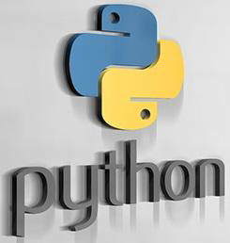
Prepared By
K Nalini
Assistant Professor
Dept., of. IT

Slide 2
UNIT – I
Contents
Introduction to Python: History
Features
Modes of Execution
Setting up path
Working with Python Basic Syntax
Variable and Data Types
Operators
Conditional Statements(If ,If- else ,Nested if-else)
Looping( for, While Nested loops)
Control Statements(Break , Continue ,Pass)

Slide 3
Introduction to Python: History

Slide 4
Introduction to Python
Python is a high-level, interpreted, interactive and object-oriented scripting language. It is designed to be highly readable.
Python is Interpreted: Python is processed at runtime by the interpreter. You do not need to compile your program before executing it .
Python is Interactive: You can actually sit at a Python prompt and interact with the interpreter directly to write your programs.
Python is Object-Oriented: Python supports Object-Oriented style or technique of programming that encapsulates code within objects.
Python is a Beginner's Language: Python is a great language for the beginner-level programmers and supports the development of a wide range of applications from simple text processing to WWW browsers to games.

Slide 5
History
Python was developed by Guido van Rossum in the late eighties and early nineties at the National Research Institute for Mathematics and Computer Science in the Netherlands.
Python is derived from many other languages, including ABC, Modula-3, C, C++, Algol-68, SmallTalk, Unix shell, and other scripting languages.
Python is copyrighted. Like Perl, Python source code is now available under the GNU General Public License (GPL).
python first version is 1.0 and latest version is 3.6
Major implementations of Python are Cpython, IronPython, Jpython,MicroPython,PyPy

Slide 6
Features
Simple & Easy to Learn
Free and Open Source
Multi Purpose [ Web,GUI, Scripting etc..]
High Level
Embedded
Extensive Standard Library
Cross Platform Compatibility
Interactive Mode
Interpreted
Object Oriented
Portable, Extendable
Databases and GUI Programming
Scalable and Dynamic in nature
Automatic Garbage Collection

Slide 7
A simple language which is easier to learn
Python has a very simple and elegant syntax. It's much easier to read and write when compared to other languages like: C++, Java, C#.
Free and open-source
You can freely use and distribute Python, even for commercial use. Not only can you use and distribute software's written in it, you can even make changes to the Python's source code.
Portability
You can move Python programs from one platform to another, and run it without any changes. It runs seamlessly on almost all platforms including Windows, Mac OS X and Linux.
Extensible and Embeddable
Suppose an application requires high performance. You can easily combine pieces of C/C++ or other languages with Python code. This will give your application high performance as well as scripting capabilities which other languages may not provide out of the box.

Slide 8
A high-level, interpreted language
Unlike C/C++, you don't have to worry about difficult tasks like memory management, garbage collection and so on. Likewise, when you run Python code, it automatically converts your code to the language your computer understands. You don't need to worry about any lower-level operations.
Large standard libraries to solve common tasks
Python has a number of standard libraries which makes life of a programmer much easier since you don't have to write all the code yourself.
Object-oriented
Everything in Python is an object. Object oriented programming (OOP) helps you solve a complex problem very easily With OOP, you are able to divide these complex problems into smaller sets by creating objects.

Slide 9
Applications of Python
Automation Applications
Data Analytics & Visualization
Scientific Applications
Web Applications
Web Scrapping
Administration Script
Networking with IOT Applications
Test Cases
GUI Applications
Gaming Applications
Animation Applications

Slide 10
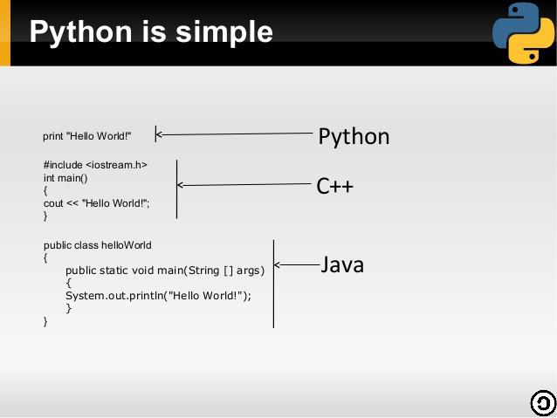


Slide 11
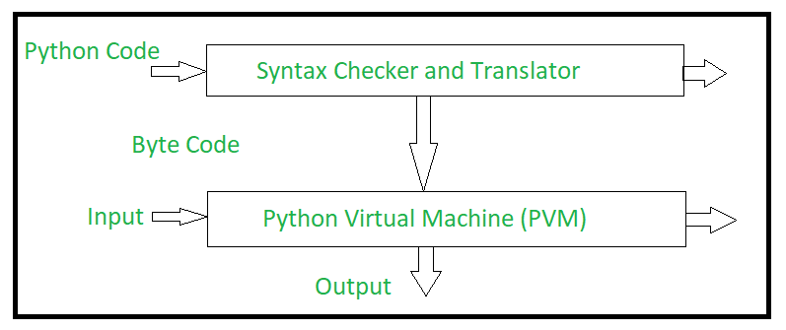
Execution of a Python Program

Slide 12
The Python source code goes through the following to generate an executable code :
Step 1: The python compiler reads a python source code or instruction. Then it verifies that the instruction is well-formatted, i.e. it checks the syntax of each line. If it encounters an error, it immediately halts the translation and shows an error message.
Step 2: If there is no error, i.e. if the python instruction or source code is well-formatted then the compiler translates it into its equivalent form in an intermediate language called “Byte code”.
Step 3: Byte code is then sent to the Python Virtual Machine(PVM) which is the python interpreter. PVM converts the python byte code into machine-executable code. If an error occurs during this interpretation then the conversion is halted with an error message.

Slide 13
Modes of Execution
In Python, there are two options/methods for running code:
Interactive mode
Script mode
In this article, we will see the difference between the modes and will also discuss the pros and cons of running scripts in both of these modes.

Slide 14
Interactive mode
Interactive mode, also known as the REPL (Read, Evaluate, Print, Loop) provides us with a quick way of running blocks or a single line of Python code. The code executes via the Python shell, which comes with Python installation. Interactive mode is handy when you just want to execute basic Python commands.
To access the Python shell, open the terminal of your operating system and then type "python". Press the enter key and the Python shell will appear. This is the same Python executable you use to execute scripts, which comes installed by default on Mac and Unix-based operating systems.
Ex:
C:\Windows\system32>python Python 3.5.0 (v3.5.0:374f501f4567, Sep 13 2015, 02:27:37) [MSC v.1900 64 bit (AMD64)] on win32 Type "help", "copyright", "credits" or "license" for more information.
>>>

Slide 15
The >>> indicates that the Python shell is ready to execute and send your commands to the Python interpreter. The result is immediately displayed on the Python shell as soon as the Python interpreter interprets the command.
To run your Python statements, just type them and hit the enter key. You will get the results immediately, unlike in script mode. For example, to print the text "Hello World", we can type the following:
>>> print("Hello World")
Hello World
>>>

Slide 16
Pros and Cons of Interactive Mode
The following are the advantages of running your code in interactive mode:
Helpful when your script is extremely short and you want immediate results.
Faster as you only have to type a command and then press the enter key to get the results.
Good for beginners who need to understand Python basics.
The following are the disadvantages of running your code in the interactive mode:
Editing the code in interactive mode is hard as you have to move back to the previous commands or else you have to rewrite the whole command again.
It's very tedious to run long pieces of code.

Slide 17
Script mode:
If you need to write a long piece of Python code or your Python script spans multiple files, interactive mode is not recommended. Script mode is the way to go in such cases. In script mode, You write your code in a text file then save it with a .py extension which stands for "Python". Note that you can use any text editor for this, including Sublime, Atom, notepad++, etc.
If you are in the standard Python shell, you can click "File" then choose "New" or simply hit "Ctrl + N" on your keyboard to open a blank script in which you can write your code. You can then press "Ctrl + S" to save it.
After writing your code, you can run it by clicking "Run" then "Run Module" or simply press F5.

Slide 18
After writing your code, you can run it by clicking "Run" then "Run Module" or simply press F5.
Let us create a new file from the Python shell and give it the name "hello.py". We need to run the "Hello World" program. Add the following code to the file:
print("Hello World") Click "Run" then choose "Run Module". This will run the program:

Slide 19
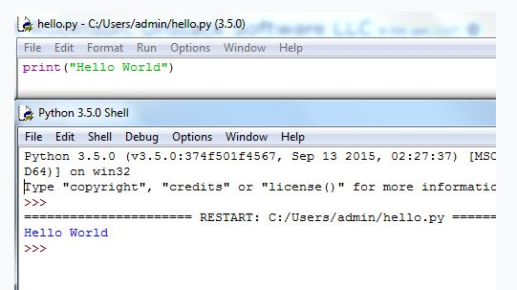
Output:

Slide 20
Open the terminal of your operating system then navigate to the location of the file. Of course, you will use the "cd (change directory)" command for this.
Once you reach the directory with the file, you will need to invoke the Python interpreter on the file. This can be done using the following syntax:
> python <filename>
To run the Python file from the terminal, you just have to type the python keyword followed by the name of the file. In our case, we need to run a file named "hello.py". We need to type the following on the terminal of the operating system:
> python hello.py Hello World

Slide 21
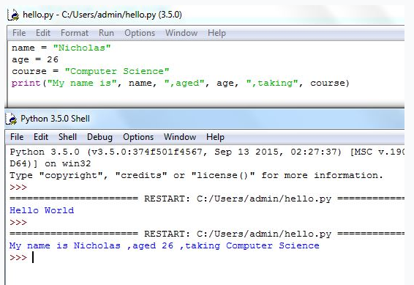
The following example demonstrates how to execute the multiple lines of code using the Python script.

Slide 22
Pros and Cons of Script Mode
The following are the advantages of running your code in script mode:
It is easy to run large pieces of code.
Editing your script is easier in script mode.
Good for both beginners and experts.
The following are the disadvantages of using the script mode:
Can be tedious when you need to run only a single or a few lines of cod.
You must create and save a file before executing your code.

Slide 23
Installation and Setting up path

Slide 24
Installation and Setting up path
To install Python on a Windows machine, follow these steps:
1. Open a web browser and go to http://www.python.org.
2. Click the Download link.
3. You should see several links here, with names such as Python 2.5.x and Python 3.5.x Windows installer. Click the Windows installer link to download the installer file.
4. Store the Windows Installer file somewhere on your computer, such as C:\download\ python-2.5.x.msi. (Just create a directory where you can find it later.)
5. Run the downloaded file by double-clicking it in Windows Explorer. Just accept the default settings, wait until the installation is finished, and you’re ready to roll!

Slide 25
Run the Python Integrated Development Environment (IDLE) by selecting Start ➤Programs ➤ Python2 ➤ IDLE (Python GUI).
This menu option will probably include your version number, as in Python 2.5.

Slide 26
Keywords in Python
Keywords are the reserved words in Python. We can not use a keyword as variable name, function name or any other identifier. They are used to define the syntax and structure of the Python language.
In Python, keywords are case sensitive. There are 33 keywords in Python. All the keywords except True, False and None are in lower case and they must be written as it is. The list of all the keywords are given below.

Slide 27
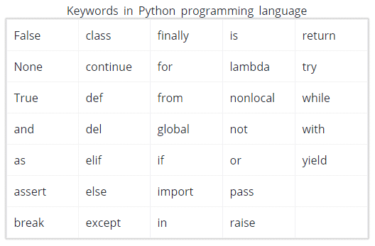

Slide 28
Python Identifiers
Identifier is the name given to entities like class, functions, variables etc. in Python.
It helps differentiating one entity from another.
Identifiers can be a combination of letters in lowercase(atoz) or uppercase(AtoZ) or digits(0to9) or anunderscore(_).
Names like myClass, var_1 and print_this_to_screen, all are valid example.
An identifier cannot start with a digit. 1variable is invalid, but variable1 is perfectly fine.
Keywords cannot be used as identifiers.
>>> global = 1
File "<interactive input>", line 1
global = 1
^
SyntaxError: invalid syntax

Slide 29
Python Statement
Instructions that a Python interpreter can execute are called statements.
For example, a = 1 is an assignment statement.
Multi-line statement
In Python, end of a statement is marked by a newline character. But we can make a statement extend over multiple lines with the line continuation character (\).
For example:
a = 1 + 2 + 3 + \
4 + 5 + 6 + \
7 + 8 + 9

Slide 30
Python Comments
Comments are very important while writing a program. It describes what's going on inside a program so that a person looking at the source code does not have a hard time figuring it out. In Python, we use the hash(#) symbol to start writing a comment.
It extends up to the new line character. Comments are for programmers for better understanding of a program. Python Interpreter ignores comment.
Example
#This is a comment
#print out Hello
print('Hello')
Multi-line comments
If we have comments that extend multiple lines, We can use triple quotes, either '''or """. These triple quotes are generally used for multi-line strings. But they can be used as multi-line comment as well.
Example
"""This is also a
Perfect example of
multi-line comments"""

Slide 31
Python Input [Reading Input from the Keyboard ]
To allow flexibility we might want to take the input from the user.
input operation: reading data that has been typed on the keyboard
In Python, input( ) –input function is used to take input from the user
The syntax for input() is :
variable = input(prompt)
Example:
>>>name = input('What is your name? ')
where prompt is the string we wish to display on the screen. It is optional.

Slide 32
Python Output Using print( ) function
We use the print( ) function to output data to the standard output device (screen).
Example
>>>print('This sentence is output to the screen')
# Output: This sentence is output to the screen
>>>a = 5
>>>print('The value of a is', a)
# Output: The value of a is 5

Slide 33
Escape Characters
An escape character is a special character that is preceded with a backslash (\), appearing inside a string literal.
When a string literal that contains escape characters is printed, the escape characters are treated as special commands that are embedded in the string.
Some of Python‟s escape characters
Escape Character Effect
\n Causes output to be advanced to the next line.
\t Causes output to skip over to the next horizontal tab position.
\’ Causes a single quote mark to be printed.
\“ Causes a double quote mark to be printed.
\\ Causes a backslash character to be printed.

Slide 34
Displaying Multiple Items with the + Operator
+ operator is used with two strings, it performs string concatenation. This means that it appends one string to another.
>>> print('This is ' + 'one string.')
O/P : This is one string.
>>> print('Enter the amount of ' + \
'sales for each day and ' + \
'press Enter.')
O/p : Enter the amount of sales for each day and press Enter.

Slide 35
Built-in function : id( )
id (object)
It returns identity of an object.
It is the address of object in memory
It will be unique and constant throughout the lifetime of an object
Ex: a=20
b=a
print (“value of a and b before incrementation”)
print(“id of a:”,id(a))
print(“id of b:”,id(b))
b=a+1
print(“Value of a and b after incrementation”)
print(“id of b: “ , id(b))

Slide 36
Built-in function : type( )
It is used to identity the type of the object
Ex: a=10
print(“Type of a:”,type(a))
b=“Hello”
print(“Type of b:”, type(b))
c=[ ]
print(“Type of c:”,type(c))
Output: Type of a:<class ‘int'>
Type of b:<class ‘str’>
Type of c:<class ‘list’>

Slide 37
Variable and Data Types

Slide 38
Python Variables
A variable is a location in memory used to store some data(value). The rules for writing a variable name is same as the rules for writing identifiers in Python. We don't need to declare a variable before using it. In Python, we simply assign a value to a variable and it will exist.
We don't even have to declare the type of the variable. This is handled internally according to the type of value we assign to the variable.
Variable assignment
We use the assignment operator (=) to assign values to a variable. Any type of value can be assigned to any valid variable.
Example
a = 5
b = 3.2
c = "Hello“
Note: Every Variable in Python is a Object

Slide 39
Expressions
An expression is a combination of values, variables, and operators. A value all by itself is considered an expression, and so is a variable.
EX: 1
>>> 1 + 1
2
EX: 2
>>> x=3
>>> x+4
7
>>>

Slide 40
Data types
A Data type represents the type of data stored into a variable or memory. The data types which are already available in python language are called Built-in data types. The data types which can be created by the programmers are called User-defined data types.
Built-in data types:
None Type
Numeric types
Sequences
Sets
Mappings

Slide 41
The None Type:
In a Python, the ‘None’ data type represents an object that does not contain any value. In languages like Java, it is called ‘null’ object. In Boolean expression ‘None’ data type represents ‘False’.
Numeric Types:
The numeric types represents numbers. There are three sub types.
Int: This value is represented by int class. It contains positive or negative whole numbers (without fraction or decimal). In Python there is no limit to how long an integer value can be.
Float: This value is represented by float class. It is a real number with floating point representation. It is specified by a decimal point. Optionally, the character e or E followed by a positive or negative integer may be appended to specify scientific notation.
Complex: Complex number is represented by complex class. It is specified as (real part) + (imaginary part)j. For example – 2+3j

Slide 42
Representing Binary, octal, Hexadecimal Numbers
A Binary number should be written by prefixing 0b(or)0B
Ex:0b101011 (or)0B101011
A Octal number should be written by prefixing 0o(or)0O
Ex: ex:0o101011 (or)0O101011
A Hexadecimal number should be written by prefixing 0x(or)0X
Ex: 0x101011 (or)0X101011
Type conversion or coercion possible in python
Boolean: Data type with one of the two built-in values, True or False. Boolean objects that are equal to True are truthy (true), and those equal to False are falsy (false). But non-Boolean objects can be evaluated in Boolean context as well and determined to be true or false. It is denoted by the class bool.
Note – True and False with capital ‘T’ and ‘F’ are valid Booleans otherwise python will throw an error.

Slide 43
Sequence Type
In Python, sequence is the ordered collection of similar or different data types. Sequences allows to store multiple values in an organized and efficient fashion. There are several sequence types in Python –
str
bytes
bytearray
list
tuple
range

Slide 44
String:In Python, Strings are arrays of bytes representing Unicode characters. A string is a collection of one or more characters put in a single quote, double-quote or triple quote. In python there is no character data type, a character is a string of length one. It is represented by str class.
Ex: str=‘welcome’
str=“welcome”
str1=“””I'm a Geek and I live in a world of "Geeks“.”””
bytes: The bytes data type represents a group of byte numbers just like an array does. A byte array can store any positive integer the range from 0 to 255 and it cannot even store negative numbers.
Ex: elements=[10,20,0,50,60]#list of byte numbers
x=bytes(elements)#convert the list in to byte array
Print(x[0])
10
for i in x:print(i)
10,20,0,50,60

Slide 45
bytearray: It Is similar to byte data type. The difference is that the bytes type array cannot be modified but the bytearray can be modified.
Ex: elements=[10,20,0,50,60]#list of byte numbers
x=bytes(elements)#convert the list in to byte array
Print(x[0])
10
x[0]=88
x[1]=87
list data type: Lists are just like the arrays, declared in other languages which is a ordered collection of data. It is very flexible as the items in a list do not need to be of the same type.
Ex: list=[10,-20,0,50.0,’vijay’]
Print(list)
Print(list[1:3])
List[0]=80

Slide 46
tuple datatype: Just like list, tuple is also an ordered collection of Python objects. The only difference between tuple and list is that tuples are immutable i.e. tuples cannot be modified after it is created. It is represented by tuple class.
Ex: tpl=[10,-20,0,50.0,’vijay’]
Print(tpl)
Print(tpl[1:3])
range datatype: The range datatype represents a sequence of numbers. The numbers in the range are not modifiable.
Ex:
r=range(10)
for i in r:print(i)
0,1,2,3,4,5,6,7,8,9

Slide 47
Sets: In Python, Set is an unordered collection of data type that is iterable, mutable and has no duplicate elements. The order of elements in a set is undefined though it may consist of various elements.
set datatype
frozenset datatypes
set datatype:
Set with the use of String: {'F', 'o', 'G', 's', 'r', 'k', 'e'}
Set with the use of List: {'Geeks', 'For'}
Set with the use of Mixed Values {1, 2, 4, 6, 'Geeks', 'For'}
s.remove(6)
s.update([20,30])

Slide 48
frozenset datatypes:
The frozenset datatype is same as the set datatype. The main difference is that the elements in the set datatype can be modified:
Ex: fs=frozenset(“welcome”)
print(fs)
mapping types: A map representes a group of elements in the form of key value pairs so that when the key is given we can retrive the associated value.
d={10:’kamal’,11:’raju’}
d={}
D[10]=‘kamal’

Slide 49
Operators
Operators are special symbols in Python that carryout arithmetic or logical computation.
The value that the operator operates on is called the operand.
Operators are used to perform specific operations on one more operands(variables) and provides a result
Arithmetic operators
Relational Operators
Logical Operators
Assignment Operators
Bitwise Operators
Membership Operators
Identity Operators

Slide 50
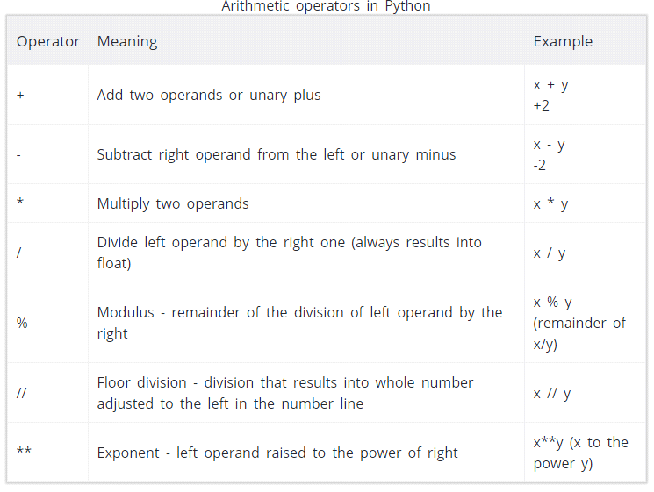
Arithmetic operators
Arithmetic operators are used to perform mathematical operations like addition, subtraction, multiplication etc.

Slide 51
Ex: x=15 Output
Y=4 x+y=19
Print(‘x+y=’,x+y) x-y=11
Print(‘x-y=’,x-y) x*y=60
Print(‘x*y=’,x*y) x/y=3.75
Print(‘x/y=’x/y) x||y=3
Print(‘x||y=’,x||y) x**y=50625
Print(‘x**y=’,x**y)

Slide 52
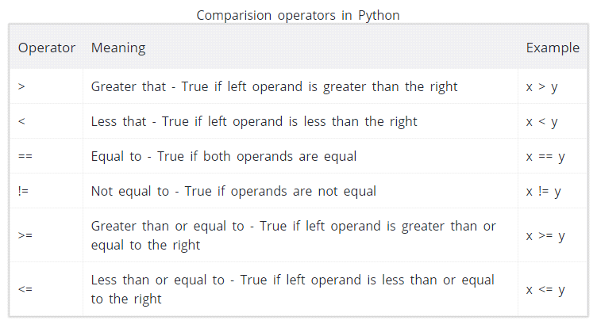
Relational / Comparison operators
Comparison operators are used to compare values. It either returns True or False according to the condition. Used in conditional Statements.

Slide 53
Eg: x=10 Output
Y=12 x>y is FALSE
Print(‘x>y is’,x>y) x<y is TRUE
Print(‘x<y is’,x<y) x==y is FALSE
Print(‘x==y is’,x==y) x!=y is TRUE
Print(‘x!=y is’,x!=y) x>=y is FALSE
Print(‘x>=y is’,x>=y) x<=y is TRUE
Print(‘x<=y is’,x<=y)

Slide 54
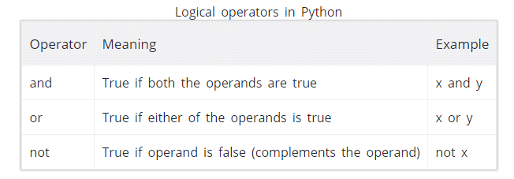
Logical operators
Logical operators are the and, or, not operators. Based on Boolean Algebra returns results as either True or False

Slide 55
Eg x=True Output
Y=False x and y is false
Print(‘x and y is’,x and y) x or y is true
Print(‘x or y is’,x or y) not x is false
Print(‘not x is ‘,not x)

Slide 56
Assignment operators
Assignment operators are used in Python to assign values to variables. a = 5 is a simple assignment operator that assigns the value 5 on the right to the variable a on the left.
Multiple Assignments: Same value can be assigned to more than one variable

Slide 57
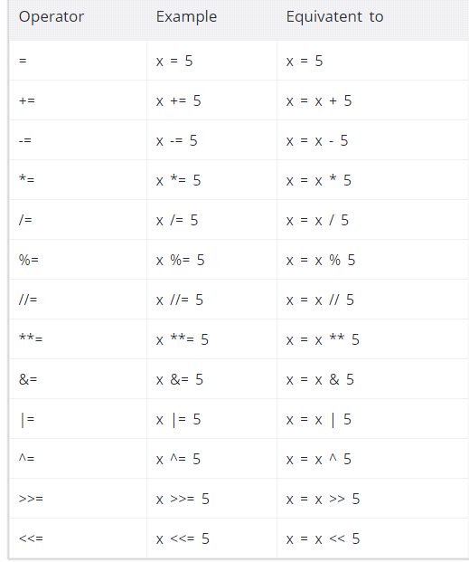

Slide 58
Bitwise operators
Bitwise operators converts the operands data in the form of binary format performs operations on the binary values and gives the result in the form of decimal format.
Operator Meaning
& bitwise AND
| Bitwise OR
~ Bitwise NOT
^ Bitwise XOR
>> Bitwise right shift
<< Bitwise left shift

Slide 59
Ex: x=10 Output
Y=4 0
Print(x&y) 4
Print(x|y) -11
Print(x~y) 14
Print(x^y) 2
Print(x>>y) 40
Print(x<<y)

Slide 60
Special operators
Python language offers some special type of operators like the identity operator or the membership operator.
Membership operators
in and not in are the membership operators in Python.
They are used to test whether a value or variable is found in a sequence(string, list, tuple, set and dictionary).
Operators Description
in Returns to true if it finds a variable in given sequence else false Example 5 in x
not in Returns to true if it does not find a variable in given sequence else false
Example 5 not in x

Slide 61
Identity Operators
is and is not are the identity operators in Python.
They are used to check if two values(or variables) are located on the same part of the memory. [used to compare memory locations of 2objects]
Two variables that are equal does not imply that they are identical.
Operator Meaning
is Returns to true if variable on either side of operator are referring to same object else false
Example : x is True
is not Returns to false if variable on either side of operator are referring to same
Example: x is not True

Slide 62
Python Operators Precedence
The following table lists all operators from highest precedence to lowest.
Operator Description
** Exponentiation (raise to the power)
~ + - Complement, unary plus and minus
*/ % // Multiply, divide, modulo and floor division
+ - Addition and subtraction
>> << Right and left bitwise shift
& Bitwise 'AND'
^ | Bitwise exclusive `OR' and regular `OR'
<= < > >= Comparison operators
<> == != Equality operators
= %= /= //= -= += *= **= Assignment operators
is is not Identity operators
in not in Membership operators
not or and Logical operators

Slide 63
Conditional Statements (if ,if- else ,Nested if-else)

Slide 64
Conditional Statements (if ,if- else ,Nested if-else)
Generally Python Program execution starts from the first line, executes each and every statement only once and stops the execution of the program when control reached to the last line.
These Statements are used to disturb the normal flow of execution of the program.
Block:
The set of statements which are following some space indentation is known as a Block.
Block begins when the indentation increases.
Blocks can contain other Blocks.
Blocks end when the indentation decreases to zero or to a containing blocks indentation.

Slide 65
Python supports 3 types of conditional statements. They are
If
else
elif
1. if:
Condition returns true then it executes the if block otherwise if block execution is skipped.
Syntax: if condition: statement (one statement)
Or
if condition :
Statement 1
Statement 2 (multiple statements)
--------------

Slide 66
EX:
Print (“begin”)
x = input (“enter a positive number”)
i= int(x)
if i<10:
print (“given number is 1 digit number”)
print (“end”)
Output 1: begin Output2: begin
enter a positive number5 enter a positive number120 Given number is 1 digit number end
end

Slide 67
2. else:
else block should be preceded by any one of the following blocks.
1.if 2.elif 3.while 4.for
else block preceding block condition returns false then only it will execute the following else block.
Syntax: if condition:
statement1
statement2
--------------
else:
statement1
statement2
--------------

Slide 68
Ex: print (“begin”)
x=input (“enter a positive number”)
i = int(x)
if x>10:
print (“Given number is 1 digit number”)
else:
print (“Given number is >=2 digit number”)
print (“end”)
output 1: output 2:
enter a positive number5 enter a positive number5
Given number is 1 digit number Given number is >=2 digit number
end end

Slide 69
3.elif:
elif block should be preceded by either if block or another elif block.
elif block preceding block returns false then only control will go to the elif block.
After reaching the control block to the elif block, if condition returns true then only it will execute elif block.

Slide 70
Ex: print (“begin”)
x = input(“enter a positive number”)
i = int(x)
if i<10:
print (“given number is 1 digit number”)
elif i<100:
print (“given number is 2 digit number”)
elif i<1000:
print (“given number is 3 digit number”)
else :
print(“given number is >=4 digit number”)
print (“end”)
Output1: Output2:
begin begin
enter a positive number5 enter a positive number15
given number is 1 digit number given number is 2 digit number
end end

Slide 71
Looping( for, while nested loops)

Slide 72
Looping( for, while nested loops)
While
In python, while loop is used to execute a block of statements repeatedly until a given a condition is satisfied.
when the condition becomes false, the line immediately after the loop in program is executed.
Ex: i =1 Output: 5050
sum =0
while i<=100:
sum = sum+i
i = i+1
print (“sum”)

Slide 73
Ex: Program for using while-else
print (“begin”) Output: begin
i =1 welcome
while i<=5: welcome
print (“welcome”) welcome
i = i + 1 welcome
else: welcome
print (“in else”) in else
print (“end”) end

Slide 74
for
for loop executes the given logic with respect to every element of the iterable object
Syntax: for variablename in iterableobject:
---------------------------
---------------------------
Ex
numbers = [0, 1, 2, 3, 4, 5, 6, 7, 8, 9]
for number in numbers:
print (number)

Slide 75
Control Statements(break , continue ,pass)

Slide 76
Control Statements(break , continue ,pass)
break
To interrupt the loop, to start a new iteration (one “round” of executing the block), or to simply end the loop we use break.
EX
print("begin")
i=1
for i in "python":
if i=='h':
break
else:
print(i)
print("end")
output
begin
p
y
t
end

Slide 77
Ex:
print (“begin”)
i =1
while True:
print (“welcome”)
i =i+1
if i==5:
break
else:
print (“if else”)
print (“end”)

Slide 78
continue
It causes the current iteration to end, and to “jump” to the beginning of the next.
It basically means “skip the rest of the loop body, but don’t end the loop.”
EX
print("begin")
i=1
for i in "python":
if i=='h':
continue
else:
print(i)
print("end")
output
begin
p
y
t
o
n
end

Slide 79
Ex
while True:
name = input("enter user name:")
if name!='Hema':
continue
password = input("Hello, Hema enter password")
if password=='hema':
break
print("access granted")
break

Slide 80
Pass
In Python programming, pass is a null statement. The difference between a comment and pass statement in Python is that, while the interpreter ignores a comment entirely, pass is not ignored.
However, nothing happens when pass is executed. It results into no operation (NOP).
Ex
sequence = {'p', 'a', 's', 's'}
for val in sequence:
pass

