Slide 1
UNIT-III
Modules
Exception Handling

Slide 2
Topics to be covered:
Modules:
Importing module,
Math module,
Random module,
Packages
Exception Handling:
Exception,
Exception Handling,
Except clause, Try? Finally clause User Defined Exceptions

Slide 3
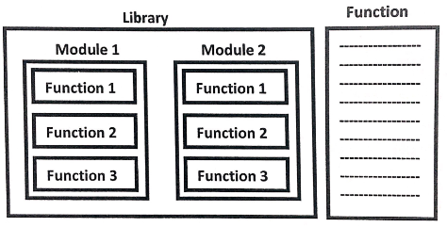
A group of lines with some name is called a Function.
A group of functions saved to a file, is called Module
A group of Modules is nothing but Library.

Slide 4
Python module is but a piece of code.
Exiting the interpreter destroys all functions and variables we created. But when we want a longer program, we create a script.
With Python, we can put such definitions in a file, and use them in a script, or in an interactive instance of the interpreter. Such a file is a module.
A python module can be defined as a python program file which contains a python code including python functions, class, or variables.
In other words, we can say that our python code file saved with the extension (.py) is treated as the module.
We may have a runnable code inside the python module.
Modules in Python provides us the flexibility to organize the code in a logical way.
To use the functionality of one module into another, we must have to import the specific module.

Slide 5
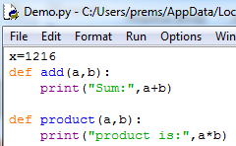
A group of functions, variables and classes saved to a file, which is nothing but module.
Every python file(.py) acts as module.
Demo module contains one variable and 2 functions.
If we want to use members of module in our program then we should import that module .

Slide 6


import modulename
We can access members by using module name.
modulename. Variable
modulename.funcion()
Whenever we are using a module in our program, for that module compiled file will be generated and stored in the hard disk permanently.

Slide 7



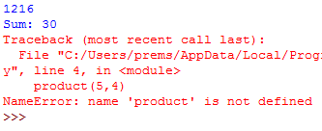
Renaming a module at the time of import (module aliasing):
from…import:
We can import particular members of module by using from…import.
The main advantage of this is we can access members directly without using module name.

Slide 8


We can import all members of a module import*
from Demo import*
Various possibilities of import:
import modulename
import module1,module2,module3
import module1 as m
import module1 as m1,module2 as m2,module3
from module import member
from module import member1,member2,member3
from module import member1 as x
from module import*

Slide 9

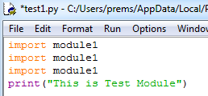

Reloading a module:
By default module will be loaded only once even though we are importing multiple times.

Slide 10
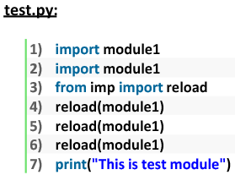
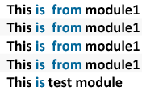

Slide 11

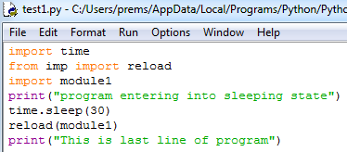

In the above program test module will be loaded only once even though we are importing multiple times.
The problem in this approach is after loading a module if it is updates outside then updates version of module1 is not available to our program.
We can solve this problem by reloading module explicitly based on our requirement.
We can reload by using reload() function from imp module.

Slide 12



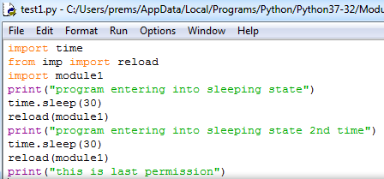
The main advantage of explicit module reloading is we can ensure that updates version is always available to our program.

Slide 13



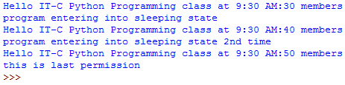

Slide 14
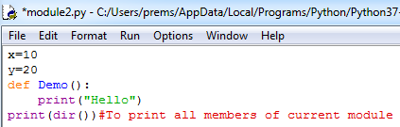
Finding members of module by using dir() function:
Python provides inbuilt function dir() to list out all members of current module or a specified module.
dir()➔To list out all members of current module.
dir(moduleName)➔To list out all members of specified module.

Slide 15
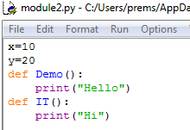

For every module at the time of execution Python Interpreter will add some special properties automatically for internal use.

Slide 16
The special variable__name__:
For every Python program, a special varaible __name__ will be added internally.
This variable stores information regarding whether the program is executed as an individual program or as a module.if the program executed as an individual program then the valu of this varaible is __main__
If the program executed as a module from some other program then the value of this variable is the name of module where it is defined.
Hence by using this __name__ variable we can identify whether the program executed directly or as a module.

Slide 17
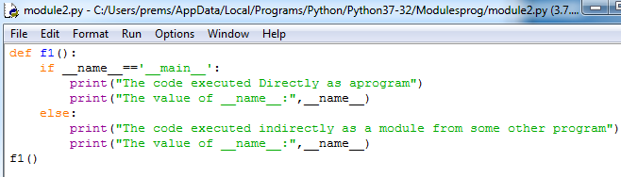

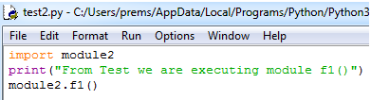


Slide 18
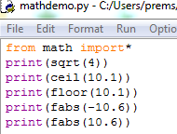

Math module:
Python provides inbuilt module math.
Tis module defines several functions which can be used for mathematical operations.
1.sqrt()
2.ceil()
3.floor()
4.fabs()
5.log(x)
6.sin(x)
7.tan(x)
Note: We can find help for any module by using help() function

Slide 19
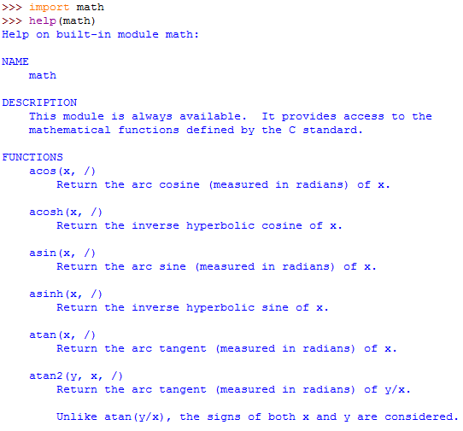

Slide 20
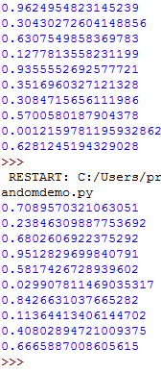

random module:
This module defines several functions to generate random numbers.
We can use these functions while developing games, in cryptography and to generate random numbers on fly for authentication.
1.random():
This function always generates some float value between 0 and 1 (not inclusive)
0<x<1

Slide 21


2.randomint():
To generate random integer between two given numbers(inclusive)

Slide 22
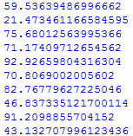

3.uniform():
It returns random float values between 2 given numbers (not inclusive)
random()➔in between 0 and 1(not inclusive)
randint(x,y)➔in between x and y(inclusive)
uniform(x,y)➔in between x and y (not inclusive)

Slide 23





randrange([start],sop,[step]):
Returns a random number from range
Start➔x<stop
Start argument is optional and default value is 0
Step argument is optional and default value is 1

Slide 24



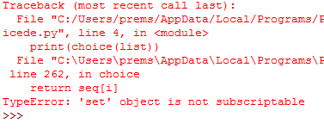
choice():
It wont return random number
It will return a random object from the given list or tuple.

Slide 25







Slide 26




Slide 27



Slide 28
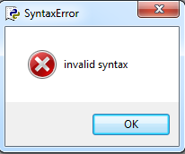

Exception Handling:
In programming language there are two types of errors are possible.
1.Syntax Errors
2.Runtime Errors
Syntax Errors:
The errors which occurs because of invalid syntax are called syntax errors.

Slide 29
Runtime Errors:
It is also known as exceptions.
While executing the program if something goes wrong because of end user input or programming logic or memory problems etc then we will get Runtime Errors.
print(10/0)➔ZeroDivisionError: division by zero
print(10/”Ten”)➔TypeError:Unsupported operand type(s) for/:’int’ and ‘str’
Note: Exception Handling concept applicable for Runtime Errors but not for syntax errors.

Slide 30
What is Exception?
An exception is an event, which occurs during the execution of a program, that disrupts the normal flow of the program's instructions.
In general, when a Python script encounters a situation that it can't cope with, it raises an exception.
An exception is a Python object that represents an error.
When a Python script raises an exception, it must either handle the exception immediately otherwise it would terminate and come out.

Slide 31
Python Exceptions
An exception can be defined as an abnormal condition in a program resulting in the disruption in the flow of the program.
Whenever an exception occurs, the program halts the execution, and thus the further code is not executed.
Therefore, an exception is the error which python script is unable to tackle with.
Common Exceptions
A list of common exceptions that can be thrown from a normal python program is given below.
ZeroDivisionError: Occurs when a number is divided by zero.
NameError: It occurs when a name is not found. It may be local or global.
IndentationError: If incorrect indentation is given.
IOError: It occurs when Input Output operation fails.
EOFError: It occurs when the end of the file is reached, and yet operations are being performed.

Slide 32

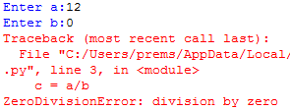
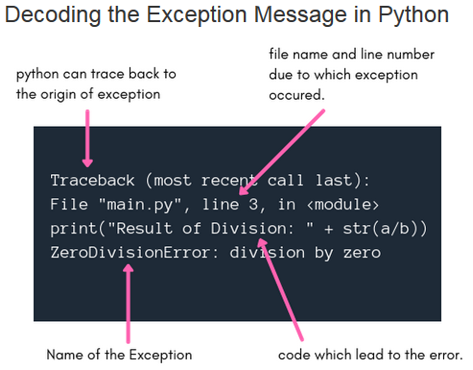

Slide 33
Default Exception Handling in Python:
Every exception in Python is an object.
For every Exception type the corresponding classes are available.
Whenever an exception occurs PVM will create the corresponding exception object and will check for handling code.
If handling code is not available then Python interpreter terminates the program abnormally and prints corresponding exception information to the console. Rest of the program won’t be executed.

Slide 34
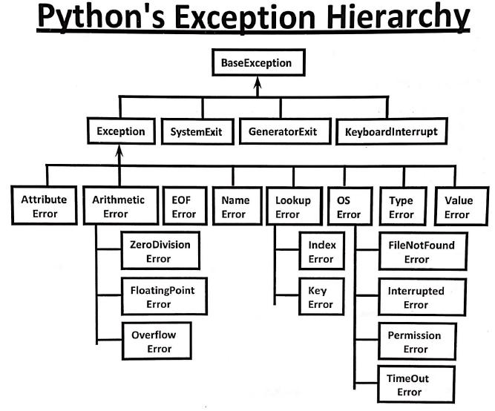

Slide 35
Every Exception in Python is a class.
All exception classes are child classes of BaseException.i.e every exception class extends Base Exception either directly or indirectly.
Hence BaseException acts as root for python Exception Hierarchy.

Slide 36
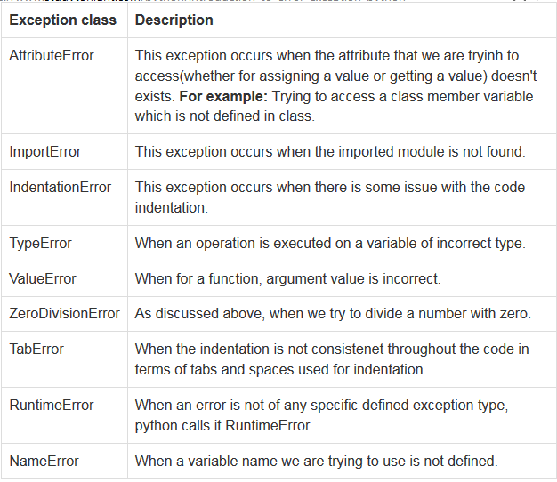
In-built Python Exception classes:
NOTE: We are calling them exception class as all these are defined in python as classes.

Slide 37
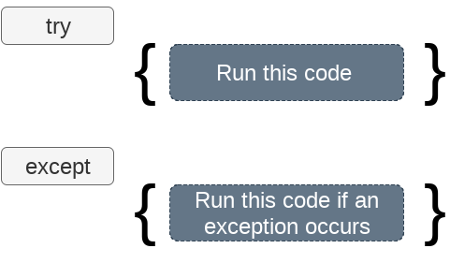
Exception handling in python
If the python program contains suspicious code that may throw the exception, we must place that code in the try block.
The try block must be followed with the except statement which contains a block of code that will be executed if there is some exception in the try block.

Slide 38


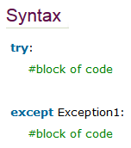
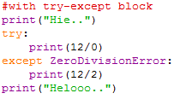


Slide 39
try block:
The try block is used to put the whole code that is to be executed in the program(which you think can lead to exception), if any exception occurs during execution of the code inside the try block, then it causes the execution of the code to be directed to the except block and the execution that was going on in the try block is interrupted.
But, if no exception occurs, then the whole try block is executed and the except block is never executed.
The except block
The try block is generally followed by the except block which holds the exception cleanup code(exception has occured, how to effectively handle the situation) like some print statement to print some message or may be trigger some event or store something in the database etc.
In the except block, along with the keyword except we can also provide the name of exception class which is expected to occur. In case we do not provide any exception class name, it catches all the exceptions, otherwise it will only catch the exception of the type which is mentioned.

Slide 40
Try with multiple except block:
The way of handling exception is varied from exception to exception.
Hence for every exception type a separate except block we have to provide. i.e. try with multiple except blocks is possible and recommended to use.
If try with multiple except blocks available then based on raised exception the corresponding except block will be executed.
try:
  --------
  --------
  --------
  Except ZeroDivision Error:
  perform alternative
  arithmetic operations
  Except FileNotFoundError:
  use local file instead of remote file

Slide 41
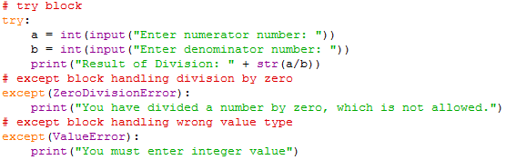




Slide 42
Single except block ha can handle multiple exceptions:
We can write single except block that can handle multiple different types of exceptions.
except (Exception1,Exception2,Exception3…)
Or
except (Exception1,Exception2,Exception3…) as msg
Parenthesis are mandatory and this group of exceptions internally considered as tuple.

Slide 43
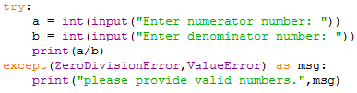



Slide 44

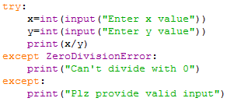


Default except block:
We can use default except block to handle any type of exceptions.
In default except block generally we can print normal error messages.
Syntax:
except:
statements

Slide 45
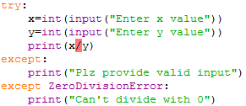
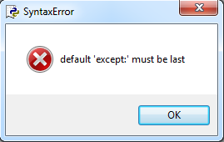
If try with multiple excepts blocks available then default except block should be last, otherwise we will get SyntaxError.
The following are various possible combinations of except block:
except ZeroDivisionError :
except ZeroDivisionError as msg:
except (ZeroDivisionError, ValueError):
except (ZeroDivisionError, ValueError) as msg:
except:

Slide 46
finally block:
The specialty of finally block is it will be executed always whether exception raised or not and whether exception handled or not handled.
Syntax:
try:
Risky code
except:
Handling Code
finally:
cleanup code

Slide 47
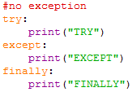

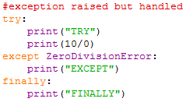

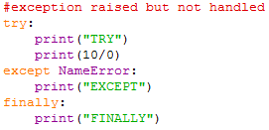
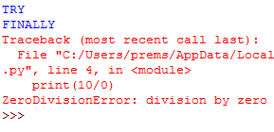

Slide 48
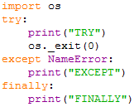

There is only one situation where finally block won’t be executed i.e. whenever we are using os._exit(0) function.
whenever we are using os._exit(0) function then PVM itself will be shutdown.
Where 0 represents status code and it indicates normal termination
These are multiple status codes are possible.
Whether it is ZERO or NON-ZERO there is no change in the result in the program.

Slide 49
else block with try-except-finally:
We can use else block with try-except-finally blocks.
Else block will be executed if and only if there are no exceptions inside try block.
Syntax:
try:
Risky code
except:
Will be executed if exception inside try
else:
Will be executed if there is no exception inside try
finally:
Will be executed whether exception raised or not and handled or not handled.

Slide 50
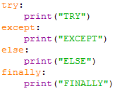
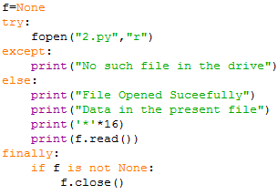

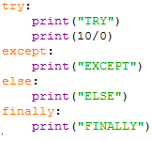

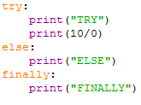
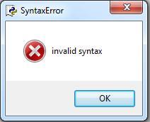

Slide 51
Types of Exceptions:
In python there are two types of exceptions.
1.Predefined exceptions.
2.User defined Exceptions.
1.Predefined Exceptions:
Also known as in-built exceptions.
The exceptions which are raised automatically by PVM whenever a particular event occurs, are called pre defined exceptions.
Examples:
ZeroDivisionError
ValueError..etc

Slide 52
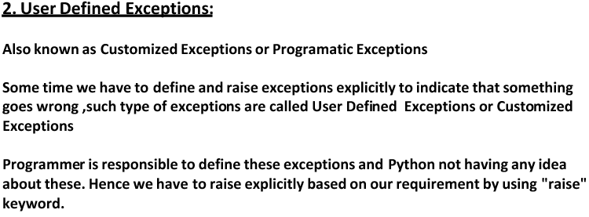
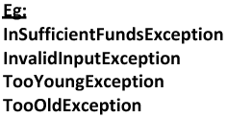

Slide 53
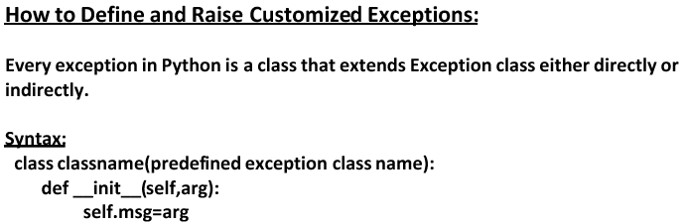

Slide 54
Packages:
It is an encapsulation mechanism to group related modules into a single unit.
Package is nothing but folder or directory which represents collection of Python modules.
Any folder or directory contains __init__.py file, is considered as Python package.
This file can be empty.
A package contains sub-packages also.
A package is basically a directory with Python files and a file with the name __init__.py.
This means that every directory inside of the Python path, which contains a file named __init__.py, will be treated as a package by Python. It's possible to put several modules into a Package.
Advantages:
We can resolve naming conflicts.
We can identify our components uniquely.
It improves modularity of the application.

Slide 55
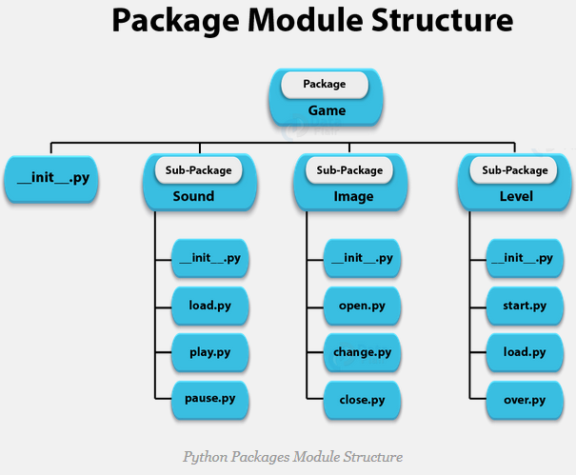

Slide 56


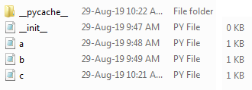

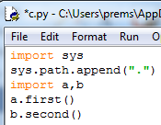


Slide 57





