Slide 1
Unit-1
Basic Structure of Computer

Slide 2
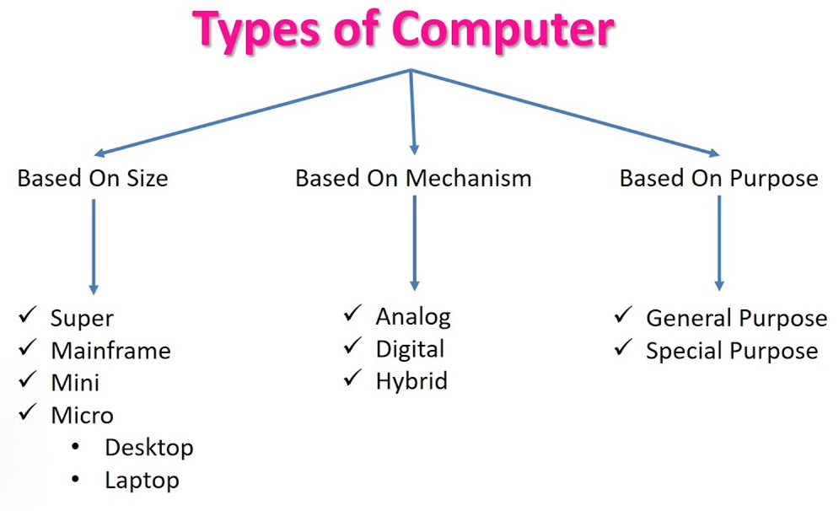
Types of Computers
Computers are classified based on data handling, size and purpose.

Slide 3
Types Based on Data Handling
1. Analog Computers
2. Digital Computers
3. Hybrid Computers

Slide 4
Analog Computers
Used for continuous data such as temperature and speed.
Example: Speedometer.

Slide 5
Digital Computers
Process data using binary numbers (0 and 1).
Examples: Desktop, Laptop, Smartphone.

Slide 6
Hybrid Computers
Combination of analog and digital computers.
Example: ECG machines used in hospitals.

Slide 7
Types Based on Size
1. Supercomputer
2. Mainframe Computer
3. Minicomputer
4. Microcomputer

Slide 8
Supercomputer
Fastest and most powerful computers.
Used for weather forecasting and space research.

Slide 9
Mainframe Computer
Large computers used by banks and large organizations for data processing.

Slide 10
Minicomputer
Medium-sized computers used by small organizations or departments.

Slide 11
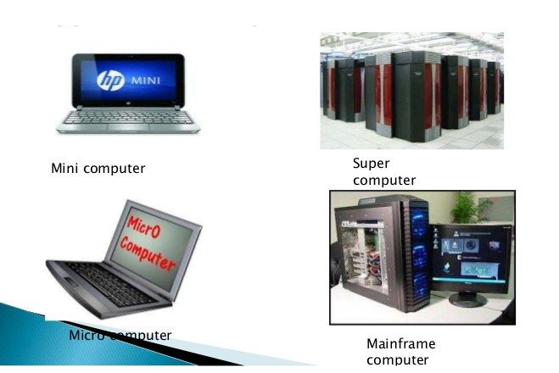
Microcomputer
Small personal computers such as desktops, laptops, tablets, and smartphones.

Slide 12
Types Based on Purpose
1. General Purpose Computer
2. Special Purpose Computer

Slide 13
General Purpose Computer
Used for many tasks like word processing, internet browsing, and calculations.

Slide 14
Special Purpose Computer
Designed for specific tasks.
Examples: ATM machines, embedded systems.

Slide 15
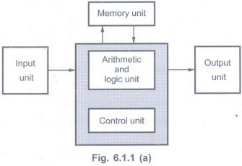
Functional Units of a computer
The functional units of a computer are the main components that work together to perform data processing.
A computer system mainly consists of five functional units.

Slide 16
1. Input Unit
The Input Unit is used to enter data and instructions into the computer.
Functions
Accepts data from the user.
Converts input data into machine-readable form (binary).
Sends the data to memory or CPU for processing.
Examples
Keyboard
Mouse
Scanner
Microphone
Webcam

Slide 17
2. Memory Unit (Storage Unit)
The Memory Unit stores data, instructions, and results temporarily or permanently.
Functions
Stores input data.
Stores instructions for processing.
Stores intermediate and final results.
Types of Memory
Primary Memory
  RAM
  ROM
  Cache
Secondary Memory
  Hard Disk
  SSD
  Pen Drive
  CD/DVD

Slide 18
3. Arithmetic Logic Unit (ALU)
The ALU performs all arithmetic and logical operations in a computer.
Arithmetic Operations
Addition
Subtraction
Multiplication
Division
Logical Operations
AND
OR
NOT
Comparison operations (<, >, =)
The ALU is a part of the CPU.

Slide 19
4. Control Unit (CU)
The Control Unit controls and coordinates all operations of the computer.
Functions
Directs the flow of data between components.
Fetches instructions from memory.
Decodes instructions.
Controls execution of instructions.
The CU acts as the brain manager of the computer system.

Slide 20
5. Output Unit
The Output Unit displays the processed results to the user.
Functions
Converts machine results into human-readable form.
Presents results to the user.
Examples
Monitor
Printer
Speaker
Projector

Slide 21
Basic Operational Concepts

Slide 22
Connections between the processor and the memory
Basic operational concepts
Memory
Processor
MAR
MDR
Control
R₀
PC
R₁
IR
.
.
.
ALU
R_{n-1}
n general purpose
registers

Slide 23
Basic operational concepts
To perform any task, a program (a list of instructions) is stored in memory.
The processor (CPU) takes one instruction at a time from memory and executes it.
The data used by the instructions is also stored in memory.

Slide 24
Instruction Register (IR)
Instruction Register (IR) stores the instruction that the CPU is currently executing.
Simple meaning:
IR holds the current instruction.
The control unit reads this instruction and generates signals to execute it.
Example:
If the CPU is executing
Add R1, R0
this instruction will be stored in the IR.

Slide 25
Program Counter (PC)
The Program Counter (PC) keeps track of the next instruction to execute.
Simple meaning:
PC stores the address of the next instruction in memory.
After one instruction finishes, the PC automatically moves to the next instruction.

Slide 26
Memory Address Register (MAR) and Memory Data Register (MDR) help the CPU communicate with memory.
MAR (Memory Address Register):
It stores the address of the memory location that the CPU wants to access.
MDR (Memory Data Register):
It stores the data that is being read from memory or written to memory.
In simple words:
MAR → Holds the memory address
MDR → Holds the data from that address

Slide 27
Operating Steps for Program Execution
1 Program Storage
Programs are first stored in memory using the input unit.
2 Program Start
Execution starts when the Program Counter (PC) points to the first instruction of the program.
3 Fetch Instruction
The address in PC is sent to the Memory Address Register (MAR).
A Read signal is sent to memory.
4 Instruction Transfer
The instruction from memory is loaded into the Memory Data Register (MDR).
Then it is moved to the Instruction Register (IR).
5 Decode and Execute
The instruction in IR is decoded.
The processor prepares to execute the instruction.

Slide 28
6 Fetch Operands (if needed)
If data is needed from memory, its address is sent to MAR.
The data is read into MDR and then sent to the ALU.
7 Perform Operation
The ALU (Arithmetic Logic Unit) performs the required operation.
8 Store Result
If the result must be stored in memory:
  The result goes to MDR.
  The destination address goes to MAR.
  A Write signal stores the result in memory.
9 Next Instruction
The PC increases automatically to point to the next instruction.

Slide 29
Basic operational concepts
Load LOCA, R1
Add R1, R0
1.Load LOCA, R1
The CPU copies the data from memory location LOCA into register R1.
Result: R1 = value stored in memory location LOCA.
2.Add R1, R0
The CPU adds the value in R1 and R0.
The result is stored in R0.
Result: R0 = R0 + R1
The old value of R0 is lost.
The old value of R1 may also change depending on the operation.
But the original value in memory location LOCA remains unchanged.

Slide 30
Interrupt
An interrupt is a request from an I/O device asking the CPU for immediate service.
What the CPU does
The CPU pauses the current program.
It saves the current state (PC, registers, etc.) in memory.
It runs a special program called Interrupt Service Routine (ISR).
After finishing the service, the CPU restores the saved state.
The original program continues execution.

Slide 31
Bus Structure

Slide 32
Bus Structure
A bus is a group of wires that connect different parts of a computer so they can communicate with each other.
The bus carries three types of information:
Data lines – carry the data
Address lines – carry the memory address
Control lines – carry control signals

Slide 33
Single Bus Structure
The simplest connection is a single bus system, where all units are connected to the same bus.
Only one data transfer can happen at a time.
Only two devices can use the bus at the same time (one sending and one receiving).
Bus control lines decide which device can use the bus.
Advantages
Low cost
Easy to connect devices (flexible)

Slide 34
Multiple Bus Structure
Some systems use multiple buses.
More than one data transfer can happen at the same time.
This improves performance.
But it costs more.
Timing Differences Between Devices
Different devices in a computer work at different speeds.
Examples:
Keyboard and printer → very slow
Hard disk / optical disk → medium speed
Memory and CPU → very fast
Because of these speed differences, data transfer can become difficult.

Slide 35
Buffer Registers (Solution)
To solve this problem, buffer registers are used.
A buffer register is a temporary storage area that holds data during transfer.
Benefits
Prevents a fast CPU from waiting for slow devices
Allows the CPU to work with multiple devices efficiently
Helps smooth out timing differences between CPU, memory, and I/O devices.

Slide 36
Software

Slide 37
Software
System software controls and manages all the activities of a computer system.
It is a collection of programs that help the computer work properly and run application programs.

Slide 38
Functions of System Software
System software performs the following tasks:
Receives and interprets user commands.
Helps create and edit programs and saves them in storage devices.
Manages files in secondary storage (like hard disks).
Runs application programs such as word processors, spreadsheets, and games.
Controls input and output devices to receive input and produce output.
Translates high-level language programs into machine language.
Links and runs user programs with standard library programs.

Slide 39
Components of System Software
1. Compiler
A compiler is a system software program that translates a high-level language program into machine language so that the computer can execute it.
2. Text Editor
A text editor is used by programmers to write and edit programs.
Programs are typed using a keyboard.
The program is stored as a file.

Slide 40
3. Operating System (OS)
The Operating System (OS) is the main system software of a computer.
It controls the working and interaction of all computer components while running programs.
Functions of OS
Assigns memory to programs
Moves data between memory and storage devices
Manages input and output operations
Controls computer resources

Slide 41
3. Operating System (OS)
The Operating System (OS) is the main system software of a computer.
It controls the working and interaction of all computer components while running programs.
Functions of OS
Assigns memory to programs
Moves data between memory and storage devices
Manages input and output operations
Controls computer resources

Slide 42
Computer Performance

Slide 43
Computer Performance
Performance means how fast a computer can run a program.
It mainly depends on the processor speed, memory, and hardware design.
1. Elapsed Time
Elapsed Time is the total time taken to run a program.
It includes the time used by:
Processor
Memory
Disk
Printer and other devices
So it measures the overall performance of the whole computer system.

Slide 44
2. Processor Time
Processor Time is the time during which the CPU is actually working on the program.
It does not include waiting time for devices like disks or printers.
Processor time mainly depends on the processor hardware and instruction execution.

Slide 45
3. Cache Memory
Cache memory is a small and very fast memory located near the processor.
CPU can access cache faster than main memory.
Frequently used instructions and data are stored in cache.
This reduces the time needed to fetch data from main memory and improves performance.

Slide 46
4. Processor Clock
The processor clock generates timing signals to control processor operations.
Time between two signals is called a clock cycle.
Each instruction is executed in several clock cycles.
Clock period
P = time of one clock cycle
Clock rate
R = 1 / P
Example
If clock rate = 500 million cycles per second
Clock period = 2 nanoseconds

Slide 47
5. Basic Performance Equation
T = (N.S)/R
Where:
T = Processor time
N = Number of instructions in the program
S = Average number of steps per instruction
R = Clock rate (cycles per second)
To improve performance:
Reduce N
Reduce S
Increase R

Slide 48
6. Pipelining
Pipelining means overlapping the execution of multiple instructions.
Example:
While one instruction is being executed,
The next instruction is being fetched from memory.
This increases the speed of instruction execution.

Slide 49
7. Superscalar Operation
Superscalar processors use multiple pipelines.
This means:
Several instructions can be executed at the same time.
This gives higher performance.

Slide 50
8. Increasing Clock Rate
Clock rate can be increased by:
1. Improving IC technology to make circuits faster.
2. Reducing the amount of work done in each step.
Both methods reduce clock period and increase speed.

Slide 51
9. Instruction Set Types
RISC (Reduced Instruction Set Computer)
Uses simple instructions
Each instruction executes in few steps
Good for pipelining
Example processors: ARM, MIPS
CISC (Complex Instruction Set Computer)
Uses complex instructions
Each instruction performs more work
Fewer instructions are needed
Example processors: x86

Slide 52
10. Compiler
A compiler converts high-level language programs into machine instructions.
An optimizing compiler improves performance by:
Reducing number of instructions (N)
Rearranging instructions for better execution.

Slide 53
11. Performance Measurement (SPEC Rating)
System Performance Evaluation Corporation provides benchmarks to measure computer performance.
SPEC Rating Formula
SPEC rating = Running time on reference computer
Running time on tested computer
Example:
If SPEC rating = 50
It means the tested computer is 50 times faster than the reference computer.
For multiple programs, the average SPEC score is calculated.

Slide 54
Multiprocessors and Multi-computers

Slide 55
Multiprocessors and Multi-computers
1. Multiprocessor Systems
A multiprocessor system is a computer system that has more than one processor (CPU).
These processors can:
Run different programs at the same time, or
Work together to complete parts of one large task.
Features
All processors share the same main memory.
Because of this, it is called a shared-memory multiprocessor system.

Slide 56
Advantages
High performance
Faster execution of tasks
Disadvantages
High cost
Complex hardware
Requires complex interconnection networks

Slide 57
2. Multi-computers
A multi-computer system is a group of separate computers connected together through a network.
Features
Each computer has its own processor and its own memory.
Computers do not share memory.
They communicate by sending messages through a network.
Because of this, they are called message-passing multi-computers.

Slide 58
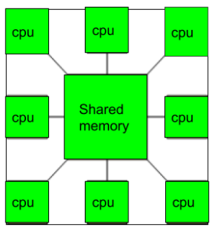
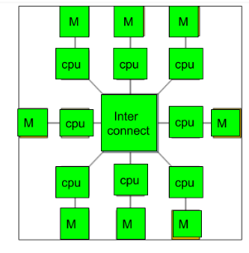
Difference Between Multiprocessor and Multi-computer
Feature Multiprocessor Multi-computer
Processors Many processors in one system Many separate computers
Memory Shared memory Each computer has its own memory
Communication Through shared memory Through message passing
Complexity More complex hardware Simpler individual systems

