Slide 1
UNIT - VI
Contents
Working with
Numpy
plotpy
scipy
GUI Programming
Tkinter
Introduction
Tkinter Programming
Tkinter Widgets

Slide 2
Numpy

Slide 3
Numpy
Numpy is an open-source module to python that provide common mathematical and numerical routines in pre-compiled, fast functions.
NumPy is the fundamental package for scientific computing with Python. It contains among other things:
→ a powerful N-dimensional array object
→ sophisticated (broadcasting) functions
→ tools for integrating C/C++ and Fortran code
→ useful linear algebra, Fourier transform, and random number capabilities
NumPy’s main object is the homogeneous multidimensional array. It is a table of elements (usually numbers), all of the same type, indexed by a tuple of positive integers. In NumPy dimensions are called axes.
NumPy’s array class is called ndarray. It is also known by the alias array.

Slide 4
The attributes of an ndarray object are:
ndarray.ndim
The number of axes (dimensions) of the array.
ndarray.shape
The dimensions of the array. This is a tuple of integers indicating the size of the array in each dimension. For a matrix with nrows and m columns, shape will be (n,m). The length of the shape tuple is therefore the number of axes, ndim.
ndarray.size
The total number of elements of the array. This is equal to the product of the elements of shape.
ndarray.dtype
An object describing the type of the elements in the array. One can create or specify dtype’s using standard Python types. Additionally NumPy provides types of its own. numpy.int32, numpy.int16, and numpy.float64 are some examples.

Slide 5
ndarray.itemsize
The size in bytes of each element of the array. For example, an array of elements of type float64 has itemsize 8 (=64/8), while one of type complex32 has itemsize 4 (=32/8). It is equivalent to ndarray.dtype.itemsize.
ndarray.data
The buffer containing the actual elements of the array. Normally, we won’t need to use this attribute because we will access the elements in an array using indexing facilities.

Slide 6
>>> import numpy as np
>>> a = np.arange(15).reshape(3, 5)
>>> a
array([[ 0, 1, 2, 3, 4],
[ 5, 6, 7, 8, 9],
[10, 11, 12, 13, 14]])
>>> a.shape
(3, 5)
>>> a.dtype.name
'int64'
>>> a.itemsize
8
>>> a.size
15

Slide 7
>>> type(a)
<type 'numpy.ndarray'>
>>> b = np.array([6, 7, 8])
>>> b
array([6, 7, 8])
>>> type(b) <type 'numpy.ndarray'>

Slide 8
Array Creation
We can create an array from a regular Python list or tuple using the array function. The type of the resulting array is deduced from the type of the elements in the sequences.
EX:
>>> import numpy as np
>>> a = np.array([2,3,4])
>>> a
array([2, 3, 4])
>>> a.dtype dtype('int64')
>>> b = np.array([1.2, 3.5, 5.1])
>>> b.dtype
dtype('float64')

Slide 9
The type of the array can also be explicitly specified at creation time:
>>> c = np.array( [ [1,2], [3,4] ], dtype=complex )
>>> c
array([[ 1.+0.j, 2.+0.j], [ 3.+0.j, 4.+0.j]])
The function zeros creates an array full of zeros, the function ones creates an array full of ones, and the function empty creates an array whose initial content is random and depends on the state of the memory.
By default, the dtype of the created array is float64.
>>> np.zeros( (3,4) )
array([[ 0., 0., 0., 0.],
[ 0., 0., 0., 0.],
[ 0., 0., 0., 0.]])

Slide 10
>>> c = np.arange(24).reshape(2,3,4)
>>> print(c)
[[[ 0 1 2 3]
[ 4 5 6 7]
[ 8 9 10 11]]
[[12 13 14 15]
[16 17 18 19]
[20 21 22 23]]]

Slide 11
Basic Operations
Arithmetic operators on arrays apply elementwise. A new array is created and filled with the result.
>>> a = np.array( [20,30,40,50] )
>>> b = np.arange( 4 )
>>> b
array([0, 1, 2, 3])
>>> c = a-b
>>> c
array([20, 29, 38, 47])
>>> b**2
array([0, 1, 4, 9])
>>> 10*np.sin(a)
array([ 9.12945251, -9.88031624, 7.4511316 , -2.62374854])
>>> a<35
array([ True, True, False, False])

Slide 12
Unlike in many matrix languages, the product operator * operates elementwise in NumPy arrays. The matrix product can be performed using the dot function or method.
>>> A = np.array( [[1,1], ... [0,1]] )
>>> B = np.array( [[2,0], ... [3,4]] )
>>> A*B # elementwise product
array([[2, 0], [0, 4]])
>>> A.dot(B) # matrix product
array([[5, 4], [3, 4]])
>>> np.dot(A, B) # another matrix product
array([[5, 4], [3, 4]])

Slide 13
>>> a = np.random.random((2,3))
>>> a
array([[ 0.18626021, 0.34556073, 0.39676747], [ 0.53881673, 0.41919451, 0.6852195 ]])
>>> a.sum()
2.5718191614547998
>>> a.min()
0.1862602113776709
>>> a.max()
0.6852195003967595

Slide 14
plotpy

Slide 15
pyplot provides a procedural interface to the matplotlib object-oriented plotting library. It is modeled closely after Matlab.
The majority of plotting commands in pyplot have Matlab analogs with similar arguments. Important commands are explained with interactive examples.

Slide 16
Linspace Array is an array of equally spaced values going from a start to an end value.
We can use np.linspace() to create an array of equally spaced values. By declaring a start value, stop value, and the num of points in between those points an array will be generated.
For example, np.linspace(0, 1, 5) results in the following array
array([ 0. , 0.25, 0.5 , 0.75, 1. ])

Slide 17
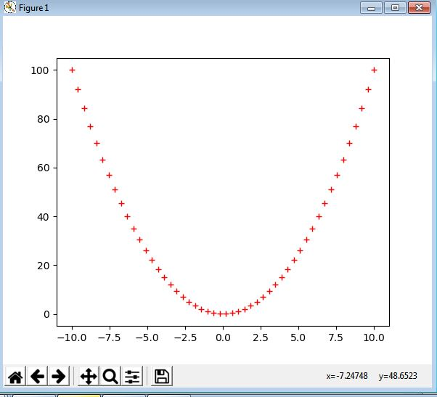
EX 1:
import matplotlib.pyplot as plt
import numpy as np
x = np.linspace(-10, 10)
plt.plot(x, x**2, 'r+')
plt.show()
Output:

Slide 18
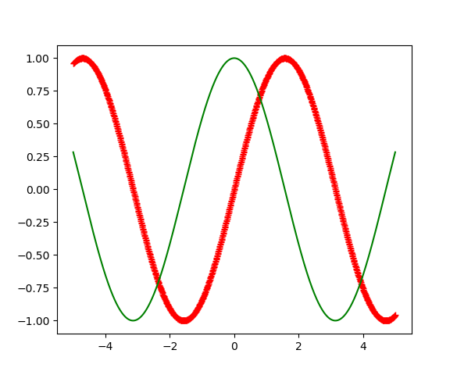
EX 2:
import matplotlib.pyplot as plt
import numpy as np
x = np.linspace(-5, 5, 1000)
plt.plot(x, np.sin(x), "r+")
plt.plot(x, np.cos(x), "g-")
plt.show()
Output

Slide 19
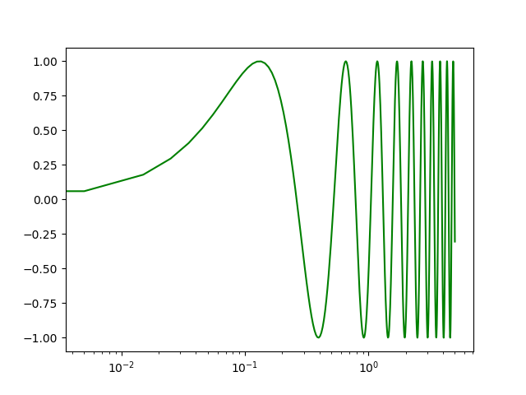
Ex 3: semilogx(*args, **kwargs)Plot curves with logarithmic x-axis scale
import matplotlib.pyplot as plt
import numpy as np
x = np.linspace(-5, 5, 1000)
plt.semilogx(x, np.sin(12*x), "g-")
plt.show()
Output

Slide 20
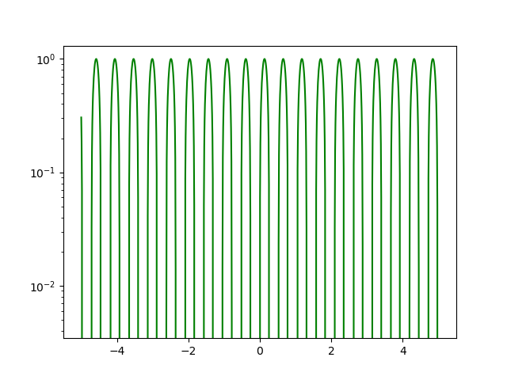
Ex 4 semilogy(*args, **kwargs)Plot curves with logarithmic y-axis scale
import matplotlib.pyplot as plt
import numpy as np
x = np.linspace(-5, 5, 1000)
plt.semilogy(x, np.sin(12*x), "g-")
plt.show()
Output

Slide 21
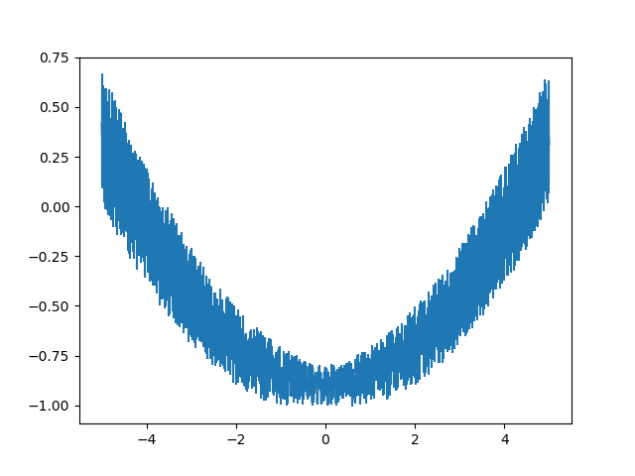
Ex 5:
import matplotlib.pyplot as plt
import numpy as np
x = np.linspace(-5, 5, 1000)
plt.errorbar(x, -1+x**2/20+.2*np.random.rand(len(x)), x/20)
plt.show()
Output

Slide 22
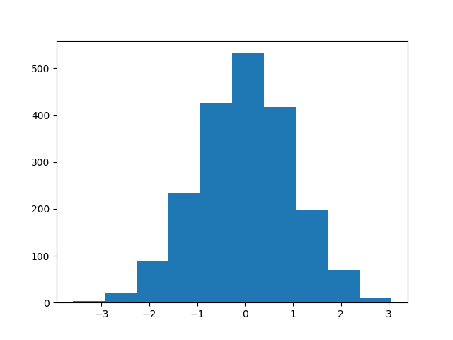
Ex 6 Plot 1-D histogram
import matplotlib.pyplot as plt
from numpy.random import normal
data = normal(0, 1, (2000, ))
plt.hist(data)
plt.show()
Output

Slide 23
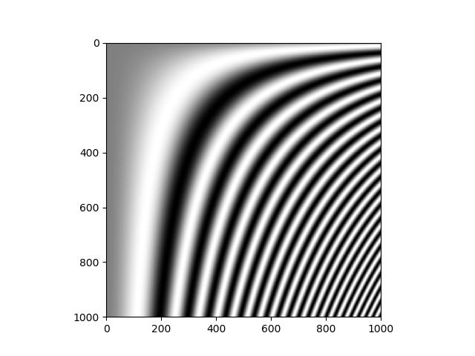
Ex 7
import matplotlib.pyplot as plt
import numpy as np
x = np.linspace(-5, 5, 1000)
img = np.fromfunction(lambda x, y: np.sin((x/200.)*(y/200.)**2), (1000, 1000))
plt.gray()
plt.imshow(img)
plt.show()
Output

Slide 24
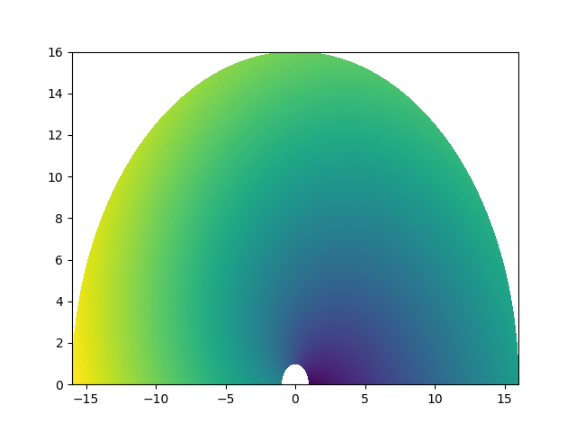
Ex 8 Create a pseudocolor plot of a 2-D array
import matplotlib.pyplot as plt
import numpy as np
r = np.linspace(1., 16, 100)
th = np.linspace(0., np.pi, 100)
R, TH = np.meshgrid(r, th)
X = R*np.cos(TH)
Y = R*np.sin(TH)
Z = 4*TH+R
plt.pcolor(X, Y, Z)
plt.show()

Slide 25
scipy

Slide 26
SciPy is a free and open-source Python library used for scientific computing and technical computing.
SciPy contains modules for optimization, linear algebra, integration, special functions, FFT, signal and image processing, solvers and other tasks common in science and engineering.
SciPy builds on the Numpy array object and is part of the Numpy stack which includes tools like Matplotlib, pandas and SymPy, and an expanding set of scientific computing libraries.

Slide 27
scipy is composed of task-specific sub-modules
scipy.cluster Vector quantization / Kmeans
scipy.constants Physical and mathematical constants
scipy.fftpack Fourier transform
scipy.integrate Integration routines
scipy.interpolate Interpolation
scipy.io Data input and output
scipy.linalg Linear algebra routines
scipy.ndimage n-dimensional image package
scipy.odr Orthogonal distance regression
scipy.optimize Optimization
scipy.signal Signal processing
scipy.sparse Sparse matrices
scipy.spatial Spatial data structures and algorithms
scipy.special Any special mathematical functions
scipy.stats Statistics

Slide 28
EX using io module
import numpy as np
from scipy import io as spio
a = np.ones((3, 3))
spio.savemat('file.mat', {'a': a})
data = spio.loadmat('file.mat')
print(data['a'])
Output
[[1. 1. 1.]
[1. 1. 1.]
[1. 1. 1.]]

Slide 29
Ex Using linalg module
import numpy as np
from scipy import linalg
arr=np.array([[1,2],[3,4]])
print(linalg.det(arr))
iarr=linalg.inv(arr)
print(iarr)
-2.0
[[-2. 1. ]
[ 1.5 -0.5]]

Slide 30
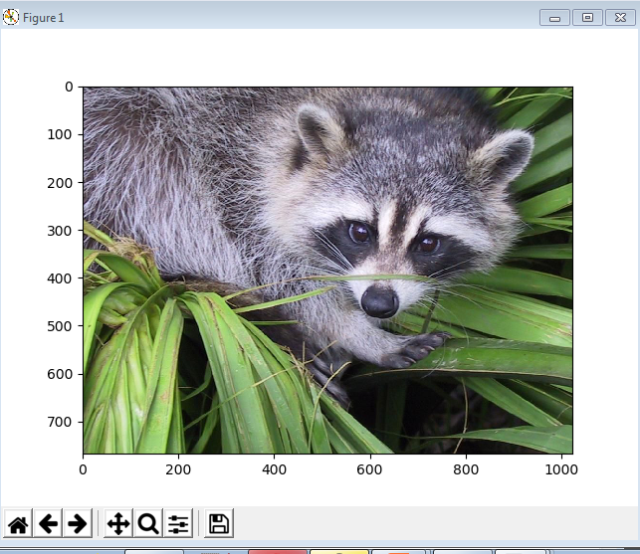
EX
import scipy
from scipy import misc
import matplotlib.pyplot as plt
face=scipy.misc.face()
print(face.shape)
print(face.max())
print(face.dtype)
plt.gray()
plt.imshow(face)
plt.show()
Output
(768, 1024, 3)
255
uint8

Slide 31
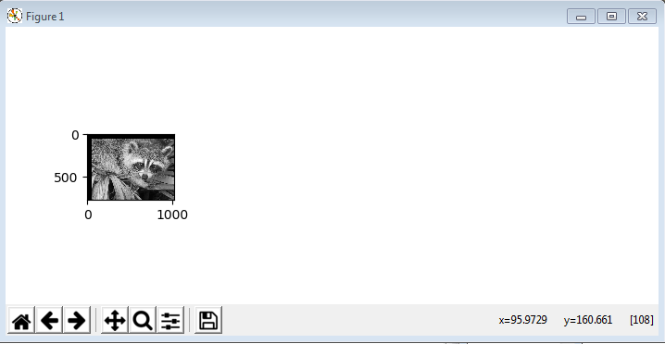
import scipy
from scipy import ndimage,misc
import matplotlib.pyplot as plt
face=misc.face(gray=True)
shifted_face = ndimage.shift(face, (50, 50))
plt.figure(figsize=(15, 3))
plt.subplot(151)
plt.imshow(shifted_face,cmap=plt.cm.gray)
plt.show()
Output

Slide 32
GUI

Slide 33
Graphical User Interface
A computer’s user interface is the part of the computer that the user interacts with.
A graphical user interface allows the user to interact with the operating system and other programs using graphical elements such as icons, buttons, and dialog boxes.
Python provides several choices for writing GUI-based programs, including wxPython, Tkinter, and Qt.

Slide 34
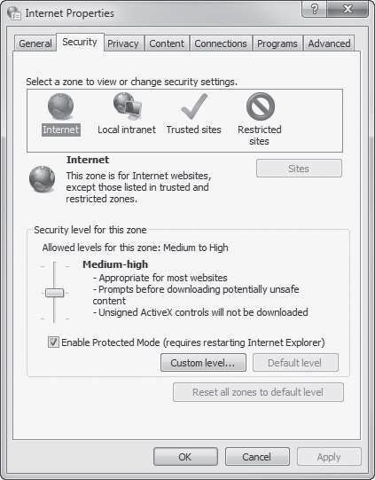
Graphical User Interface

Slide 35
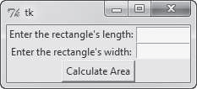
GUI Programs are Event-Driven
GUI programs must respond to the actions of the user.
The user causes events to take place, such as the clicking of a button, and the program must respond to the events.
A GUI program

Slide 36
tkinter Module
Use the tkinter module to create simple GUI programs.
A GUI program presents a window with various graphical widgets that the user can interact with or view. The tkinter module provides 15 widgets

Slide 37
tkinter Widgets
Widget Description
Button A button that can cause an action to occur when it is clicked.
Canvas A rectangular area that can be used to display graphics.
Checkbutton A button that may be in either the “on” or “off” position.
Entry An area in which the user may type a single line of input from the keyboard.
Frame A container that can hold other widgets.
Label An area that displays one line of text or an image.
Listbox A list from which the user may select an item
Menu A list of menu choices that are displayed when the user clicks a Menubutton widget.
Menubutton A menu that is displayed on the screen and may be clicked by the user

Slide 38
Message Displays multiple lines of text.
Radiobutton A widget that can be either selected or deselected. Radiobutton widgets usually appear in groups and allow the user to select one of several options.
Scale A widget that allows the user to select a value by moving a slider along a track.
Scrollbar Can be used with some other types of widgets to provide scrolling ability.
Text A widget that allows the user to enter multiple lines of text input.
Toplevel A container, like a Frame, but displayed in its own window.

Slide 39
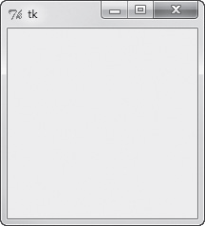
Simple GUI Program to display an empty window
import tkinter
def main():
main_window = tkinter.Tk()
tkinter.mainloop()
main()
output
main_window=tkinter.Tk()
creates an instance of the tkinter module’s Tk class and assigns it to the main_window variable. This object is the root widget, which is the main window in the program.
tkinter.mainloop()
calls the tkinter module’s mainloop function. This function runs like an infinite loop until we close the main window.

Slide 40
Using Object Oriented
import tkinter
class MyGUI:
def __init__(self):
self.main_window = tkinter.Tk()
tkinter.mainloop()
gui=MyGUI()

Slide 41

Display Text with Label Widgets
use a Label widget to display a single line of text in a window.
To make a Label widget you create an instance of the tkinter module’s Label class.
import tkinter
class MyGUI:
def __init__(self):
self.main_window = tkinter.Tk()
self.label=tkinter.Label(self.main_window,text=“Hello GUI”)
self.label.pack()
tkinter.mainloop()
gui=MyGUI()
output

Slide 42
self.label = tkinter.Label(self.main_window, text='Hello World!')
This statement creates a Label widget and assigns it to self.label.
The first argument inside the parentheses is self.main_window, which is a reference to the root widget. It specifies that the Label widget to belong to the root widget.
The second argument is text='Hello World!'. This specifies the text that we want displayed in the label.
The pack method determines where a widget should be positioned and makes the widget visible when the main window is displayed.

Slide 43

Displays two labels with text
import tkinter
class MyGUI:
def __init__(self):
self.main_window = tkinter.Tk()
self.label1=tkinter.Label(self.main_window,text=“Hello world!”)
self.label2=tkinter.Label(self.main_window,text=“This is my GUI program ”)
self.label1.pack()
self.label2.pack()
tkinter.mainloop()
gui=MyGUI()
output

Slide 44
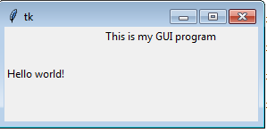
Using side argument
import tkinter
class MyGUI:
def __init__(self):
self.main_window = tkinter.Tk()
self.label1=tkinter.Label(self.main_window,text=“Hello world!”)
self.label2=tkinter.Label(self.main_window,text=“This is my GUI program ”)
self.label1.pack(side=‘left’)
self.label2.pack(side=‘top’)
tkinter.mainloop()
gui=MyGUI()
output

Slide 45
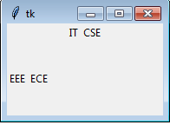
Organizing Widgets with Frames
A Frame is a container that can hold other widgets. You can use Frames to organize the widgets in a window.
import tkinter
class MyGUI:
def __init__(self):
self.main_window = tkinter.Tk()
self.top_frame=tkinter.Frame(self.main_window)
self.bottom_frame=tkinter.Frame(self.main_window)
self.label1=tkinter.Label(self.top_frame,text="IT")
self.label2=tkinter.Label(self.top_frame,text="CSE")
self.label1.pack(side='left')
self.label2.pack(side='left')
self.label3=tkinter.Label(self.bottom_frame,text="ECE")
self.label4=tkinter.Label(self.bottom_frame,text="EEE")
self.label3.pack(side='right')
self.label4.pack(side='right')
self.top_frame.pack(side='top')
self.bottom_frame.pack(side='left')
tkinter.mainloop()
gui=MyGUI()
output

Slide 46
Button Widgets and Info Dialog Boxes
A Button is a widget that the user can click to cause an action to take place. When you create a Button widget you can specify the text that is to appear on the face of the button and the name of a callback function.
A callback function is a function or method that executes when the user clicks the button.
A callback function is also known as an event handler
We use a function named showinfo, which is in the tkinter.messagebox module, to display the info dialog box.
tkinter.messagebox.showinfo(title, message)

Slide 47
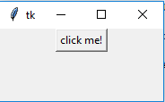
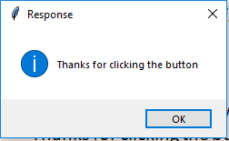
import tkinter
import tkinter.messagebox
class MyGUI:
def __init__(self):
self.main_window=tkinter.Tk()
self.my_button=tkinter.Button(self.main_window,text=
'click me!',command=self.do_something)
self.my_button.pack()
tkinter.mainloop()
def do_something(self):
tkinter.messagebox.showinfo('Response',\
'Thanks for clicking the button')
gui=MyGUI()
output

Slide 48
When the user clicks the button, the program displays a separate info dialog Box.
showinfo, which is in the tkinter.messagebox module, to display the info dialog box.
The general format of the showinfo function call:
tkinter.messagebox.showinfo(title, message)
title is a string that is displayed in the dialog box’s title bar, and message is an informational string that is displayed in the main part of the dialog box.

Slide 49
Creating a Quit Button
GUI programs usually have a Quit button (or an Exit button) that closes the program when the user clicks it.
To create a Quit button in a Python program we simply create a Button widget that calls the root widget’s destroy method as a callback function.

Slide 50
import tkinter
import tkinter.messagebox
class MyGUI:
def __init__(self):
self.main_window=tkinter.Tk()
self.my_button=tkinter.Button(self.main_window,text=
'click me!',command=self.do_something)
self.quit_button=tkinter.Button(self.main_window,text=
'quit',command=self.main_window.destroy)
self.my_button.pack()
self.quit_button.pack()
tkinter.mainloop()
def do_something(self):
tkinter.messagebox.showinfo('Response',\
'Thanks for clicking the button')
gui=MyGUI()

Slide 51
Getting Input with the Entry Widget
An Entry widget is a rectangular area that the user can type text into.Entry widgets are used to gather input in a GUI program.
A program will have one or more Entry widgets in a window, along with a button that the user clicks to submit the data that he or she has typed into the Entry widgets.
The button’s callback function retrieves data from the window’s Entry widgets and processes it.
An Entry widget’s get method to retrieve the data that the user has typed into the widget.
The get method returns a string, so it will have to be converted to the appropriate data type if the Entry widget is used for numeric input.

Slide 52
import tkinter
import tkinter.messagebox
class KiloConverterGUI:
def __init__(self):
self.main_window=tkinter.Tk()
self.top_frame=tkinter.Frame(self.main_window)
self.bottom_frame=tkinter.Frame(self.main_window)
self.prompt_label = tkinter.Label(self.top_frame, \
text='Enter a distance in kilometers:')
self.kilo_entry = tkinter.Entry(self.top_frame, \
width=10)
self.prompt_label.pack(side='left')
self.kilo_entry.pack(side='left')
self.calc_button = tkinter.Button(self.bottom_frame, \
text='Convert', command=self.convert)
self.quit_button = tkinter.Button(self.bottom_frame, \
text='Quit', command=self.main_window.destroy)

Slide 53
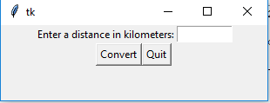
self.calc_button.pack(side='left')
self.quit_button.pack(side='left')
self.top_frame.pack()
self.bottom_frame.pack()
tkinter.mainloop()
def convert(self):
kilo = float(self.kilo_entry.get())
miles = kilo * 0.6214
tkinter.messagebox.showinfo('Results', \
str(kilo) + ' kilometers is equal to ' + str(miles) + ' miles.')
kilo_conv=KiloConverterGUI()
output

Slide 54
Radio Buttons
Radio buttons are useful when you want the user to select one choice from several possible options.
Use the tkinter module’s Radiobutton class to create Radiobutton widgets.
A radio button may be selected or deselected.
Each radio button has a small circle that appears filled in when the radio button is selected and appears empty when the radio button is deselected.

Slide 55
import tkinter
import tkinter.messagebox
class MyGUI:
def __init__(self):
self.main_window=tkinter.Tk()
self.top_frame=tkinter.Frame(self.main_window)
self.bottom_frame=tkinter.Frame(self.main_window)
self.radio_var=tkinter.IntVar()
self.radio_var.set(1)
self.rb1=tkinter.Radiobutton(self.top_frame,text='option 1',variable=self.radio_var,value=1)
self.rb2=tkinter.Radiobutton(self.top_frame,text='option 2',variable=self.radio_var,value=2)
self.rb3=tkinter.Radiobutton(self.top_frame,text='option 3',variable=self.radio_var,value=3)
self.rb1.pack()
self.rb2.pack()
self.rb3.pack()

Slide 56
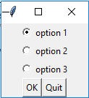
self.ok_button = tkinter.Button(self.bottom_frame, \
text='OK', command=self.show_choice)
self.quit_button = tkinter.Button(self.bottom_frame, \
text='Quit', command=self.main_window.destroy)
self.ok_button.pack(side='left')
self.quit_button.pack(side='left')
self.top_frame.pack()
self.bottom_frame.pack()
tkinter.mainloop()
def show_choice(self):
tkinter.messagebox.showinfo('Selection', 'You selected option ' +str(self.radio_var.get()))
my_gui = MyGUI()
output

Slide 57
Check Buttons
A check button appears as a small box with a label appearing next to it. When a check button is selected, a small check mark appears inside its box
import tkinter
import tkinter.messagebox
class MyGUI:
def __init__(self):
self.main_window = tkinter.Tk()
self.top_frame = tkinter.Frame(self.main_window)
self.bottom_frame = tkinter.Frame(self.main_window)
self.cb_var1 = tkinter.IntVar()
self.cb_var2 = tkinter.IntVar()
self.cb_var3 = tkinter.IntVar()
self.cb_var1.set(0)
self.cb_var2.set(0)
self.cb_var3.set(0)
self.cb1 = tkinter.Checkbutton(self.top_frame,text='Option 1', variable=self.cb_var1)
self.cb2 = tkinter.Checkbutton(self.top_frame,text='Option 2', variable=self.cb_var2)
self.cb3 = tkinter.Checkbutton(self.top_frame,text='Option 3', variable=self.cb_var3)
self.cb1.pack()
self.cb2.pack()
self.cb3.pack()

Slide 58
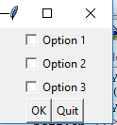
self.ok_button = tkinter.Button(self.bottom_frame, text='OK', command=self.show_choice)
self.quit_button = tkinter.Button(self.bottom_frame,text='Quit', command=self.main_window.destroy)
self.ok_button.pack(side='left')
self.quit_button.pack(side='left')
self.top_frame.pack()
self.bottom_frame.pack()
tkinter.mainloop()
def show_choice(self):
self.message = 'You selected:\n'
if self.cb_var1.get() == 1:
self.message = self.message + '1\n'
if self.cb_var2.get() == 1:
self.message = self.message + '2\n'
if self.cb_var3.get() == 1:
self.message = self.message + '3\n'
tkinter.messagebox.showinfo('Selection', self.message)
my_gui = MyGUI()
output

