Slide 1

Date: 31-03-2026
ORKAY ADVERTISING & MARKETING SERVICES
ORKAY ADVERTISING & MARKETING SERVICES
#76, K.H.B Complex,
Opp.Gov. Samudhaya Bhavan, Naubad Road, Bidar 585402
Karnataka India
Phone: +91-9035070653
Availability Date: 31/03/2026
Total Availability: 79

Slide 2
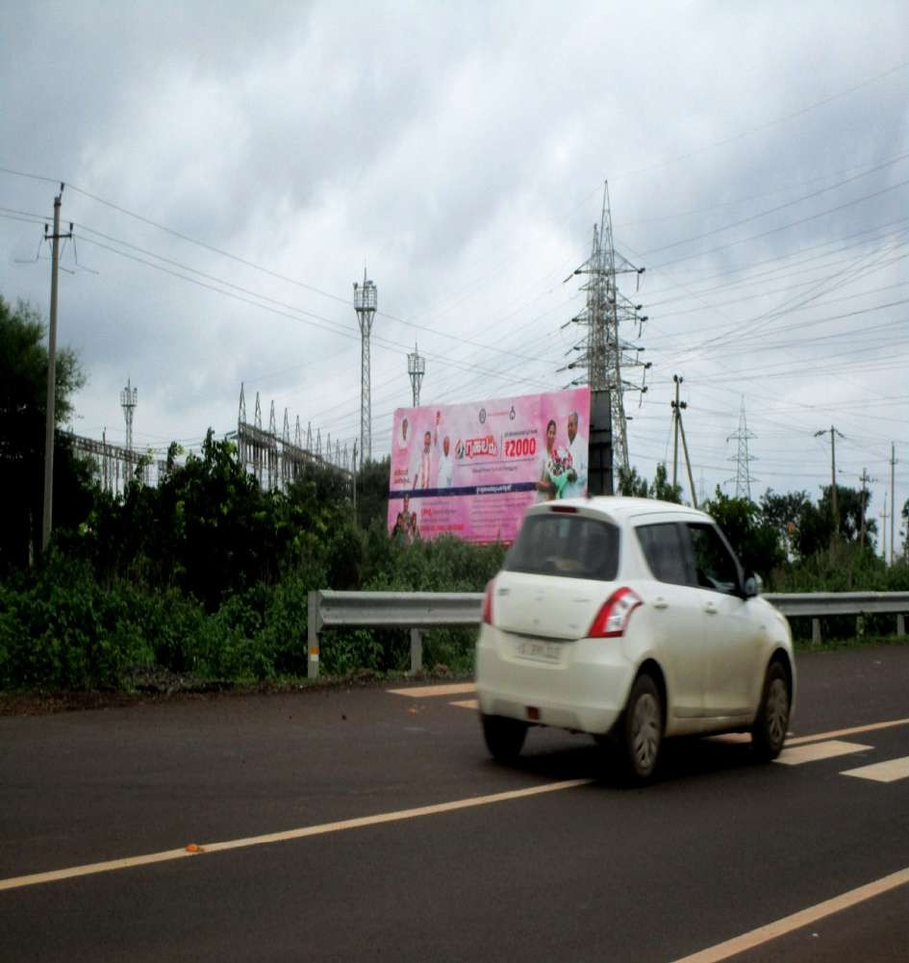
Date: 31-03-2026
ORKAY ADVERTISING & MARKETING SERVICES
#: 1 Zone: Andhoor Thanda(Bidar Dist:) Location: [B AT Hd 2] Towards Bidar-30'x10' Media Type: Hoardings Illumination: NonLit Width: 30.00 Height: 10.00 Total Size: 300.00

Slide 3
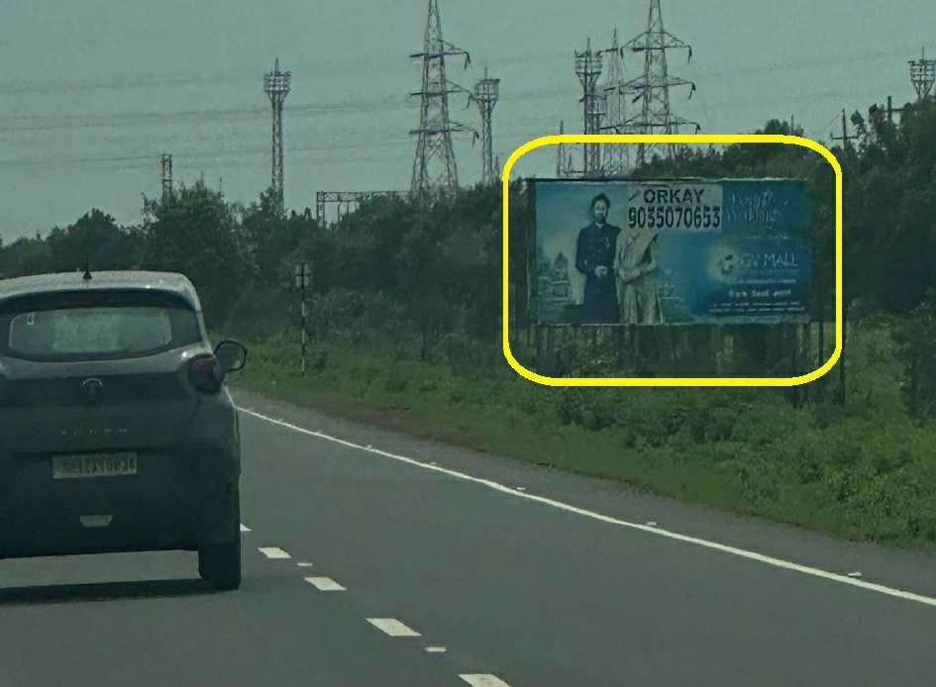
Date: 31-03-2026
ORKAY ADVERTISING & MARKETING SERVICES
#: 2 Zone: Andhoor wadi(Bidar Dist:) Location: [B AW Hd 2] Andhoor wadi State Highway Back to Back -24'x10' Media Type: Hoardings Illumination: NonLit Width: 24.00 Height: 10.00 Total Size: 240.00

Slide 4
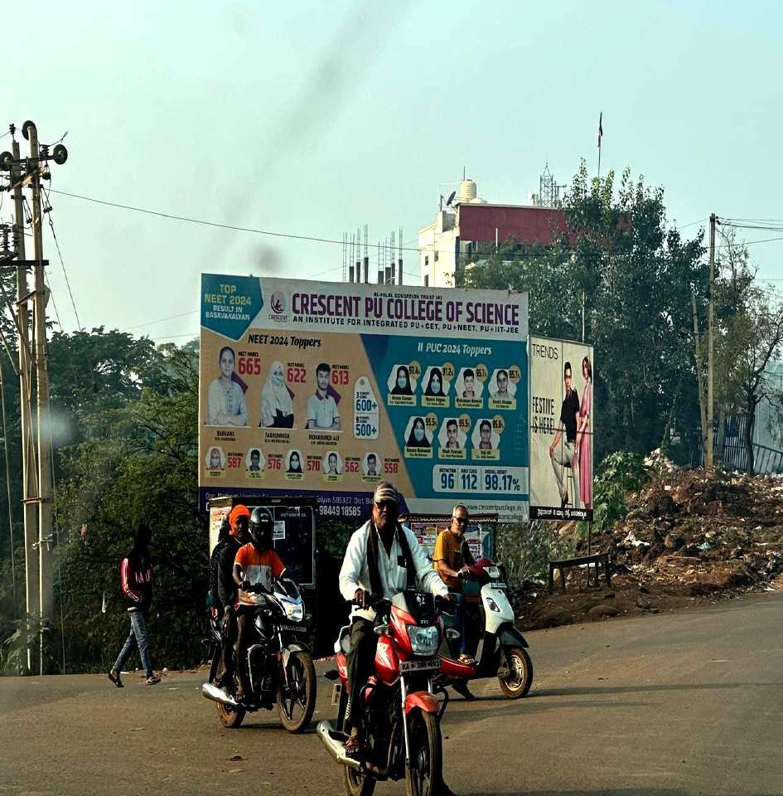
Date: 31-03-2026
ORKAY ADVERTISING & MARKETING SERVICES
#: 3 Zone: Basavakalyan(Bidar Dist:) Location: [BK HD 2] Near Lic Office ,Narayapur Rd-20'x10' Media Type: Hoardings Illumination: NonLit Width: 20.00 Height: 10.00 Total Size: 200.00

Slide 5
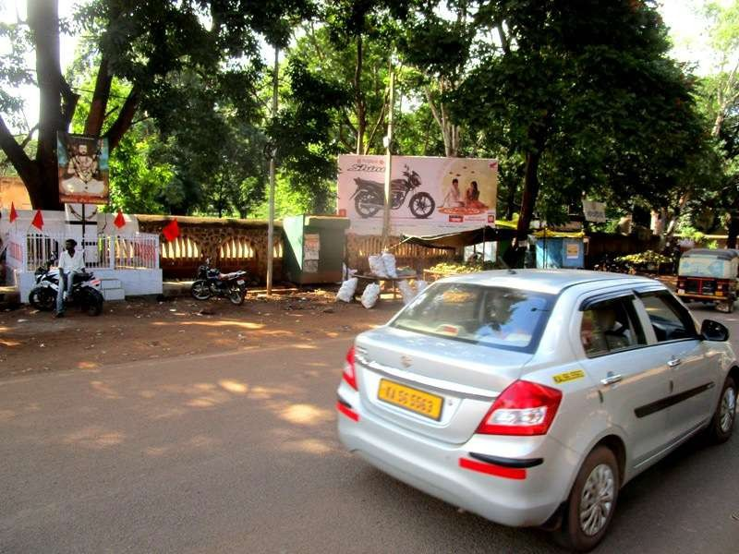
Date: 31-03-2026
ORKAY ADVERTISING & MARKETING SERVICES
#: 4 Zone: Basavakalyan(Bidar Dist:) Location: [BK Hd] Haralayya Circle-20'x07' Media Type: Hoardings Illumination: NonLit Width:
20.00 Height: 7.00 Total Size: 140.00

Slide 6
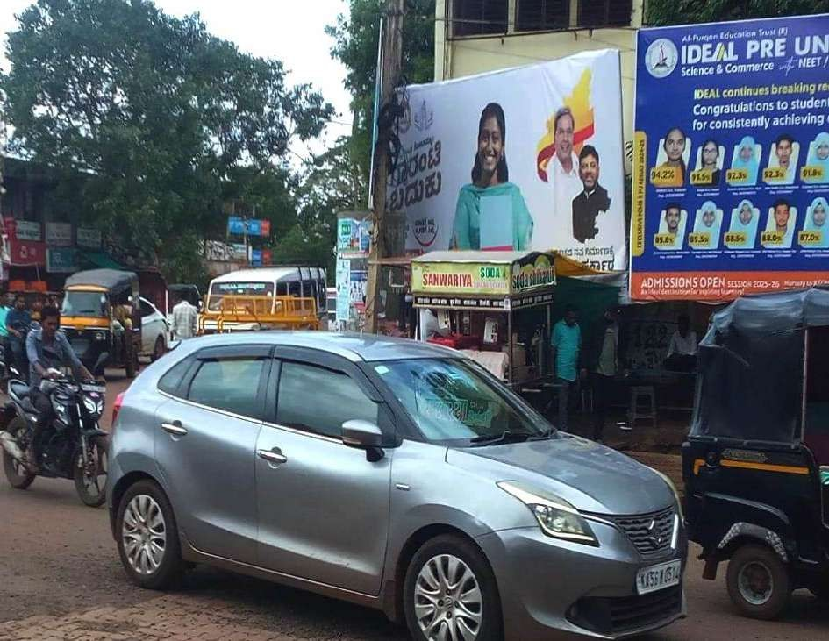
Date: 31-03-2026
ORKAY ADVERTISING & MARKETING SERVICES
#: 5 Zone: Basavakalyan(Bidar Dist:) Location: Ambedkar Circle- 20'x10' Media Type: Hoardings Width: 20.00 Height: 10.00 Total Size: 200.00

Slide 7
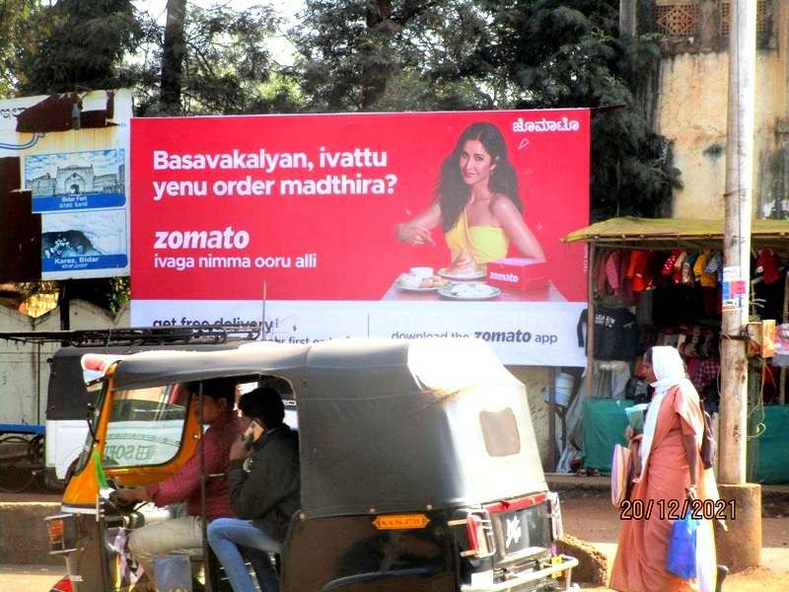
Date: 31-03-2026
ORKAY ADVERTISING & MARKETING SERVICES
#: 6 Zone: Basavakalyan(Bidar Dist:) Location: [BK HD 1] Ambedkar Circle-20x10 Media Type: Hoardings Illumination: NonLit Width: 20.00 Height: 10.00 Total Size: 200.00

Slide 8
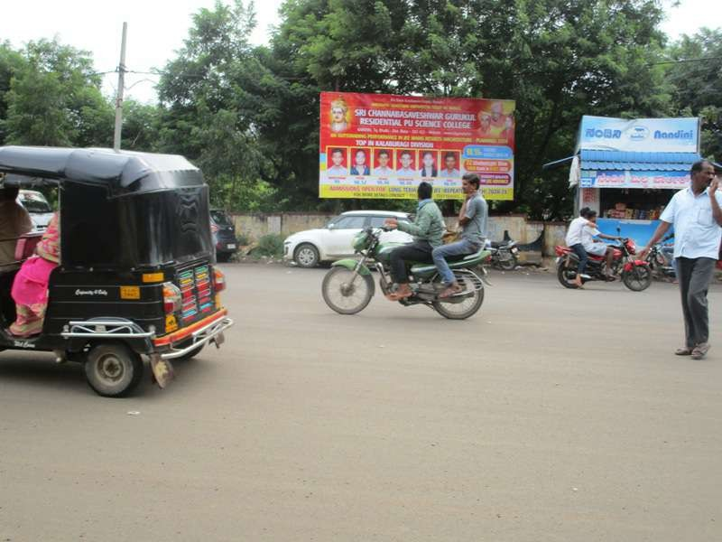
Date: 31-03-2026
ORKAY ADVERTISING & MARKETING SERVICES
#: 7 Zone: Bhalki (Bidar Dist:) Location: [BHLK HD] Basaveshwar Circle-20x10 Media Type: Hoardings Illumination: NonLit Width:
20.00 Height: 10.00 Total Size: 200.00

Slide 9
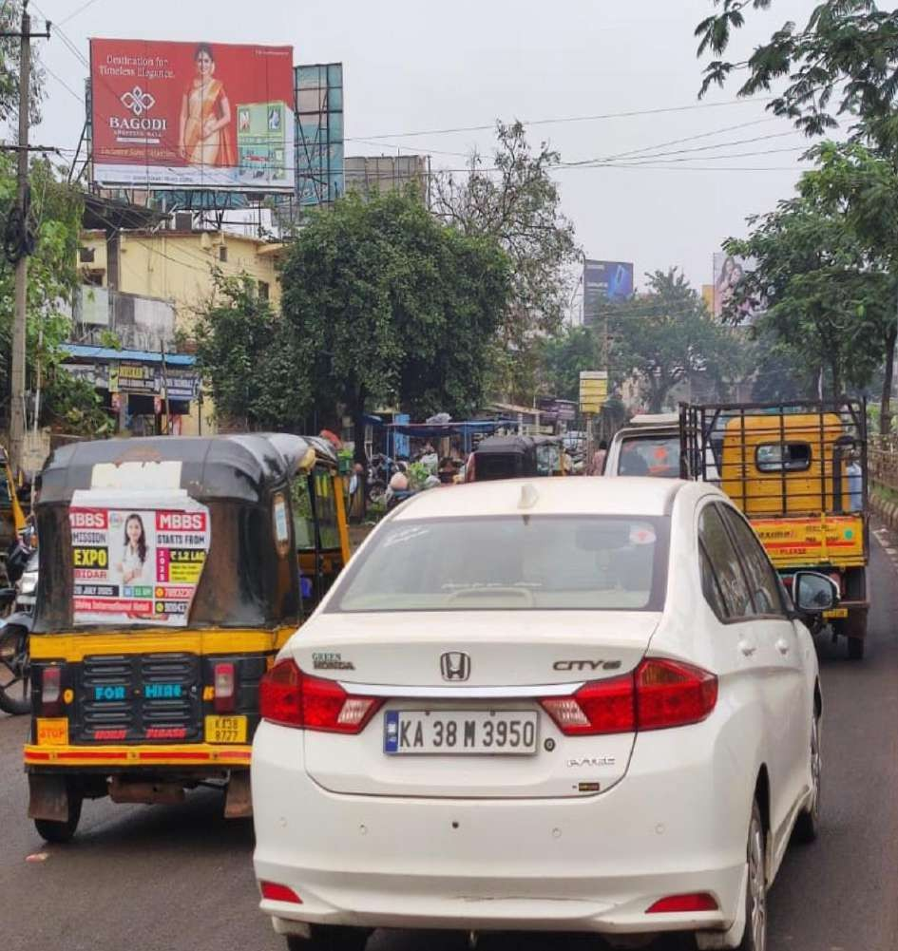
Date: 31-03-2026
ORKAY ADVERTISING & MARKETING SERVICES
#: 8 Zone: Bidar Location: [B Hd 2] Near Govt Hospital( Taluka Panchayat)-25x15 Media Type: Hoardings Illumination: NonLit Width: 25.00 Height: 15.00 Total Size: 375.00

Slide 10
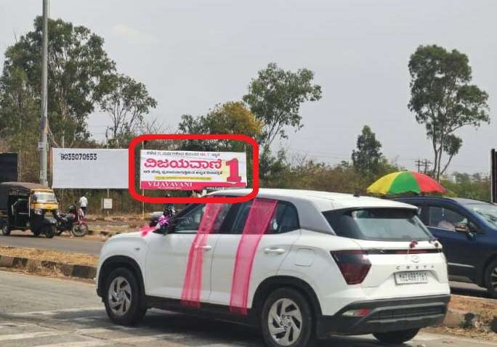
Date: 31-03-2026
ORKAY ADVERTISING & MARKETING SERVICES
#: 9 Zone: Bidar Location: Bhalki Gulbarga Chowrasata 3rd board 30X10 Media Type: Hoardings Illumination: NonLit Width: 30.00 Height: 10.00 Total Size: 300.00

Slide 11
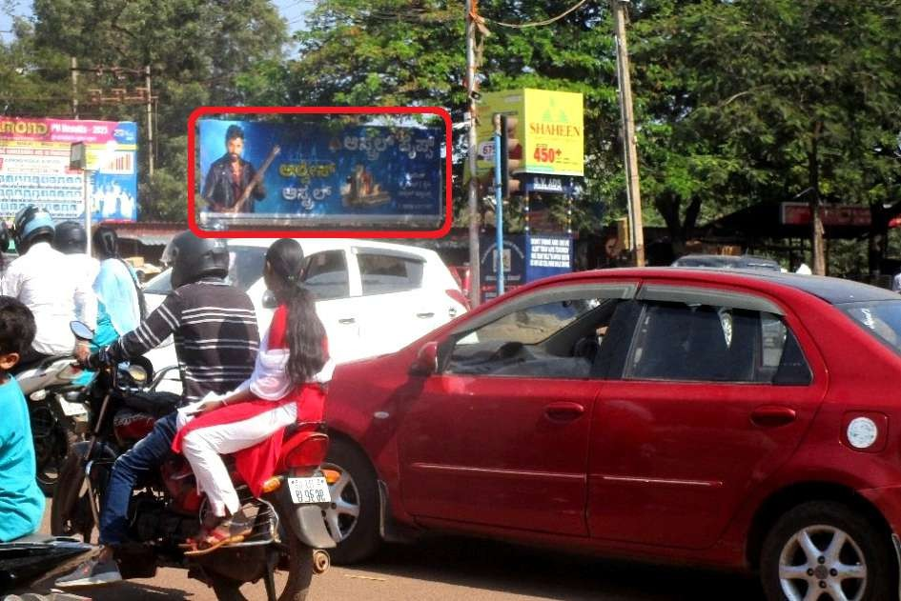
Date: 31-03-2026
ORKAY ADVERTISING & MARKETING SERVICES
#: 10 Zone: Bidar Location: [B Hd 3] Basaveshwar Circle-30'x09' Media Type: Hoardings Illumination: NonLit Width: 30.00 Height: 9.00 Total Size: 270.00

Slide 12
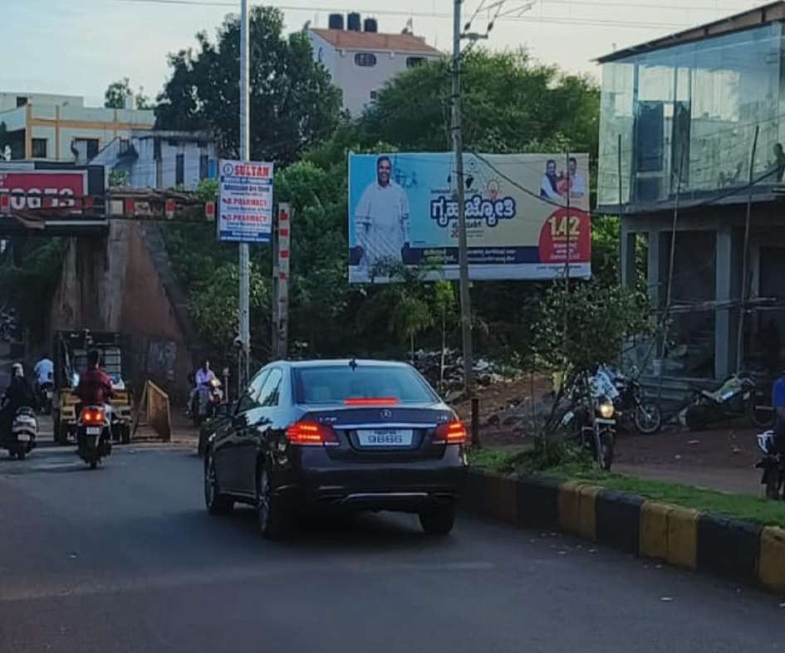
Date: 31-03-2026
ORKAY ADVERTISING & MARKETING SERVICES
#: 11 Zone: Bidar Location: [B Hd] Near Basaveshwar Circle- Railway Under Bridge-22x10 Media Type: Hoardings Illumination: NonLit Width: 22.00 Height: 10.00 Total Size: 220.00

Slide 13
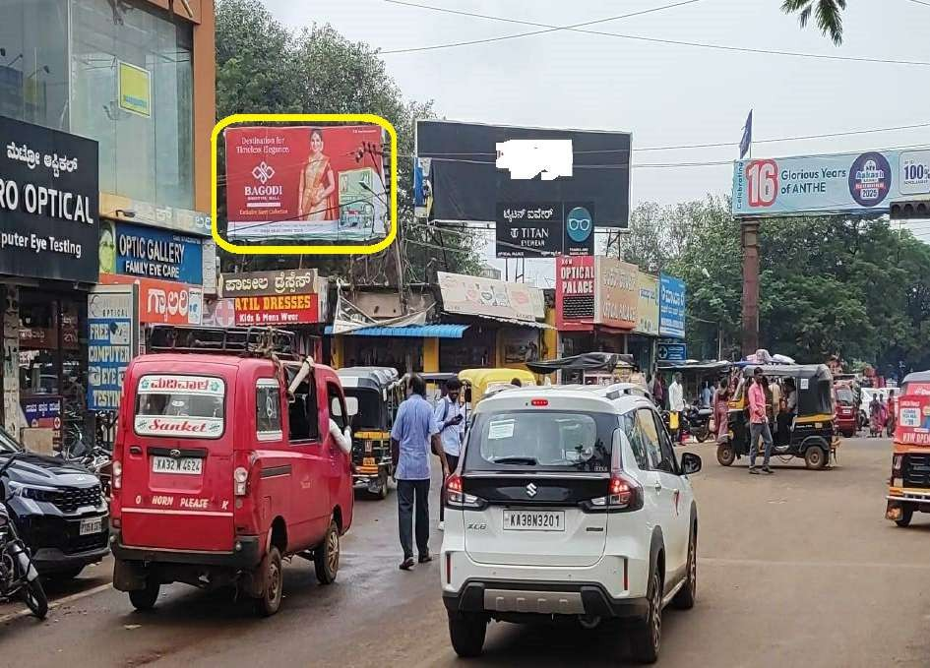
Date: 31-03-2026
ORKAY ADVERTISING & MARKETING SERVICES
#: 12 Zone: Bidar Location: [B Hd] Kariappa Cricle-( Back Ward complex)-20x10 Media Type: Hoardings Illumination: NonLit Width: 20.00 Height: 10.00 Total Size: 200.00

Slide 14
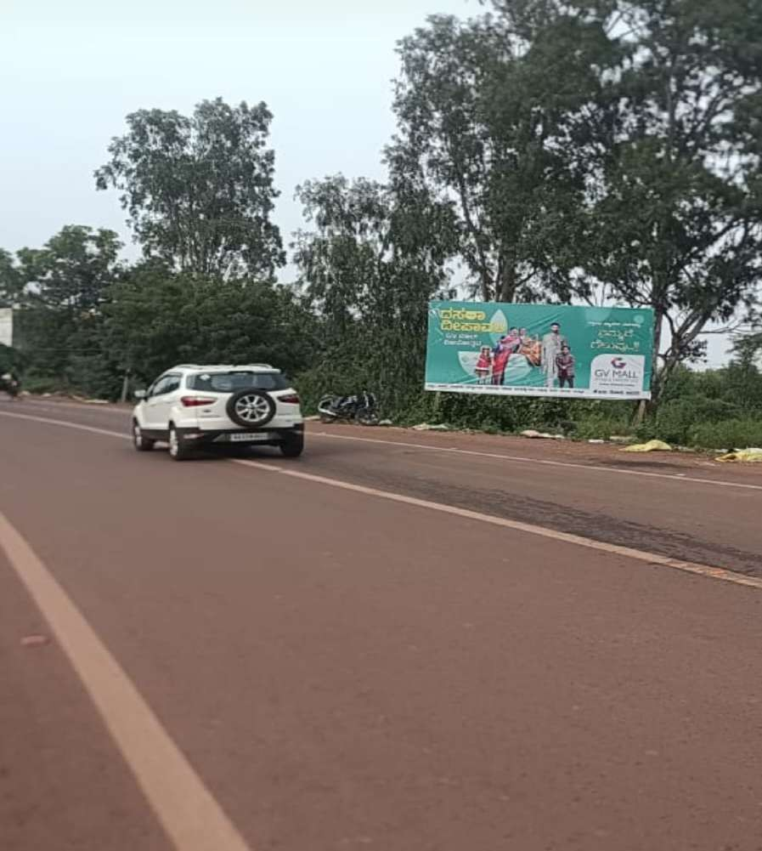
Date: 31-03-2026
ORKAY ADVERTISING & MARKETING SERVICES
#: 13 Zone: Bidar Location: [B Hd] Opp Dental college Gulbaraga rd-20x10 Media Type: Hoardings Illumination: NonLit Width:
20.00 Height: 10.00 Total Size: 200.00

Slide 15
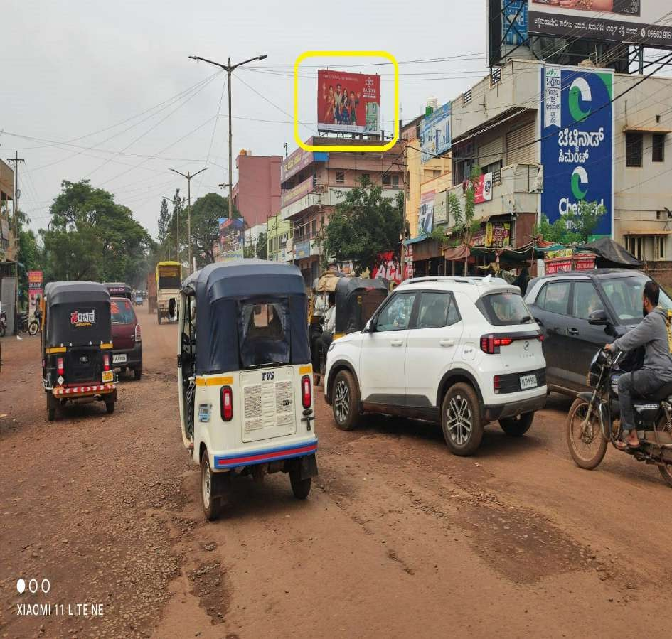
Date: 31-03-2026
ORKAY ADVERTISING & MARKETING SERVICES
#: 14 Zone: Bidar Location: [B Hd] Gummpa Rd on Cananra Bank- 28x15 Media Type: Hoardings Illumination: NonLit Width: 28.00 Height: 15.00 Total Size: 420.00

Slide 16
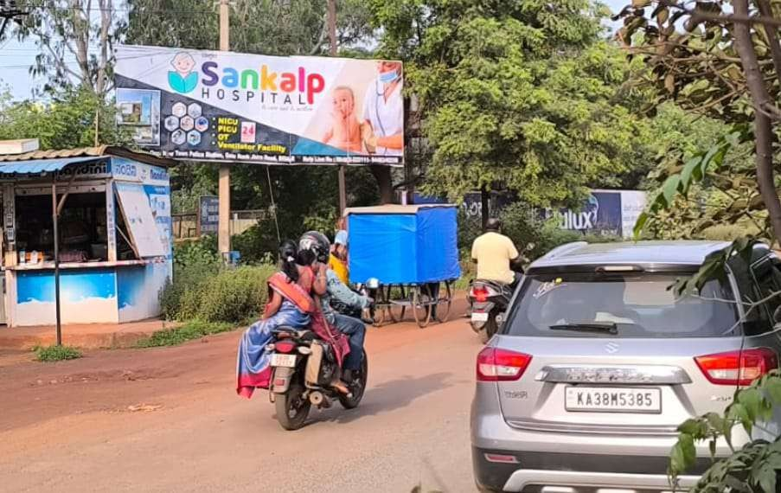
Date: 31-03-2026
ORKAY ADVERTISING & MARKETING SERVICES
#: 15 Zone: Bidar Location: [B Hd] Near New RTO Office Gulbarga rd-20'X07' Media Type: Hoardings Illumination: NonLit Width:
20.00 Height: 7.00 Total Size: 140.00

Slide 17
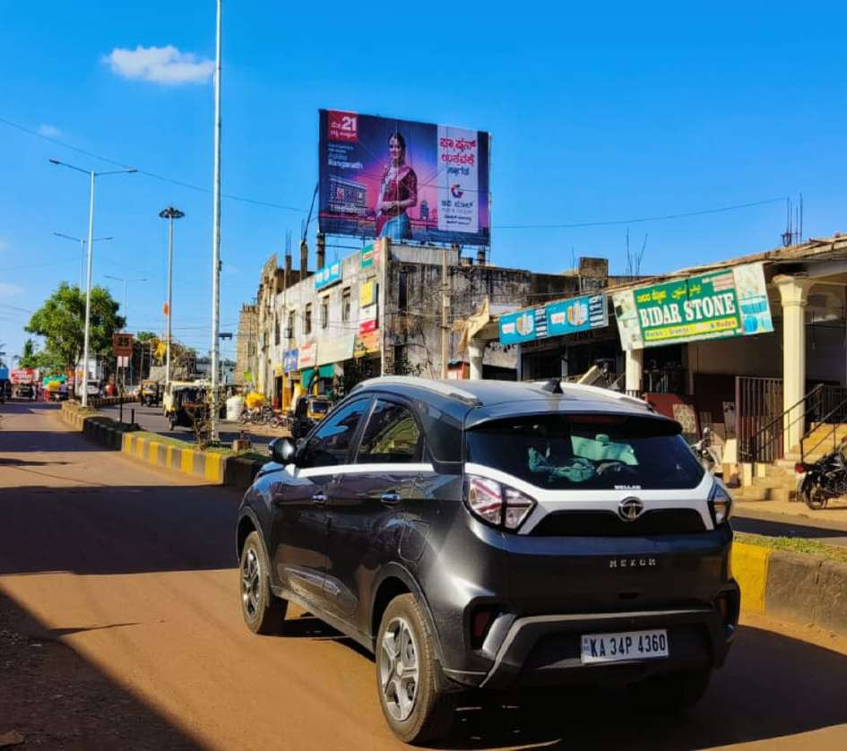
Date: 31-03-2026
ORKAY ADVERTISING & MARKETING SERVICES
#: 16 Zone: Bidar Location: [B Hd] Basaveshwar Circle-Near Railway Bridge-35'x20' Media Type: Hoardings Illumination: NonLit Width: 35.00 Height: 20.00 Total Size: 700.00

Slide 18
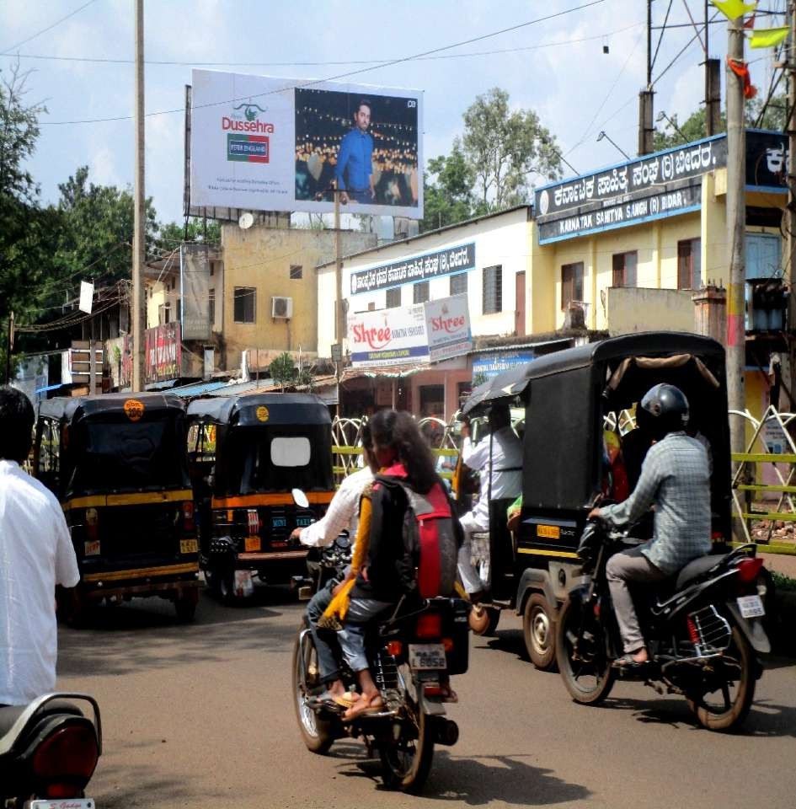
Date: 31-03-2026
ORKAY ADVERTISING & MARKETING SERVICES
#: 17 Zone: Bidar Location: [B Hd 1] Ambedkar circle(Taluka Panchayat)-38x15 Media Type: Hoardings Illumination: NonLit Width: 38.00 Height: 15.00 Total Size: 570.00

Slide 19
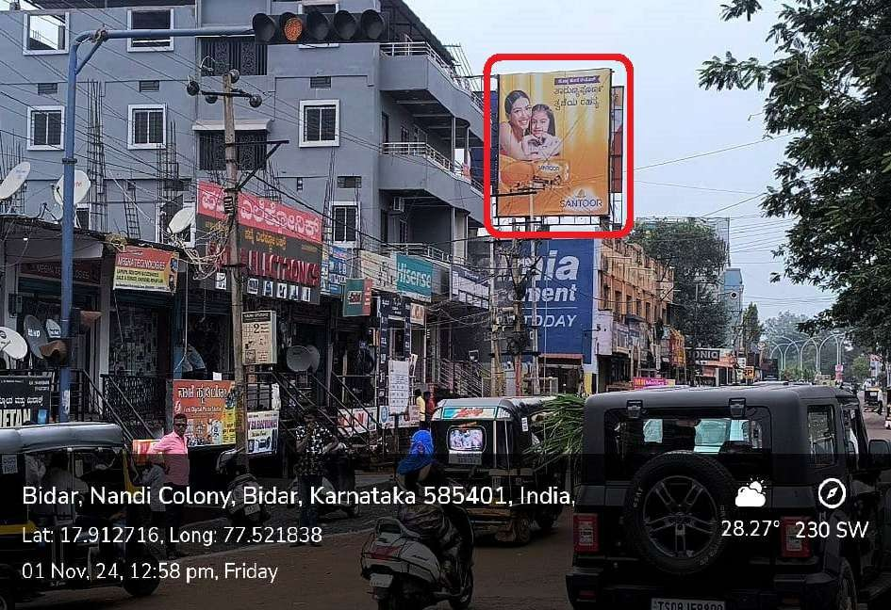
Date: 31-03-2026
ORKAY ADVERTISING & MARKETING SERVICES
#: 18 Zone: Bidar Location: [B Hd 1] Basaveshwar circle(Sindol Building)-17'x20' Media Type: Hoardings Illumination: NonLit Width: 17.00 Height: 20.00 Total Size: 340.00

Slide 20
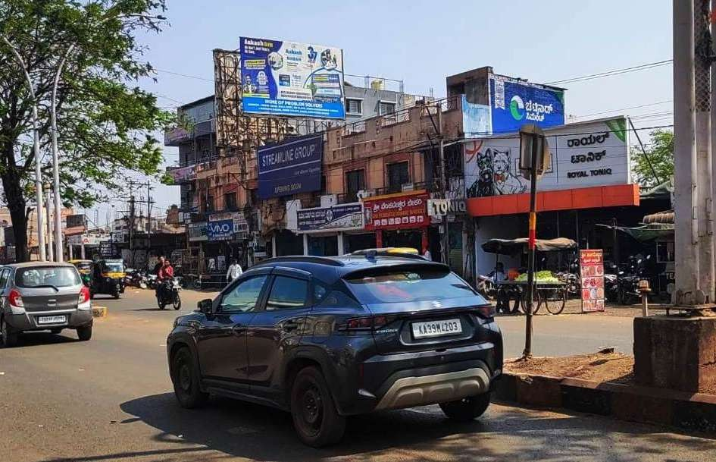
Date: 31-03-2026
ORKAY ADVERTISING & MARKETING SERVICES
#: 19 Zone: Bidar Location: [B Hd 2] Basaveshwar Circle Back to Back(Sindol Building)-25x15-25x15 Media Type: Hoardings Illumination: NonLit Width: 25.00 Height: 15.00 Total Size: 375.00

Slide 21
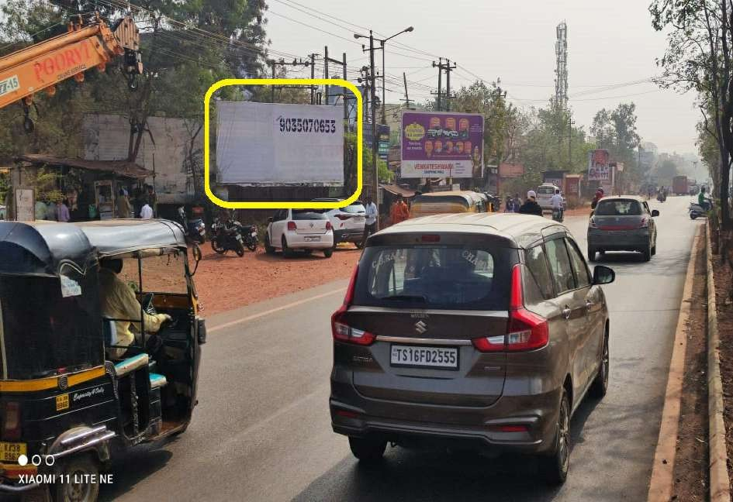
Date: 31-03-2026
ORKAY ADVERTISING & MARKETING SERVICES
#: 20 Zone: Bidar Location: Bidar Rto office Main Gate -20x10 Media Type: Hoardings Illumination: NonLit Width: 20.00 Height: 10.00 Total Size: 200.00

Slide 22
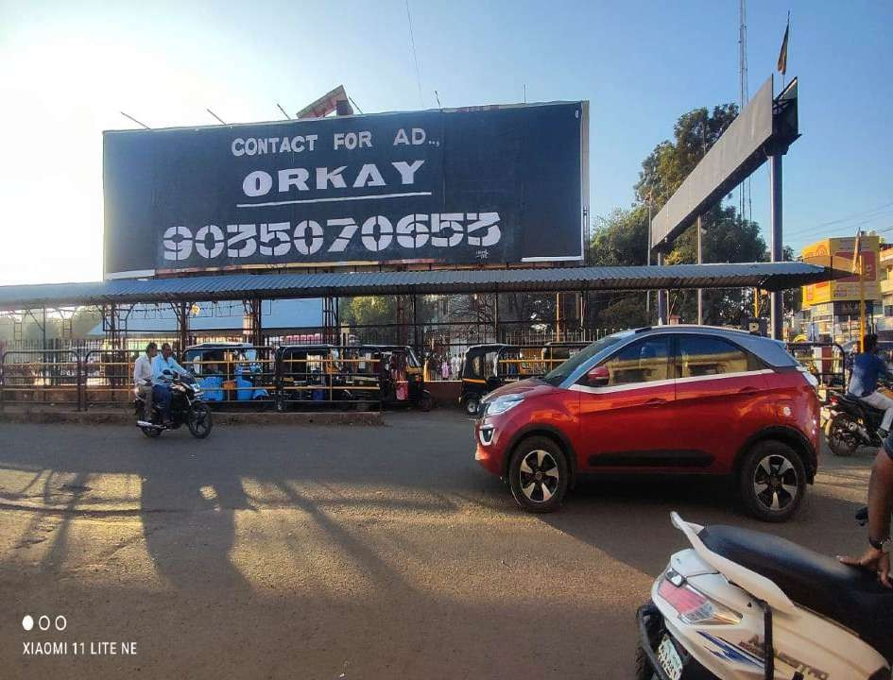
Date: 31-03-2026
ORKAY ADVERTISING & MARKETING SERVICES
#: 21 Zone: Bidar Location: [B Hd] Bus stand rd-64'x15' Media Type: Hoarding Illumination: NonLit Width: 64.00 Height: 15.00 Total Size: 960.00

Slide 23
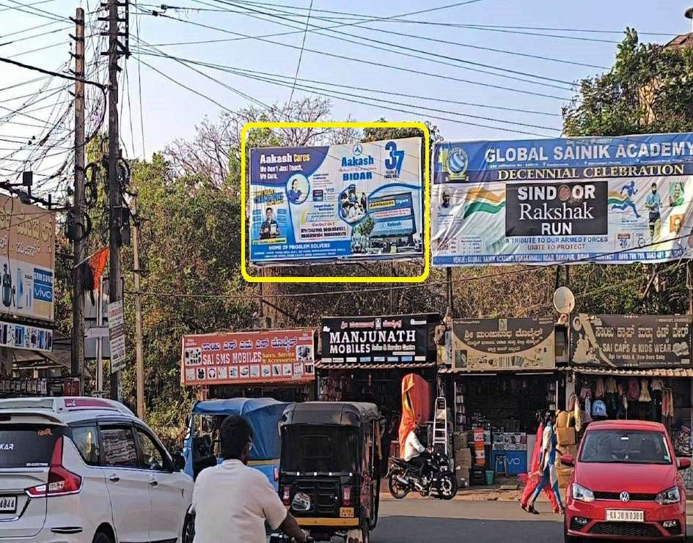
Date: 31-03-2026
ORKAY ADVERTISING & MARKETING SERVICES
#: 22 Zone: Bidar Location: [B Hd 2] Backward complex-Station rd- 20'x10' Media Type: Hoardings Illumination: NonLit Width: 20.00 Height: 10.00 Total Size: 200.00

Slide 24
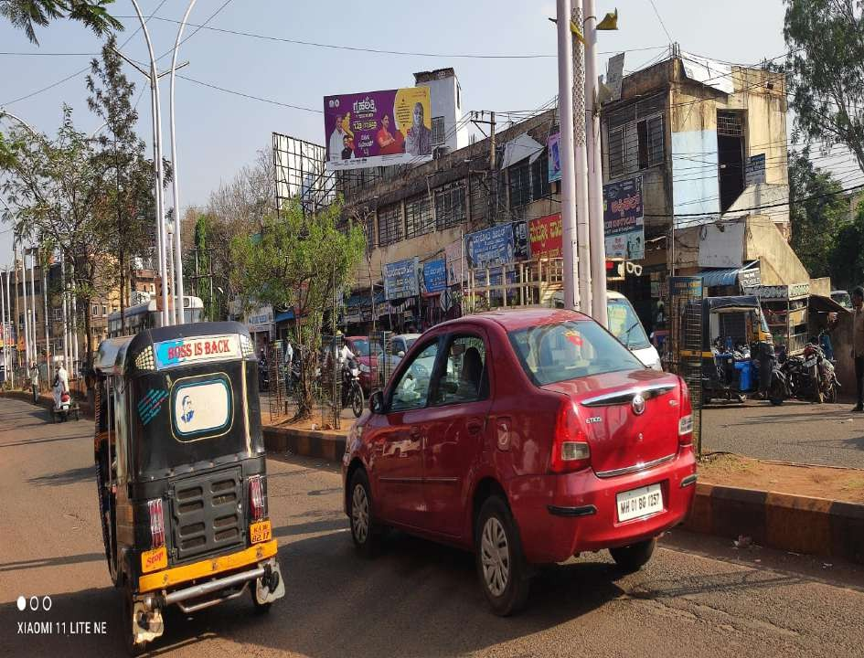
Date: 31-03-2026
ORKAY ADVERTISING & MARKETING SERVICES
#: 23 Zone: Bidar Location: [B Hd] Ambedkar circle-(CMC Complex)-24x10 Media Type: Hoardings Illumination: NonLit Width: 24.00 Height: 10.00 Total Size: 240.00

Slide 25
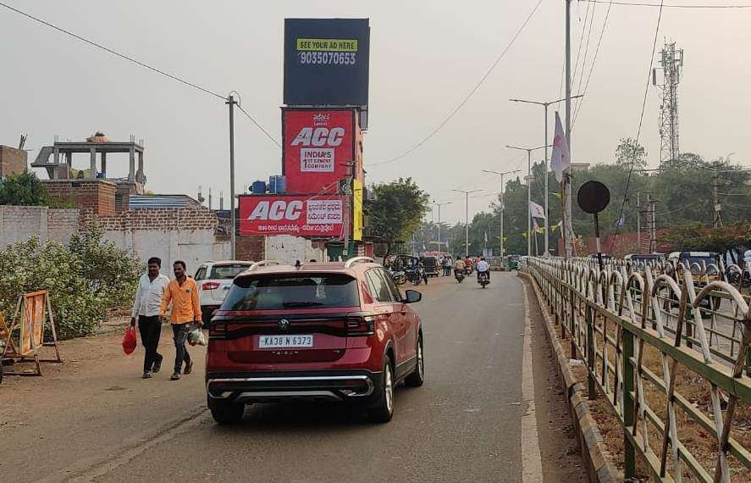
Date: 31-03-2026
ORKAY ADVERTISING & MARKETING SERVICES
#: 24 Zone: Bidar Location: Near Ambedkar Circle,Janwada Rd- 20'x20' Media Type: Hoardings Width: 20.00 Height: 20.00 Total Size: 400.00

Slide 26
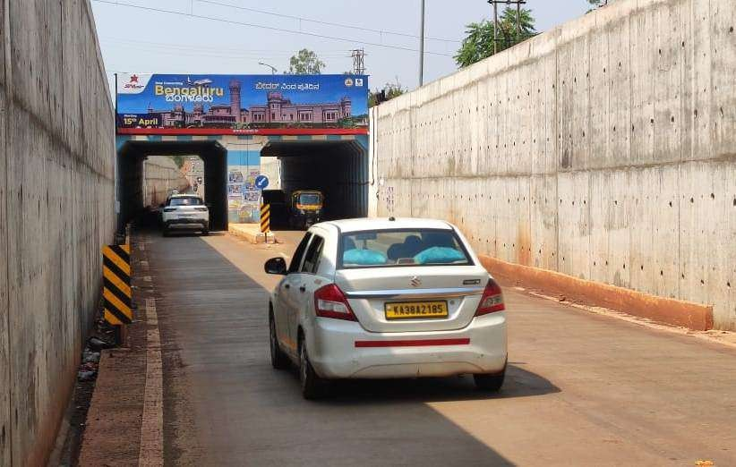
Date: 31-03-2026
ORKAY ADVERTISING & MARKETING SERVICES
#: 25 Zone: Bidar Location: RUB Near Reshmi ilakhe,Naubad rd-
33.6x08 Media Type: Gantry Width: 33.60 Height: 8.00 Total Size: 268.80

Slide 27
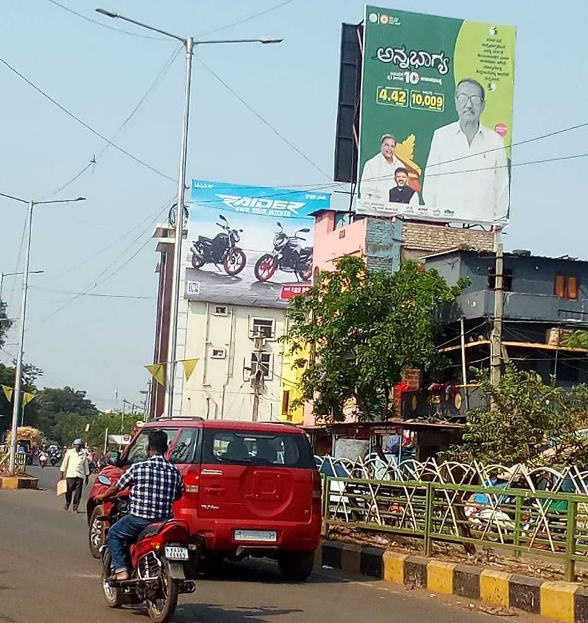
Date: 31-03-2026
ORKAY ADVERTISING & MARKETING SERVICES
#: 26 Zone: Bidar Location: Near Ambekdar Circle,Janwada Rd, Back to Back-20'x20' Media Type: Hoardings Width: 20.00 Height: 25.00 Total Size: 500.00

Slide 28
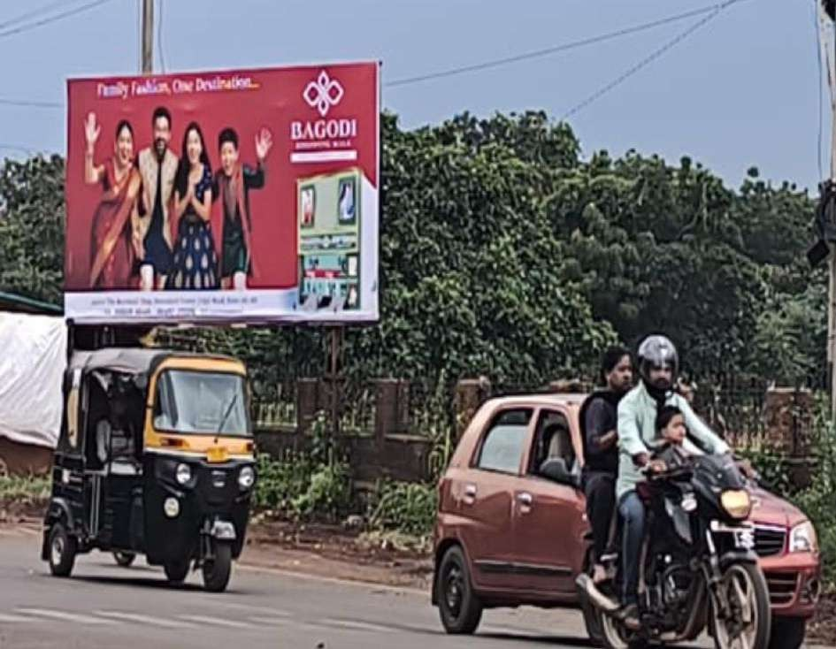
Date: 31-03-2026
ORKAY ADVERTISING & MARKETING SERVICES
#: 27 Zone: Bidar Location: Shivanagar Circle-20x10 Media Type: Hoardings Illumination: NonLit Width: 20.00 Height: 10.00 Total Size: 200.00

Slide 29
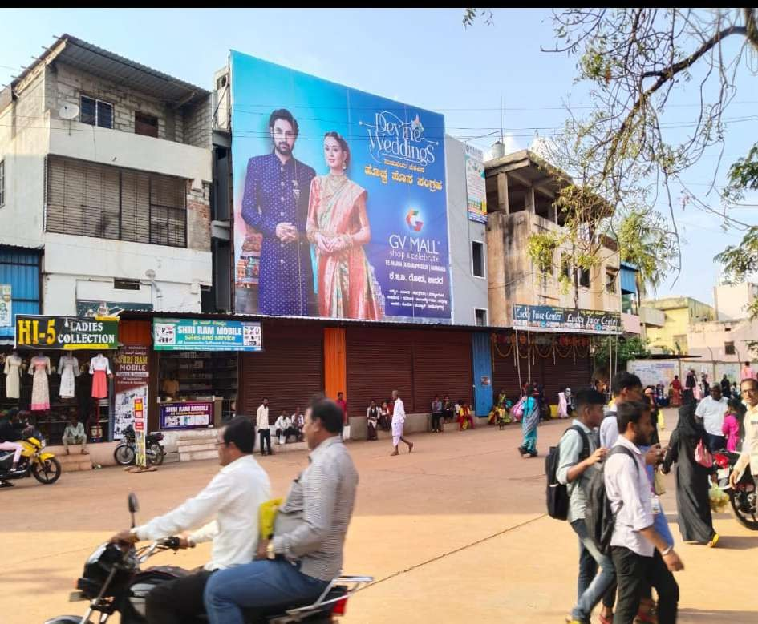
Date: 31-03-2026
ORKAY ADVERTISING & MARKETING SERVICES
#: 28 Zone: Bidar Location: Old Bus Stand -35x30 Media Type:
Hoardings Width: 35.00 Height: 30.00 Total Size: 1050.00

Slide 30
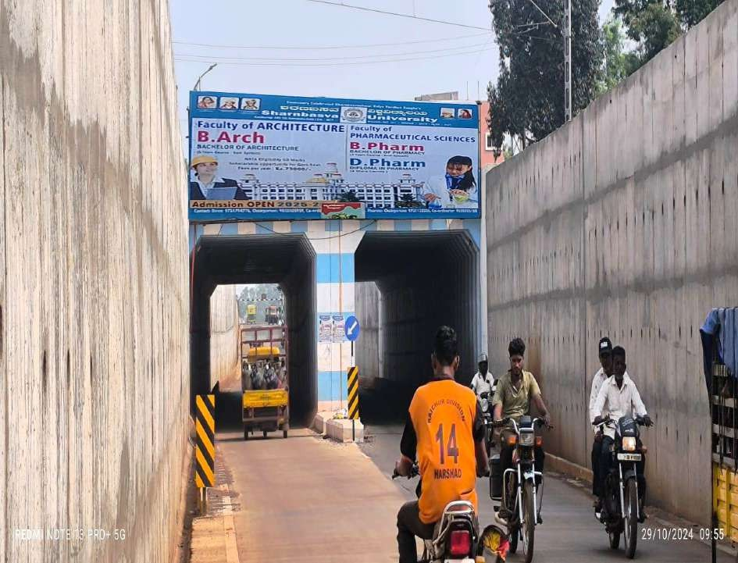
Date: 31-03-2026
ORKAY ADVERTISING & MARKETING SERVICES
#: 29 Zone: Bidar Location: RUB-Near Resmi ilakhe naubad rd-
33.6'x08' Media Type: Gantry Width: 33.60 Height: 8.00 Total Size: 268.80

Slide 31
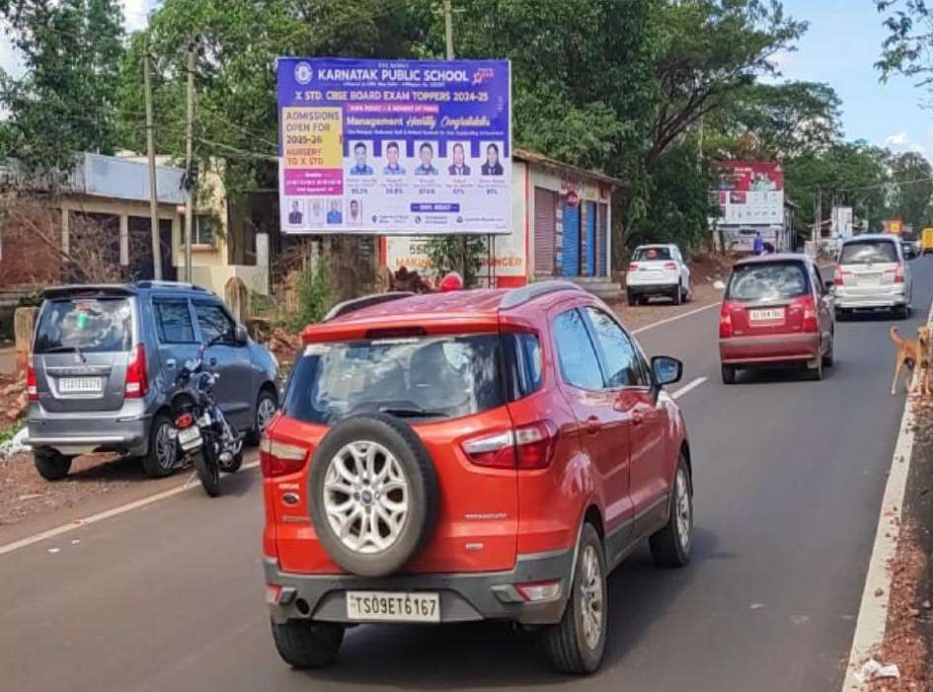
Date: 31-03-2026
ORKAY ADVERTISING & MARKETING SERVICES
#: 30 Zone: Bidar Location: Noubad City Entrance,Beside DIC office 2nd 20x12 Media Type: Hoardings Illumination: NonLit Width: 20.00 Height: 12.00 Total Size: 240.00

Slide 32
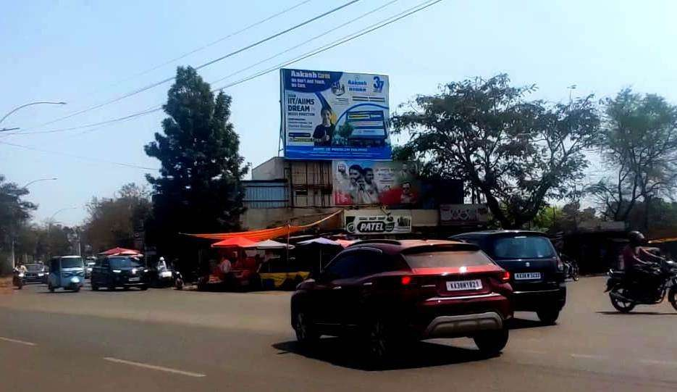
Date: 31-03-2026
ORKAY ADVERTISING & MARKETING SERVICES
#: 31 Zone: Bidar Location: [B Hd 1] Old RTO Office Road-25x20 Media Type: Hoardings Illumination: NonLit Width: 25.00 Height: 20.00 Total Size: 500.00

Slide 33
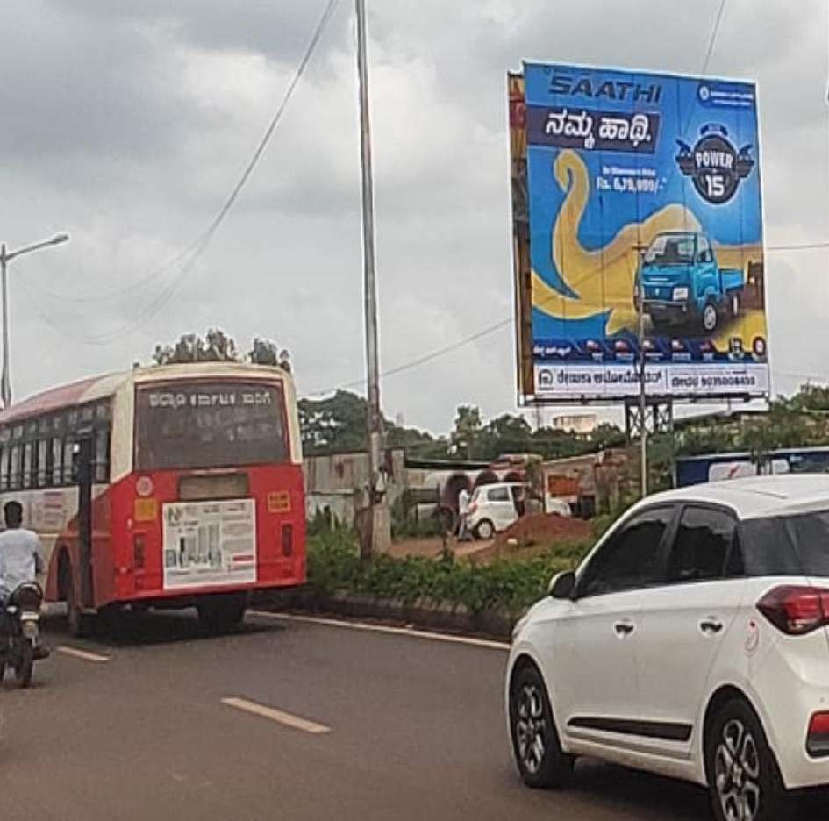
Date: 31-03-2026
ORKAY ADVERTISING & MARKETING SERVICES
#: 32 Zone: Bidar Location: Naubad-Entrance from Gulbarga- 30x30 Media Type: Unipole Width: 30.00 Height: 30.00 Total Size: 900.00

Slide 34
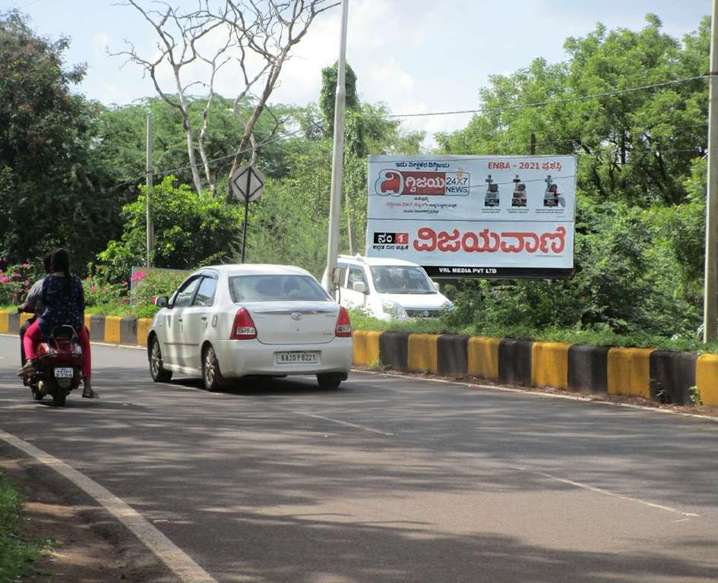
Date: 31-03-2026
ORKAY ADVERTISING & MARKETING SERVICES
#: 33 Zone: Bidar Location: [B Hd] Near Noor College Hyd Road- 20x10 Media Type: Hoardings Illumination: NonLit Width: 20.00 Height: 10.00 Total Size: 200.00

Slide 35
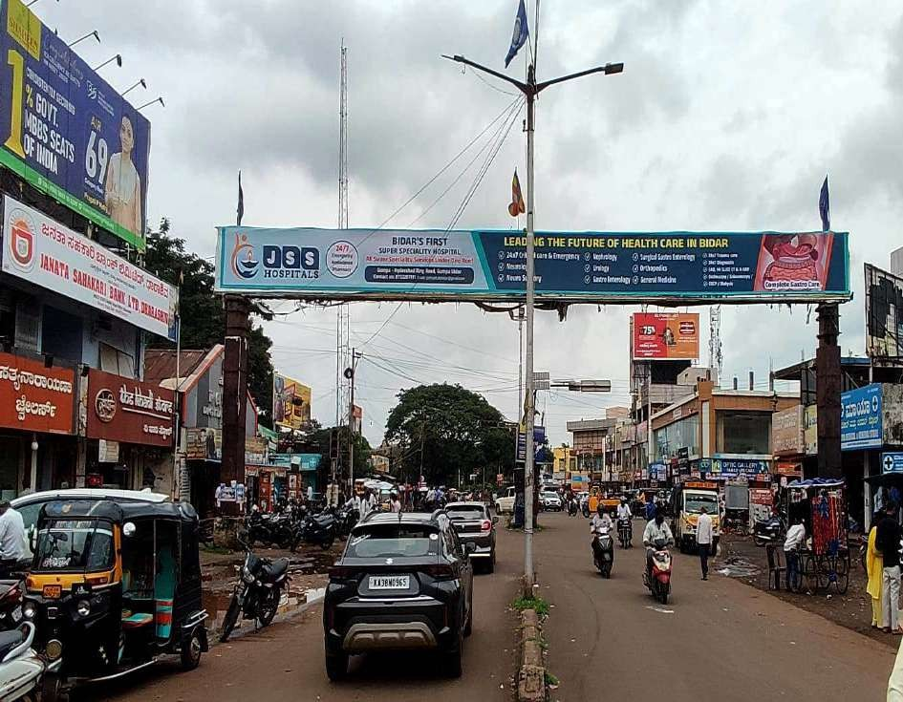
Date: 31-03-2026
ORKAY ADVERTISING & MARKETING SERVICES
#: 34 Zone: Bidar Location: [B GT 2] Govt Hospital Circle-Back To Back-80x06 Media Type: Gantry Illumination: NonLit Width:
80.00 Height: 6.00 Total Size: 480.00

Slide 36
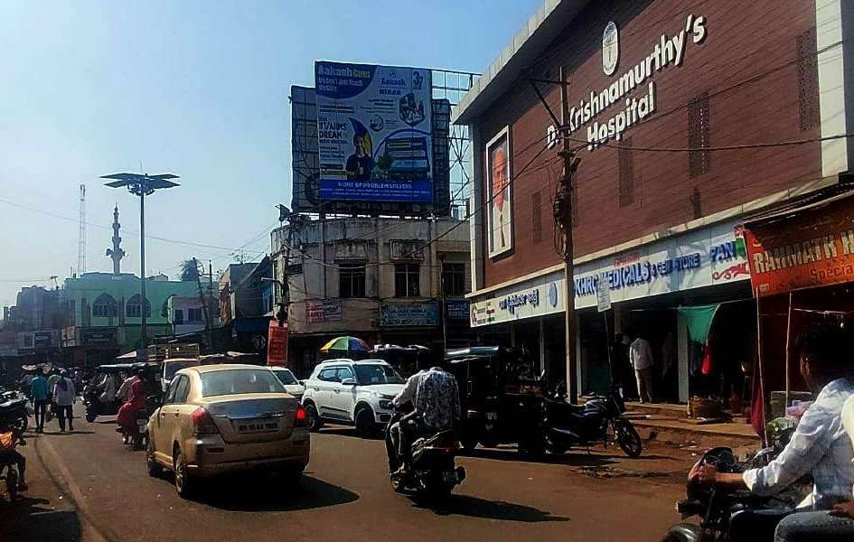
Date: 31-03-2026
ORKAY ADVERTISING & MARKETING SERVICES
#: 35 Zone: Bidar Location: [B Hd] Old city Naya Kaman (Facing old City)-20x20 Media Type: Hoardings Illumination: NonLit Width: 20.00 Height: 20.00 Total Size: 400.00

Slide 37
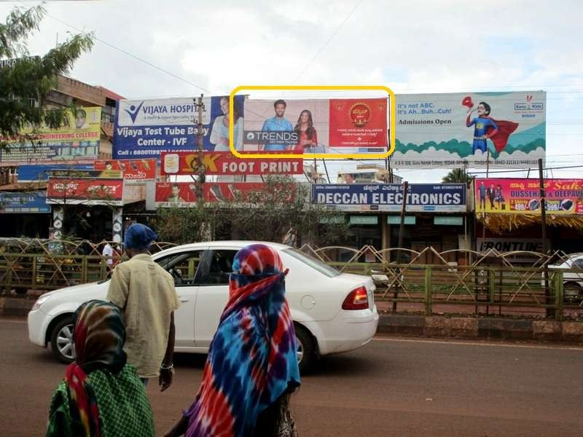
Date: 31-03-2026
ORKAY ADVERTISING & MARKETING SERVICES
#: 36 Zone: Bidar Location: [B Hd 5] New Opp:Bus Stand (GND Complex)-24x08 Media Type: Hoardings Illumination: NonLit Width: 24.00 Height: 8.00 Total Size: 192.00

Slide 38
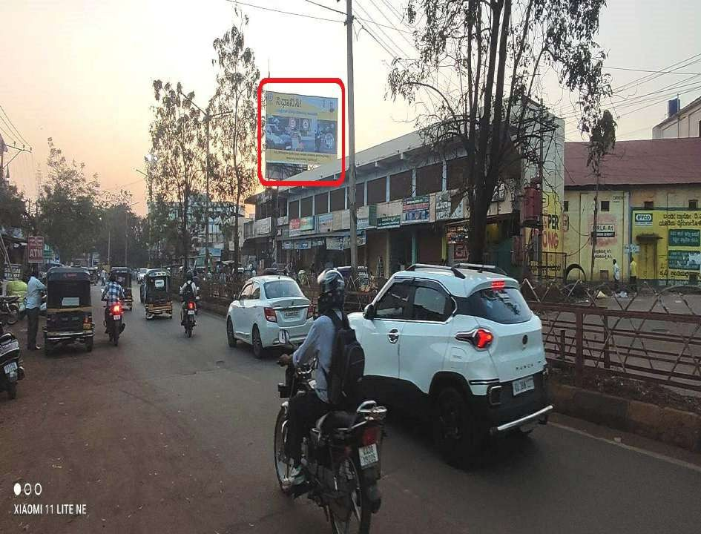
Date: 31-03-2026
ORKAY ADVERTISING & MARKETING SERVICES
#: 37 Zone: Bidar Location: [B Hd 2] Gunj Road-35x20 Media Type: Hoardings Width: 35.00 Height: 20.00 Total Size: 700.00

Slide 39
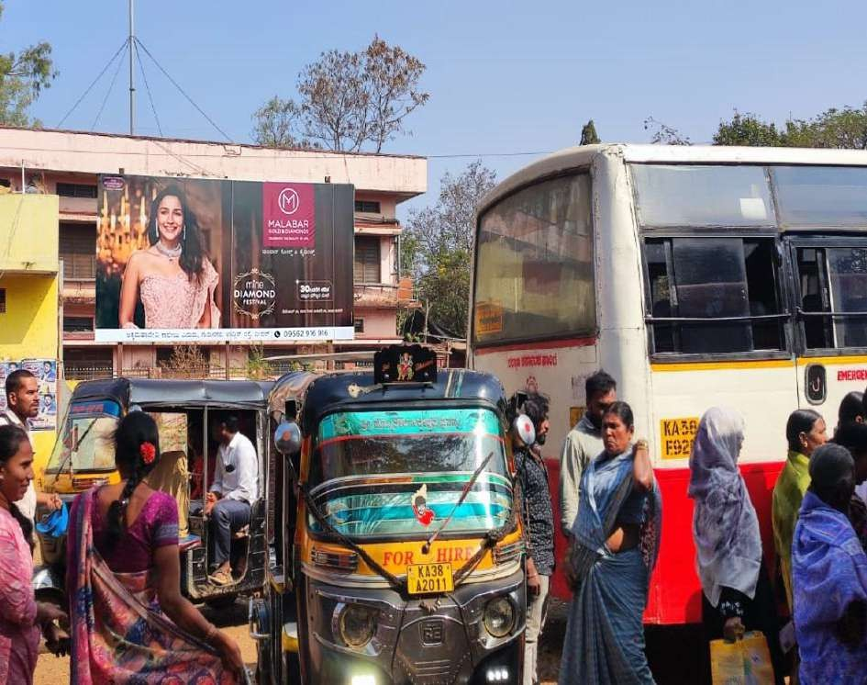
Date: 31-03-2026
ORKAY ADVERTISING & MARKETING SERVICES
#: 38 Zone: Bidar Location: bidar-Opp Sidharth collage bus stand janwada Rd 20x10 Media Type: Hoardings Illumination: NonLit Width: 20.00 Height: 10.00 Total Size: 200.00

Slide 40
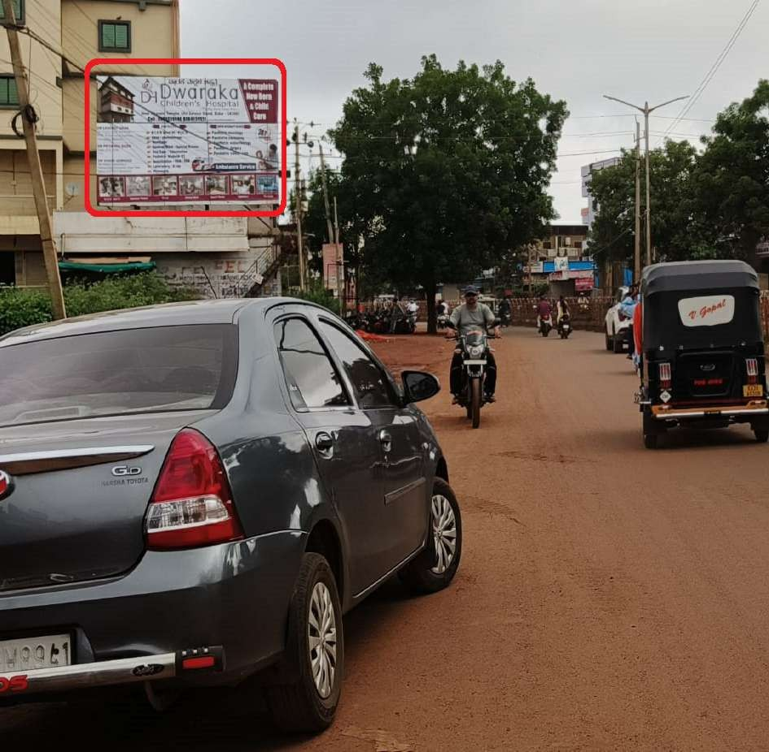
Date: 31-03-2026
ORKAY ADVERTISING & MARKETING SERVICES
#: 39 Zone: Bidar Location: [BH-] Opp Beldale Petrolpump,Gumppa Rd-26'x16' Media Type: Hoardings Width: 26.00 Height: 16.00 Total Size: 416.00

Slide 41
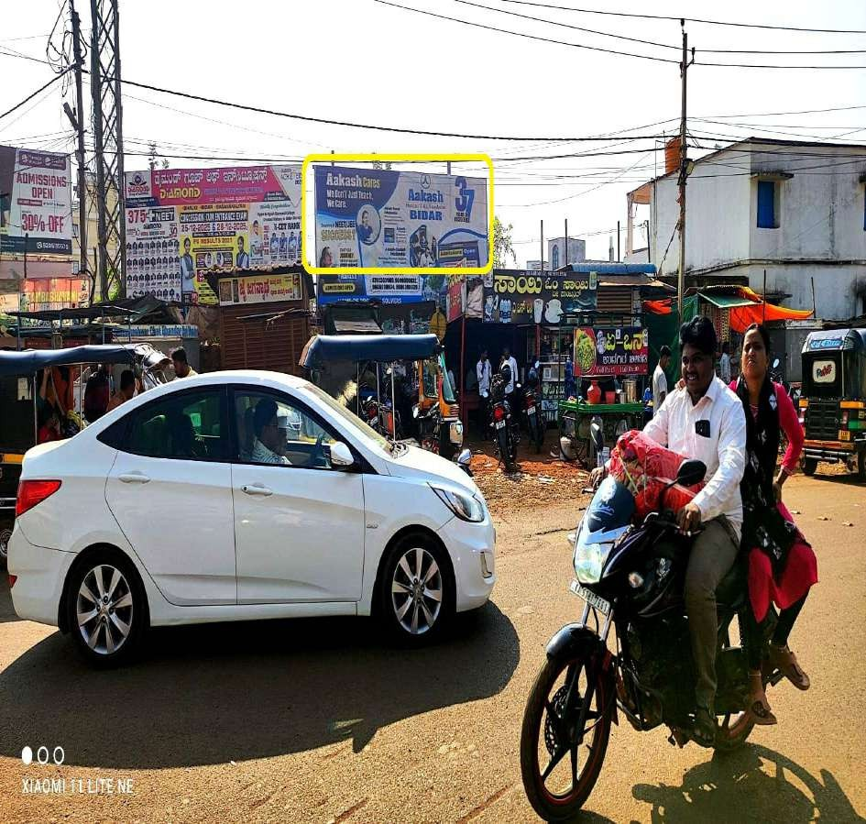
Date: 31-03-2026
ORKAY ADVERTISING & MARKETING SERVICES
#: 40 Zone: Bidar Location: [B Hd] Noubad Circle , Gulbaraga Road-3rd- 20'x07' Media Type: Hoardings Illumination: NonLit Width: 20.00 Height: 7.00 Total Size: 140.00

Slide 42
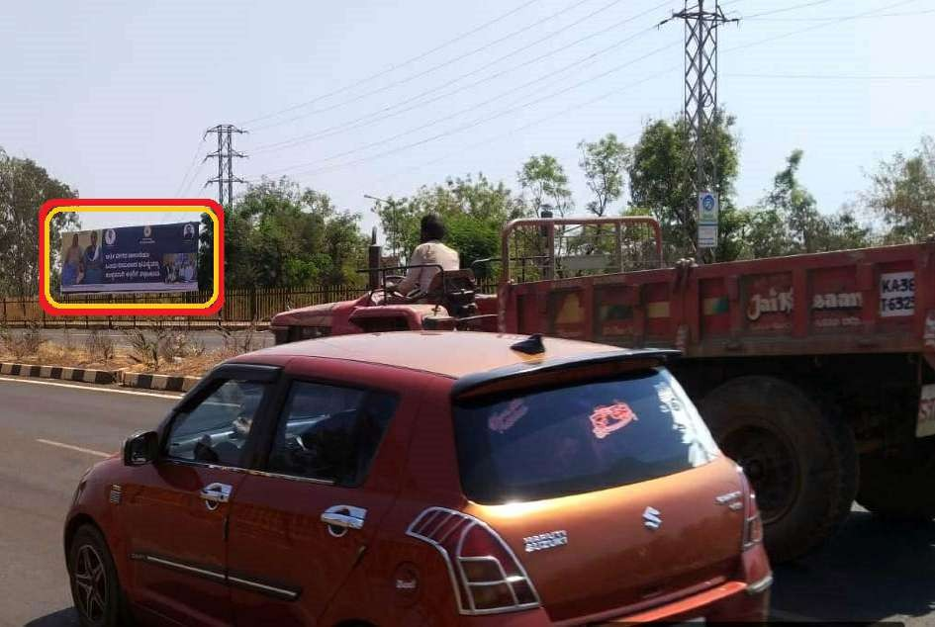
Date: 31-03-2026
ORKAY ADVERTISING & MARKETING SERVICES
#: 41 Zone: Bidar Location: Entrance from Gulbarga-40'x12' Media Type: Hoardings Width: 40.00 Height: 12.00 Total Size: 480.00

Slide 43
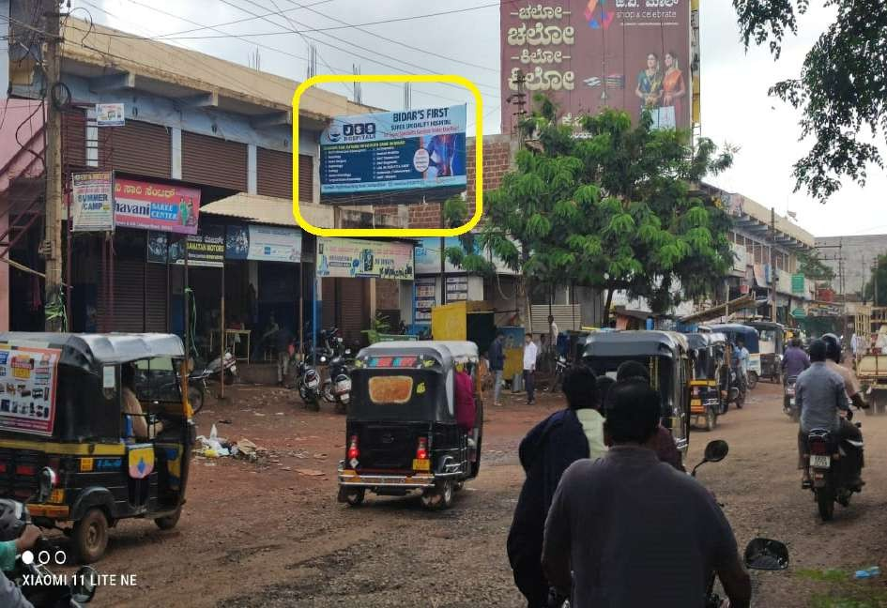
Date: 31-03-2026
ORKAY ADVERTISING & MARKETING SERVICES
#: 42 Zone: Bidar Location: Near Axises Bank,Gunj Road-20'x07' Media Type: Hoardings Width: 20.00 Height: 7.00 Total Size: 140.00

Slide 44
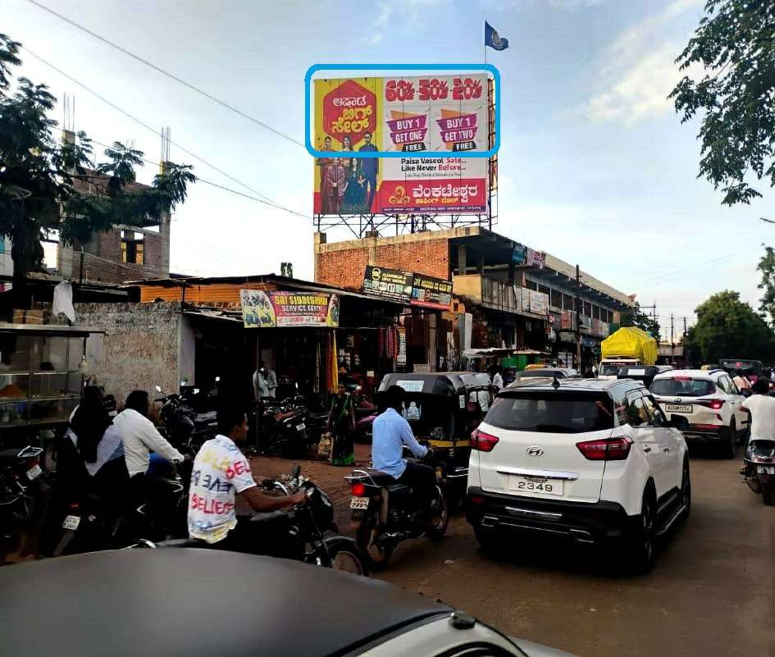
Date: 31-03-2026
ORKAY ADVERTISING & MARKETING SERVICES
#: 43 Zone: Bidar Location: [B Hd 1] Near Big Bazar, Opp Harigeri Kaman -35x25 Media Type: Hoardings Illumination: NonLit Width: 35.00 Height: 10.00 Total Size: 350.00

Slide 45
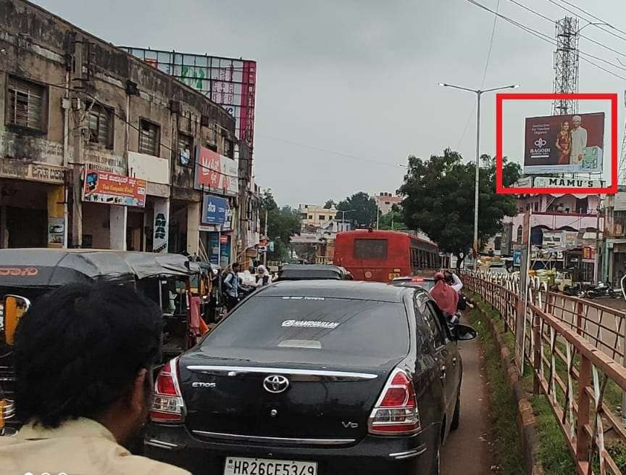
Date: 31-03-2026
ORKAY ADVERTISING & MARKETING SERVICES
#: 45 Zone: Bidar Location: Basaveshwar Circle-30'x20' Media Type: Hoardings Illumination: NonLit Width: 30.00 Height: 20.00 Total Size: 600.00

Slide 46
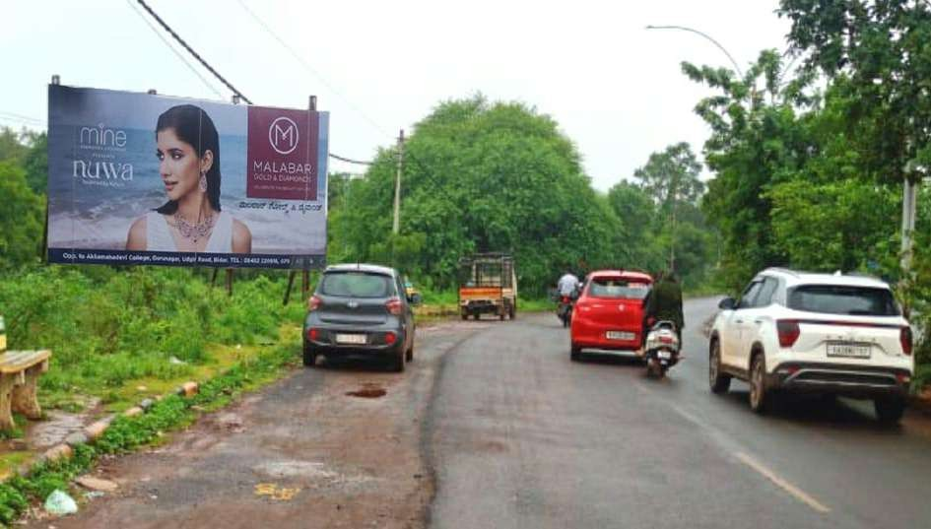
Date: 31-03-2026
ORKAY ADVERTISING & MARKETING SERVICES
#: 46 Zone: Bidar Location: Old Rto Office Road-30'x15' Media Type: Hoardings Illumination: NonLit Width: 30.00 Height: 15.00 Total Size: 450.00

Slide 47
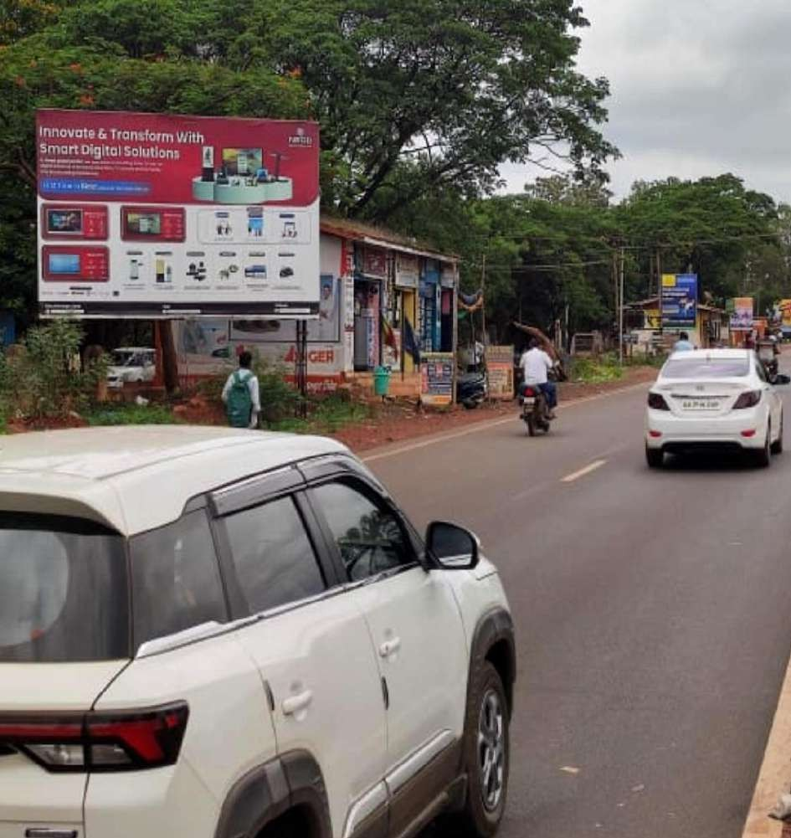
Date: 31-03-2026
ORKAY ADVERTISING & MARKETING SERVICES
#: 47 Zone: Bidar Location: Noubad City Entrance-Beside Diet College 3rd 20x12 Media Type: Hoardings Width: 20.00 Height:
12.00 Total Size: 240.00

Slide 48
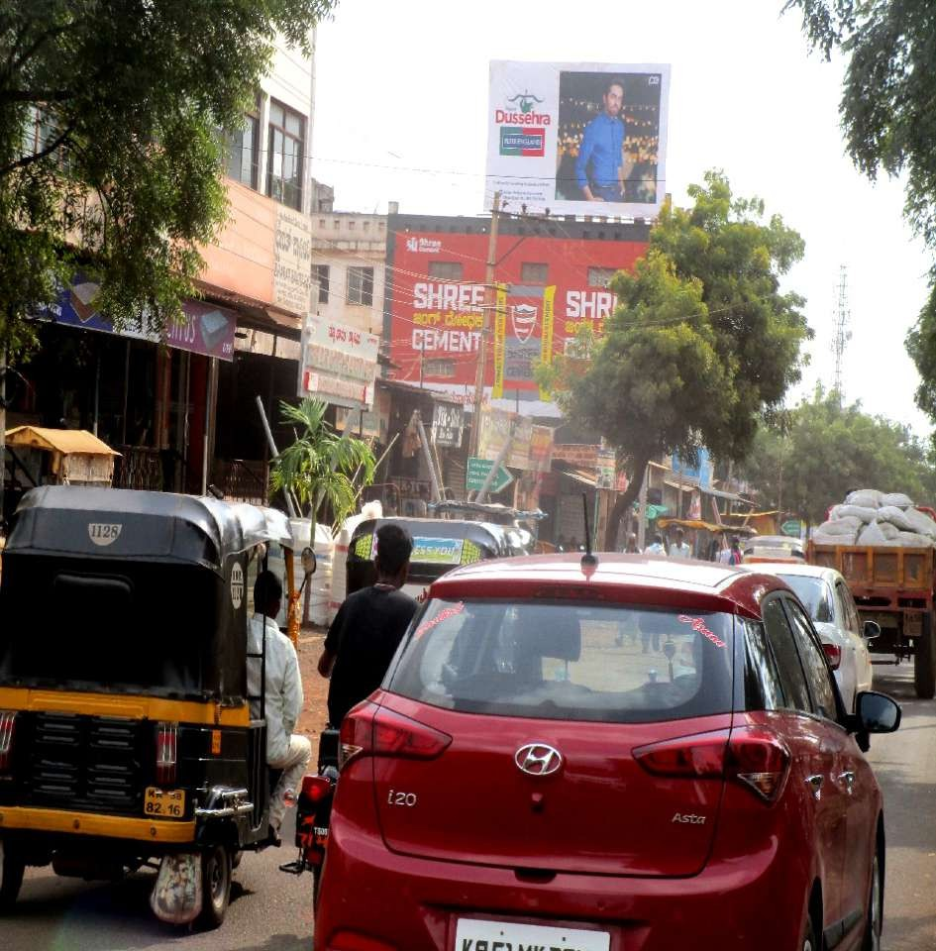
Date: 31-03-2026
ORKAY ADVERTISING & MARKETING SERVICES
#: 48 Zone: Bidar Location: [B Hd] Gunj Road (Bharat Shetkar )- 25x15 Media Type: Hoardings Illumination: NonLit Width: 25.00 Height: 15.00 Total Size: 375.00

Slide 49
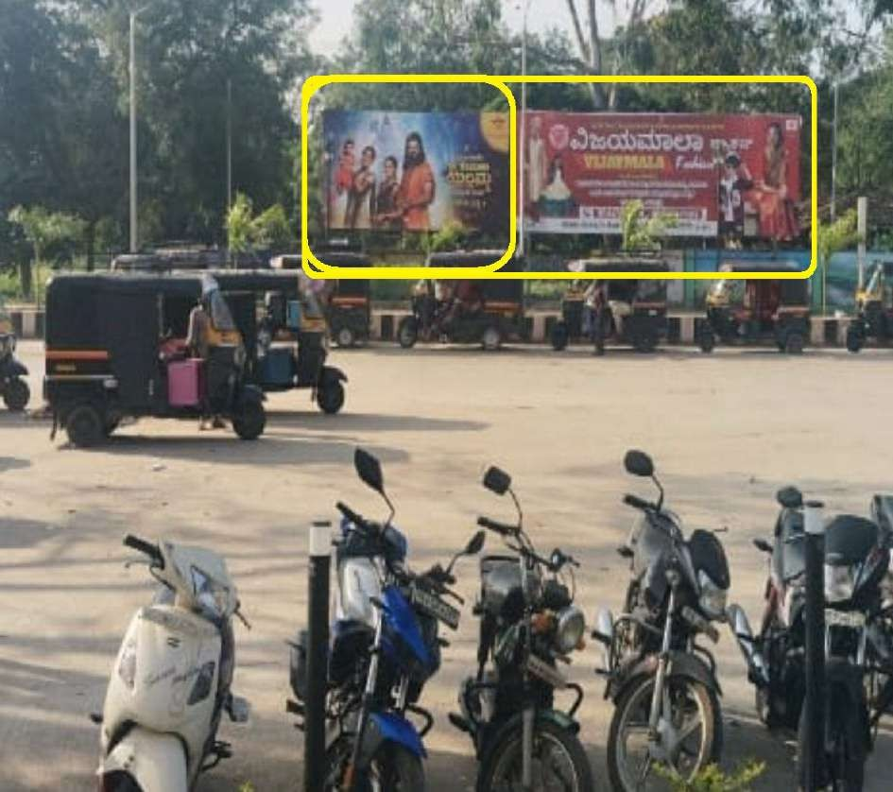
Date: 31-03-2026
ORKAY ADVERTISING & MARKETING SERVICES
#: 49 Zone: Gadag Location: Gadag railway station-51x10 Media Type: Hoardings Width: 51.00 Height: 10.00 Total Size: 510.00

Slide 50
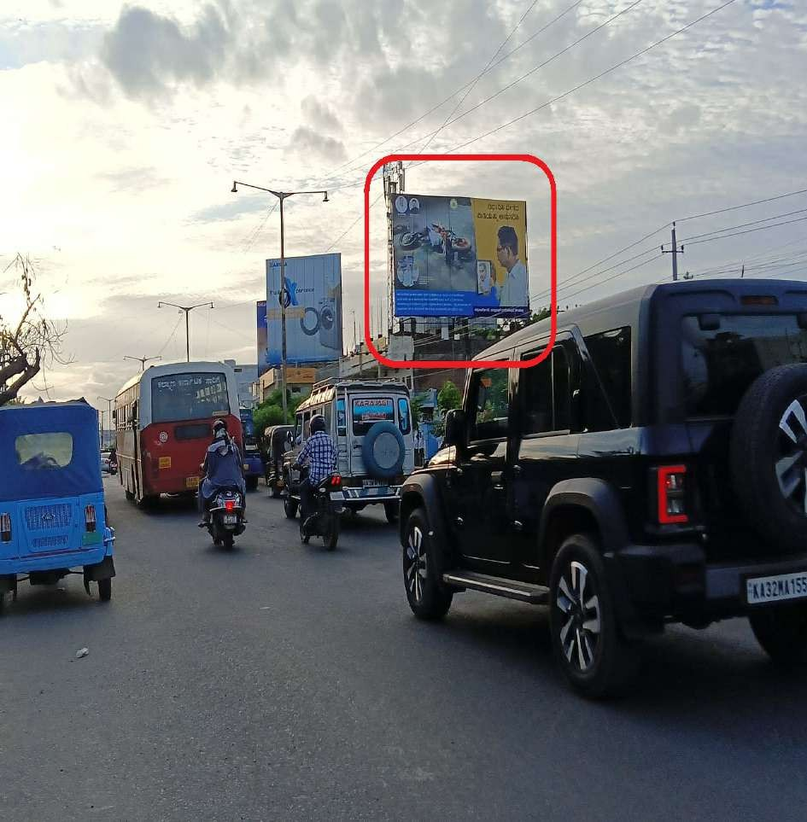
Date: 31-03-2026
ORKAY ADVERTISING & MARKETING SERVICES
#: 50 Zone: Gulbarga Location: [Gul Hd] Om Nagar,Near ESI Hospital- AIR PORT RD-40x24 Media Type: Hoardings Illumination: NonLit Width: 40.00 Height: 24.00 Total Size: 960.00

Slide 51
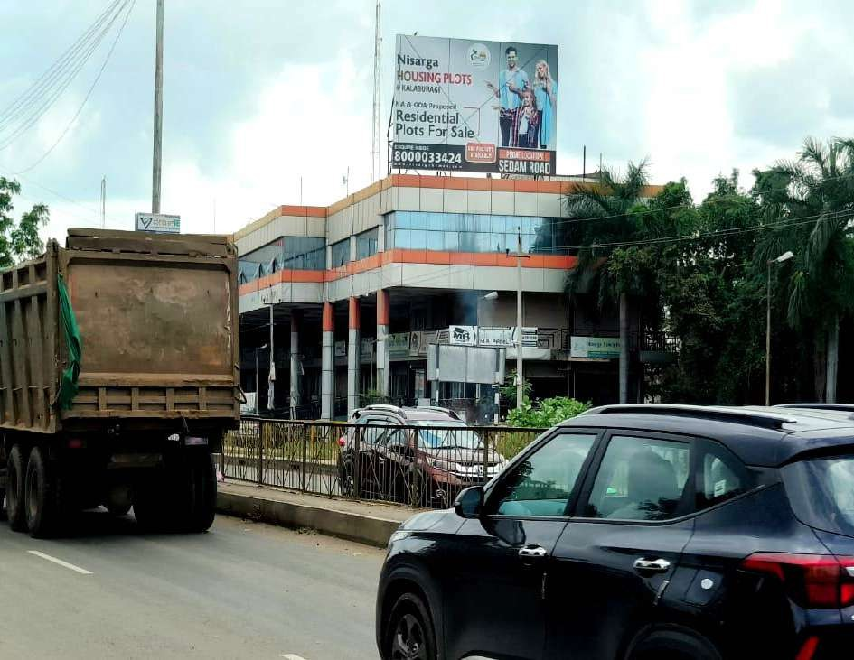
Date: 31-03-2026
ORKAY ADVERTISING & MARKETING SERVICES
#: 51 Zone: Gulbarga Location: [Gul Hd] Near Kharge Petrol Pump,Opp Karuna Toyota Showroom-30'x20' Media Type: Hoardings Illumination: NonLit Width: 30.00 Height: 20.00 Total Size: 600.00

Slide 52

Date: 31-03-2026
ORKAY ADVERTISING & MARKETING SERVICES
#: 52 Zone: Haillikhed ( Bidar Dist) Location: [HK RUB] Hailikhed Main Road RUB -80x10 Media Type: RUB Width: 80.00 Height:
10.00 Total Size: 800.00

Slide 53

Date: 31-03-2026
ORKAY ADVERTISING & MARKETING SERVICES
#: 53 Zone: Haillikhed ( Bidar Dist) Location: [HK RUB] Hailikhed Main Road RUB Back To Back -80x10 Media Type: RUB Width:
80.00 Height: 10.00 Total Size: 800.00

Slide 54

Date: 31-03-2026
ORKAY ADVERTISING & MARKETING SERVICES
#: 54 Zone: Haillikhed ( Bidar Dist) Location: Near Sugar Factory- 24x10 Media Type: Hoardings Illumination: NonLit Width: 24.00 Height: 10.00 Total Size: 240.00

Slide 55

Date: 31-03-2026
ORKAY ADVERTISING & MARKETING SERVICES
#: 55 Zone: Humanabad (Bidar Dist:) Location: Humanabad-Near Noor Dhaba Towards Solapur -57'x30' Width: 57.00 Height: 30.00 Total Size: 1710.00

Slide 56

Date: 31-03-2026
ORKAY ADVERTISING & MARKETING SERVICES
#: 56 Zone: Humanabad (Bidar Dist:) Location: [B HUM Hd] Near Water Purife Office-30x10 Media Type: Hoardings Illumination: NonLit Width: 30.00 Height: 10.00 Total Size: 300.00

Slide 57

Date: 31-03-2026
ORKAY ADVERTISING & MARKETING SERVICES
#: 57 Zone: Hyderabad-Mumbai Highway Location: [HYD Hd] Sadhashivapet towards Sangareddy 62'x20' Media Type: Hoardings Illumination: NonLit Width: 62.00 Height: 20.00 Total Size: 1240.00

Slide 58

Date: 31-03-2026
ORKAY ADVERTISING & MARKETING SERVICES
#: 58 Zone: Hyderabad-Mumbai Highway Location: [HYD 1] Budera- After Tollgate towards Hyderabad-30x14 Media Type: Hoardings Width: 30.00 Height: 14.00 Total Size: 420.00

Slide 59

Date: 31-03-2026
ORKAY ADVERTISING & MARKETING SERVICES
#: 59 Zone: Hyderabad-Mumbai Highway Location: Sadashivapet- Near Surarm Towards Zaheerabad-40'x25' Media Type: Hoardings Width: 40.00 Height: 25.00 Total Size: 1000.00

Slide 60

Date: 31-03-2026
ORKAY ADVERTISING & MARKETING SERVICES
#: 60 Zone: Hyderabad-Mumbai Highway Location: Zaheerabad- Hugelli towards Hyderabad,Opp:Shalimar Dhaba-28'x25' Media Type: Hoardings Width: 28.00 Height: 25.00 Total Size: 700.00

Slide 61

Date: 31-03-2026
ORKAY ADVERTISING & MARKETING SERVICES
#: 61 Zone: Hyderabad-Mumbai Highway Location: Toll gate- towards Hyd-113x30 Media Type: Hoardings Width: 113.00 Height: 30.00 Total Size: 3390.00

Slide 62

Date: 31-03-2026
ORKAY ADVERTISING & MARKETING SERVICES
#: 62 Zone: Hyderabad-Mumbai Highway Location: Budera-Opp Taj Hotel(Bismala Hotel-Below) Towards Hyd-38'x30' Media Type: Hoardings Illumination: NonLit Width: 38.00 Height: 30.00 Total Size: 1140.00

Slide 63

Date: 31-03-2026
ORKAY ADVERTISING & MARKETING SERVICES
#: 63 Zone: Hyderabad-Mumbai Highway Location: [HYD Hd] Sangareddy( Peddapure )-Towards Hyderabad--25x20 Media Type: Hoardings Illumination: NonLit Width: 25.00 Height: 20.00 Total Size: 500.00

Slide 64

Date: 31-03-2026
ORKAY ADVERTISING & MARKETING SERVICES
#: 64 Zone: Hyderabad-Mumbai Highway Location: Sadashivapet- Near Surarm Towards Hyd-40'x25' Media Type: Hoardings Width:
40.00 Height: 25.00 Total Size: 1000.00

Slide 65

Date: 31-03-2026
ORKAY ADVERTISING & MARKETING SERVICES
#: 65 Zone: Hyderabad-Mumbai Highway Location: [HYD Hd] Kamkole-Nr Toll Gate- towards Hyderabad 40x20 Media Type: Hoardings Illumination: NonLit Width: 40.00 Height: 20.00 Total Size: 800.00

Slide 66

Date: 31-03-2026
ORKAY ADVERTISING & MARKETING SERVICES
#: 66 Zone: Hyderabad-Mumbai Highway Location: [HYD Hd] Digwal -Towards to Hyderabad -40'x20' Media Type: Hoardings Illumination: NonLit Width: 40.00 Height: 20.00 Total Size: 800.00

Slide 67

Date: 31-03-2026
ORKAY ADVERTISING & MARKETING SERVICES
#: 67 Zone: Hyderabad-Mumbai Highway Location: Nandi Kandi Towards Zaheerabad-30'x25' Media Type: Hoardings Illumination: NonLit Width: 30.00 Height: 25.00 Total Size: 750.00

Slide 68

Date: 31-03-2026
ORKAY ADVERTISING & MARKETING SERVICES
#: 68 Zone: Hyderabad-Mumbai Highway Location: [HYD Hd 2] Lingapalli- towards Hyderabad-42x20 Media Type: Hoardings Illumination: NonLit Width: 42.00 Height: 20.00 Total Size: 840.00

Slide 69

Date: 31-03-2026
ORKAY ADVERTISING & MARKETING SERVICES
#: 69 Zone: Kamalpur (Gulbarga Dist:) Location: [KML RUB] Kamlapur Main Road RUB Back To Back -80x10 Media Type: RUB Width: 80.00 Height: 10.00 Total Size: 800.00

Slide 70

Date: 31-03-2026
ORKAY ADVERTISING & MARKETING SERVICES
#: 70 Zone: Koppal Location: [K Hoar] Opp: Railway Station- 30'x10' Media Type: Hoardings Width: 30.00 Height: 10.00 Total Size: 300.00

Slide 71

Date: 31-03-2026
ORKAY ADVERTISING & MARKETING SERVICES
#: 71 Zone: Sedam (Gulbarga Dist:) Location: [SD Hd] Station Road -20x07 Media Type: Hoardings Illumination: NonLit Width:
20.00 Height: 7.00 Total Size: 140.00

Slide 72

Date: 31-03-2026
ORKAY ADVERTISING & MARKETING SERVICES
#: 72 Zone: yadgir Location: [Y Hd-1] Cental Bus stand-61x15 - Media Type: Hoardings Illumination: NonLit Width: 61.00 Height: 15.00 Total Size: 915.00

Slide 73

Date: 31-03-2026
ORKAY ADVERTISING & MARKETING SERVICES
#: 73 Zone: ZAHEERABAD(GOPANPALLY)(HYD) -SHOLAPUR
HIGHWAY Location: [HOARDING] Tadola towards Sholapur-30'x25'
Width: 30.00 Height: 25.00 Total Size: 750.00

Slide 74

Date: 31-03-2026
ORKAY ADVERTISING & MARKETING SERVICES
#: 74 Zone: ZAHEERABAD(GOPANPALLY)(HYD) -SHOLAPUR
HIGHWAY Location: Itkal- Towards Sholapur-45'x25' Media Type:
Hoardings Width: 45.00 Height: 25.00 Total Size: 1125.00

Slide 75

Date: 31-03-2026
ORKAY ADVERTISING & MARKETING SERVICES
#: 75 Zone: ZAHEERABAD(GOPANPALLY)(HYD) -SHOLAPUR
HIGHWAY Location: Fulwadi Toll Gate-Towards Sholapur-40'x25' Media Type: Hoardings Width: 40.00 Height: 25.00 Total Size: 1000.00

Slide 76

Date: 31-03-2026
ORKAY ADVERTISING & MARKETING SERVICES
#: 76 Zone: ZAHEERABAD(GOPANPALLY)(HYD) -SHOLAPUR
HIGHWAY Location: Chandikapur- Towards Sholapur-30'x30' Media Type: Hoardings Width: 30.00 Height: 30.00 Total Size: 900.00

Slide 77

Date: 31-03-2026
ORKAY ADVERTISING & MARKETING SERVICES
#: 77 Zone: ZAHEERABAD(GOPANPALLY)(HYD) -SHOLAPUR
HIGHWAY Location: Thalmadgi-Towards Humanabad-45x25 Media Type: Hoardings Width: 45.00 Height: 25.00 Total Size: 1125.00

Slide 78

Date: 31-03-2026
ORKAY ADVERTISING & MARKETING SERVICES
#: 78 Zone: ZAHEERABAD(GOPANPALLY)(HYD) -SHOLAPUR
HIGHWAY Location: Fulwadi Toll Gate-Towards Omarga-40'x25' Media Type: Hoardings Width: 40.00 Height: 25.00 Total Size: 1000.00

