Slide 1
UNIT II
THEORY OF PRODUCTION
&
COST ANALYSIS

Slide 2
UNIT 2 - TOPICS
Production Function
Isoquants
Isocosts
Internal and External Economies of Scale
Law of Returns
Cost Analysis
Cost concepts
Types of costs
Break-even Analysis (BEA)- Determination of Break-Even Point
BEP problems

Slide 3
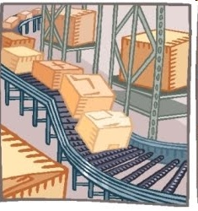
WHAT IS PRODUCTION???
Production is an activity that transforms inputs into output.
It can be defined as the process of creation of utility.

Slide 4
PRODUCTION FUNCTION
Production Function is purely a technological relationship which expresses the relation between output of a good and the different combinations of inputs used in its production.
It shows the maximum production obtained from a given set of inputs with a given state of technology.

Slide 5
MATHEMATICAL EXPRESSION
Production Function can be expresses mathematically in the form of an equation.
Q = f (L1, L2, C, O, T)
Where, Q= Quantity of production
f = function C = Capital
L1= Land O = Organization
L2= Labour T = Technology

Slide 6
ISOQUANT
An Isoquant is a curve representing the various combinations of two inputs that produce the same amount of output.
An isoquant is also known as iso-product curve, equal – product curve or production indifference curve.

Slide 7
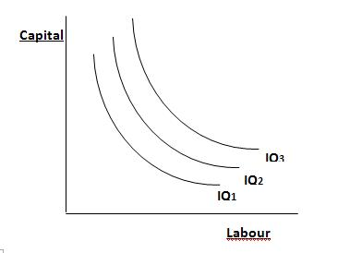

Slide 8
Properties of Isoquants
An Isoquants is downward sloping to the right
Higher Iso-quant represents larger output
No two Isoquants intersect or touch each other
Isoquants are convex to the origin.

Slide 9
ISOCOSTS
Isocosts refers to that cost curve that represents the combination of inputs that will cost the producer the same amount of money.

Slide 10
Capital
ISOCOSTS
IC 3
IC 2
IC 1
Labour

Slide 11
There are two methods by which output can be raised:
Changing some inputs
Changing all inputs
Changing some inputs - Law of Variable proportions
(or) Law of Diminishing returns
Changing all inputs - Returns to Scale

Slide 12
LAW OF VARIABLE PROPORTIONS
Law of Variable proportions refers to the short run.
Law of Variable proportions explains the changes in output when a factor of production is varied while keeping other factors constant.
It is also called “ Law of Diminishing returns”

Slide 13
ASSUMPTIONS OF THE LAW
The state of technology or the methods of production remain constant..
Only one factor of input is made variable and other factors are kept constant.
The analysis relates to short period.
The law assumes labour is homogeneous i.e. no difference in labour skills.

Slide 14
EXPLANATION OF LAW
Labour | TP | AP | MP | Stages
0 | 0 | 0 | 0 | STAGE I
1 | 5 | 5 | 5
2 | 12 | 6 | 7
3 | 18 | 6 | 6 | STAGE II
4 | 20 | 5 | 2
5 | 20 | 4 | 0
6 | 18 | 3 | -2 | STAGE III
7 | 14 | 2 | -4

Slide 15
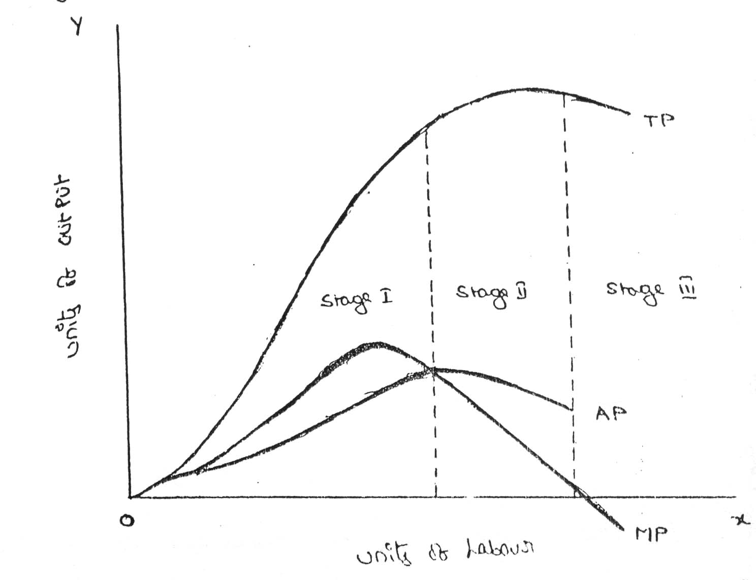

Slide 16
RETURNS TO SCALE
Economists use the phrase, “Returns to Scale” to describe the relationship between output behavior in the long run in relation to the variations of factor inputs.
In the long run, adjustments can be made among the different factors and therefore, all factors become variable during this period.

Slide 17
Returns to scale are of three types:
Increasing Returns to Scale
Constant Returns to Scale
Decreasing Returns to Scale

Slide 18
Increasing returns to scale
Increasing returns to scale arise when a given percentage increase in inputs leads to a greater percentage increase in the resultant output.
Hence, the total product increases at an increasing rate.

Slide 19
Constant Returns to Scale
Constant returns to scale is a stage where the given percentage increase in inputs will be equal to the percentage increase in the resultant output.

Slide 20
Decreasing Returns To Scale
Decreasing returns to scale will occur when a firm continues to expand its size beyond a particular point.
Decreasing returns to scale operate when the percentage increase in output is less than the percentage increase in input.

Slide 21
ECONOMIES OF SCALE
The advantages of large scale production are called Economies of Scale.
Internal Economies
External Economies

Slide 22
INTERNAL ECONOMIES
Internal Economies are those economies which are open to an individual firm when its size expands.
Technical Economies
Marketing Economies
Managerial Economies
Financial Economies
Risk Bearing Economies

Slide 23
TECHNICAL ECONOMIES
Technical Economies arise when a firm uses better machines & techniques of production, as a result of these economies there will be increase in production and fall in the cost of production.

Slide 24
MARKETING ECONOMIES
A large firm purchases various inputs in bulk and therefore, it can secure them at cheaper rate when compared to small firms.
It can also secure special transport concessions & better quality inputs etc.
It can also sell its finished goods without any difficulty with the help of best marketing strategies.

Slide 25
MANAGERIAL ECONOMIES
A large firm can appoint specially qualified and highly paid officials to look after the production, accounts, advertisements etc.
Managerial Economies arise due to better and more elaborate management which only large size firm can afford.

Slide 26
FINANCIAL ECONOMIES
A large firm can procure money in time at cheaper rates of interests because it possesses large assets and good reputation.
It can also mobilize fresh capital by issue of shares and debentures in the capital market easily.

Slide 27
RISK BEARING ECONOMIES
A large firm produces a variety of products and sells them in different areas. Therefore it is in a better position then a small firm in facing the risk. It can counter balance the loss in one product by gain in the other products

Slide 28
EXTERNAL ECONOMIES
When the number of firms producing the same commodity increase in a particular area, all the firms enjoy certain advantages which are called External Economies.
Economies of Concentration
Economies of Information
Economies of Specialization
Economies of Welfare

Slide 29
Both internal and external economies increase the output and reduce the cost of production.
But, these economies arise only up to a particular limit beyond which, diseconomies emerge.

Slide 30
COST ANALYSIS

Slide 31
Different business proposals are evaluated in terms of their costs and revenues.
To know what costs are to be examined, it is necessary to understand what cost is and how to analyze the cost.
Cost refers to expenditure incurred to produce a product or service.
Cost of production normally includes cost of materials, labor, and other overheads this is known as the total cost.

Slide 32
Total cost = fixed cost + variable cost + semi variable cost.
Total cost is compared with total revenue. The difference between total cost & total revenue is termed as profit.
(TR-TC=PROFIT)
Understanding the meaning of various cost concepts is essential for clear business thinking.

Slide 33
Fixed costs are those costs that are fixed in the short run.
Whether the production is taken up or not we have to incur certain expenses such as rent for factory & office buildings, insurance, telephone, electricity and so on.
In other words total fixed costs remain constant in the short run.

Slide 34
Variable cost are those costs that vary with the volume of production.
Variable costs comprises cost of raw materials, wages and so on, these costs are incurred only when there is production.
In other words the more the production the more will be the variable cost and vice versa.

Slide 35
Marginal cost it refers to additional cost incurred for manufacturing an additional unit of product.
Marginal cost in economic theory is useful in matters relating to allocation of resources, product pricing decisions, make or buy decisions and so on.

Slide 36
Opportunity cost it refers to cost of next best alternative foregone.
Opportunity costs refers to earnings/profits that are foregone from alternative ventures by using given limited facilities for a particular purpose.
If there are no alternatives there will be no opportunity cost.
They record only the sacrificed alternative so they are not recorded in the books of accounts.

Slide 37
Opportunity cost is said to exist when the resources are scarce and there are alternative uses for the resources.
Opportunity cost example:
The cost of getting college education is not merely you spend on college fee & books. It also includes the earnings you have foregone throughout the year by not taking up a full time job.

Slide 38
Explicit costs are also called as out of pocket costs.
Explicit costs involves payment of cash.
Rent for the landlord, wages for the labor, taxes & duties paid and so on are the explicit costs.
Explicit costs are also called as out of pocket costs because they are incurred in reality.

Slide 39
Implicit costs are also called as imputed costs or non cash costs or notional cost.
Implicit costs don't involve payment of cash as they are not actually incurred.
They would have been incurred had the owner not been in the possession of facilities.
Interest on own capital, rent on own premises, savings in terms of salary due to own supervision are examples of implicit cost.

Slide 40
BREAKEVEN ANALYSIS

Slide 41
INTRODUCTION
Break even analysis refers to analysis (study) of Break Even Point (BEP).
BEP is defined as no profit or no loss point. (BEP is the point at which total revenue is equal to total cost)
The term BEA is interpreted in two senses, In its narrow sense, it is concerned with finding out BEP. In its broad sense determines the probable profit at any level of production.

Slide 42
BEP denotes minimum volume of production to be undertaken to avoid losses.
In other words BEP points out, how much minimum is to be produced to get the profit.
BEP is a technique for profit planning & control.
Break Even Analysis is defined as analysis of Costs & their possible impact on Profits & Volumes of the firm, hence it is also called as CVP analysis.
A firm is said to attain the BEP when its Total Revenue equals to Total Cost (TR =TC).

Slide 43
Assumptions underlying Break Even Analysis
All costs are classified into two – fixed and variable.
Selling price per unit remains constant in spite of competition or change in the volume of production.
There will be no change in operating efficiency.
Volume of sales and volume of production are equal. Hence there is no unsold stock (closing stock).

Slide 44
DETERMINATION OF BREAK EVEN POINT
Break Even Point can be determined by two methods:
1. Graphical Representation Method &
2. Algebraic Method

Slide 45
Determination of Break even point with Graphical representation method

Slide 46
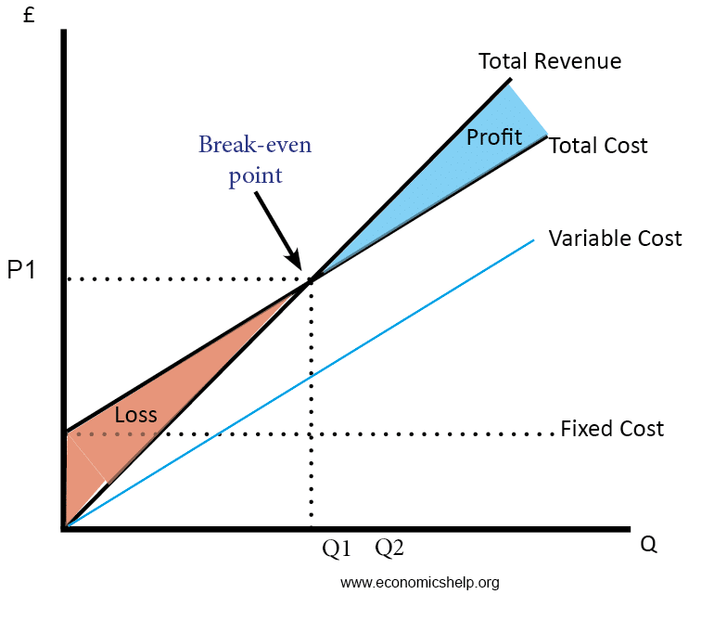
Graphical Representation Method

Slide 47
Example
No. of Units | FC | VC | TC | TR(SP = Rs. 50) | Profit / Loss
10 | 1000 | 100 | 1100 | 10 x 50 = 500 | -600
20 | 1000 | 200 | 1200 | 20 x 50 = 1000 | -200
22 | 1000 | 220 | 1220 | 22 x 50 = 1100 | -120
24 | 1000 | 240 | 1240 | 24 x 50 = 1200 | -40
25 | 1000 | 250 | 1250 | 25 x 50 = 1250 | No Profit, No loss
30 | 1000 | 300 | 1300 | 30 x 50 = 1500 | 200

Slide 48
Break Even Chart explanation:
The total variable cost (TVC) line is drawn first, variable cost varies proportionately with the volume of production.
Total Fixed cost(TFC) line is horizontal straight line, it is parallel to X axis since total fixed cost remains constant in the short run.
The total cost (TC) line is derived by adding, the TVC & TFC. The total cost line is parallel to total variable cost line.

Slide 49
The total revenue (TR) line starts from origin & increases along with the volume of sales.
The total revenue line intersects total cost line at point BEP. (BEP = TC = TR)
The zone below BEP point is loss zone & zone above BEP point is profit zone.
The point at which total cost line & total revenue line intersects is called Break – Even Point (BEP), At this point there exists neither profit nor loss

Slide 50
The angle formed at BEP, i.e., the point of intersection of total cost & total revenue is called ANGLE OF INCIDENCE (AOI).
The larger the angle of incidence , the higher is the quantum of profit.
Sales over & above break even sales are termed as MARGIN OF SAFETY (MOS).
In the above graph margin of safety is OQ – OP i.e.,
MOS = total sales – break even sales

Slide 51
Analysis of Break Even Chart
A break even chart gives us clear picture about the following:
Break Even Point (BEP)
Angle Of Incidence (AOI)
Margin Of Safety (MOS)

Slide 52
The lower the BEP the better it is, a firm can survive even if it is operating at a lower level of activity.
The larger the AOI the greater is the benefit, angle of incidence represents the difference between total revenue & total cost.
The larger the MOS the better it is for the firm, it has greater capacity to with stand Recessionary phases.
Conclusion a high MOS, large AOI & low BEP denotes the most favorable position to the firm.

Slide 53
SIGNIFICANCE OF BEA
BEP denotes minimum volume of production to be under taken to avoid losses, in other words it points out how much minimum is to be sold to get the profits.
It helps in ascertaining the profit on a particular level of sales volume.
It also helps in estimating sales required, to earn a particular desired level of profit.
It is useful tool in comparing the efficiency of different firms.

Slide 54
It helps in “Make or Buy decisions” for a given component or spare part.
It helps in assessing the impact of changes in fixed cost, variable cost & selling price on profits during a period of time. (CVP analysis)

Slide 55
LIMITATIONS OF BEA
BEA is based on Fixed cost concept, & hence holds good only in the short run.
If business conditions are Volatile, BEP cannot give stable results.
All costs cannot be Classified into Fixed & Variable costs, some times we may also have Semi variable costs.
In case of Multi Product Firm, a single chart cannot be of any use, series of charts have to be made use of, which is a complex process.

Slide 56
The above limitations do not deter the utility of Break Even Analysis.
Even today most of the business proposals are evaluated on the concept of BEP, the given project is chosen if its break even point is lower.

Slide 57
APPLICATION OF BEA
The following are some of the areas of applications of Break Even Analysis
Make or Buy decisions
Drop or Add decisions
Choosing a product mix when there is a limiting factor

Slide 58
Determination of BEP - Algebraic Method
The following formulae are used to determine Break Even Point.
SP = FC + VC + profit
SP – VC = FC + Profit
= Contribution
So, Contribution per Unit = SP p.u – VC p.u
BREAK EVEN POINT = FC (in units)
Contribution p.u

Slide 59
CONTRIBUTION MARGIN
Contribution Margin is the difference between receipts and variable expenses.
Ex: If a product is sold at Rs.10 per unit and its variable expenses are Rs.4.
This implies that each unit of the product recovers Rs.6 over and above its variable expenses of Rs.4.Thus, Rs.6 is contribution to the recovery of fixed expenses or profit.

Slide 60
DETERMINATION OF BREAK EVEN POINT
BREAK EVEN POINT = FC (in value)
Contribution margin
ratio
Where, CMR = CM p. u
SP p. u

Slide 61
Determination of Break Even Point when per unit data is not available
BREAK EVEN = FC
POINT (in value) PV Ratio
Where, PV ratio = Profit Volume ratio
= Contribution
Sales
MOS = Net profit
P/V Ratio

Slide 62
PROBLEMS ON BEP
If sales are 10,000 units and selling price is Rs.20 per unit, variable cost Rs.10 per unit and fixed cost is Rs.80000, find out BEP in units and in sales revenue. What is profit earned? What should be the sales for earning a profit of Rs.60,000?
2. Determine MOS using above information.

Slide 63
2. The information about Raj & Co., are given below:
i) Profit-Volume Ratio 20%
ii) Fixed Cost Rs.36,000
iii) Selling price per unit Rs.150
Calculate:
a) BEP (in Rs.)
b) BEP (in units)

Slide 64
3. Analyze the following information:
Sales are Rs. 90,000 producing a profit of Rs. 2900 in period-I
Sales are Rs. 1, 10,000 producing a profit of Rs. 6000/- in period-II
Determine BEP and Fixed Expenses.

Slide 65
4 .Calculate the following parameters using given data.
i) p/v ratio
ii) Break even sales volume
iii) Margin of safety
iv) Profit
Given data: Sales Rs 4000, Cost Rs 2000,
Fixed Cost Rs 1600.

Slide 66
5. If Selling Price Per Unit Rs.12,
Variable Cost Per Unit Rs.8,
Fixed Cost Rs.40000
Find out
(a) Break Even sales units and value
(b) profit when sales are Rs.300000
(c) Margin of Safety when sales are Rs.350000.

Slide 67
6. A company prepares a budget to produce 3 lakh units, with fixed costs as Rs.15 lakhs and average variable cost of Rs.10 each . The selling price is to yield 20% profit on cost. you are required to calculate
(a) P/V ratio.
(b) Break even point.

Slide 68
END

